Slide 1
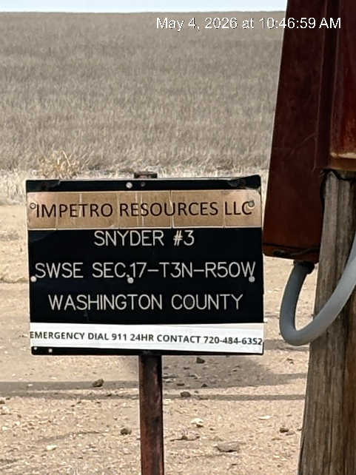
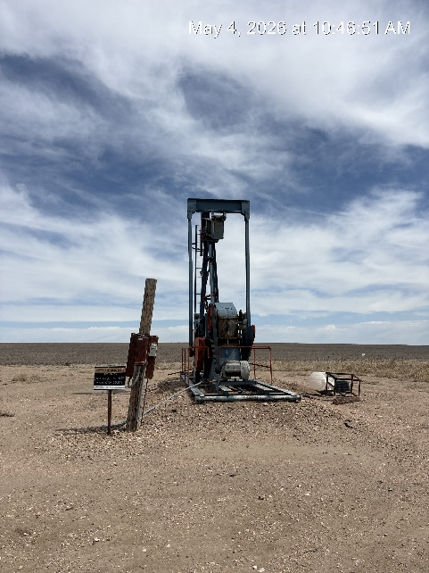
Impetro Resources LLC #10690
SNYDER 3 121-08457
SIGN AT WH
WH-SIGNAGE-PJ-PM

