Slide 1
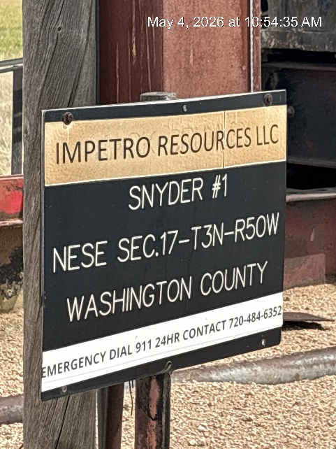
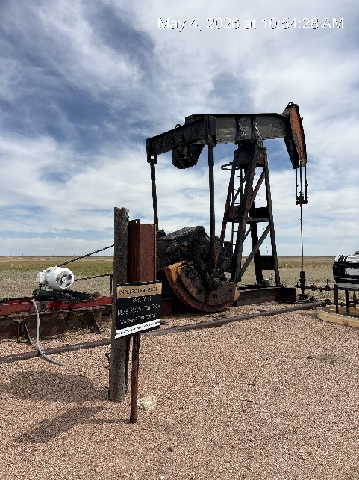
Impetro Resources LLC #10690
SNYDER 1 121-08445
SIGN AT WH
WH-SIGNAGE-PJ-PM

Slide 2
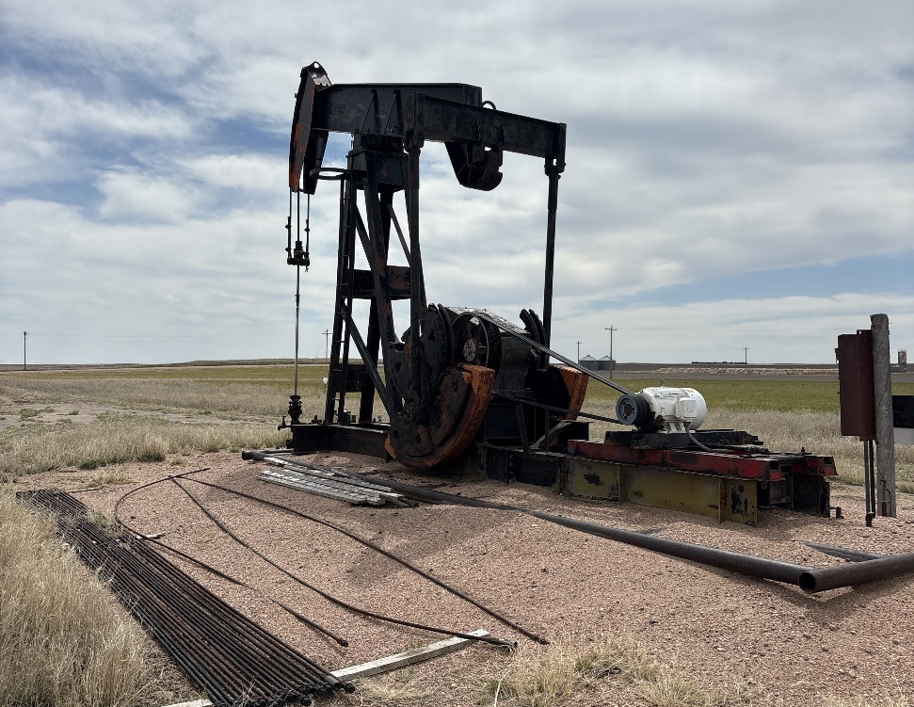
IMPETRO RESOURCES LLC #10690
SNYDER 1 121-08445
RODS ON LOCATION

