Slide 1
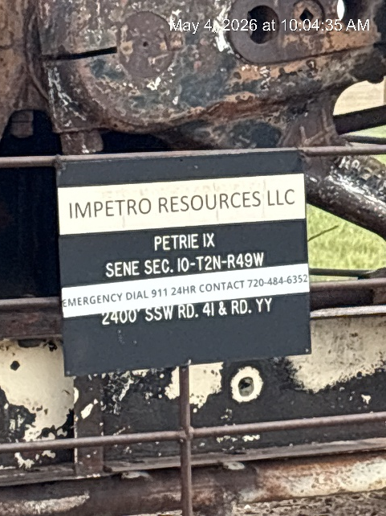
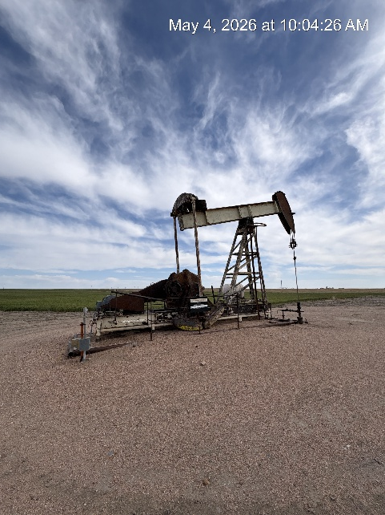
Impetro Resources LLC #10690
PETRIE 1-X 121-10281
SIGN AT WH
WH-SIGNAGE-PJ-PM

