Slide 1
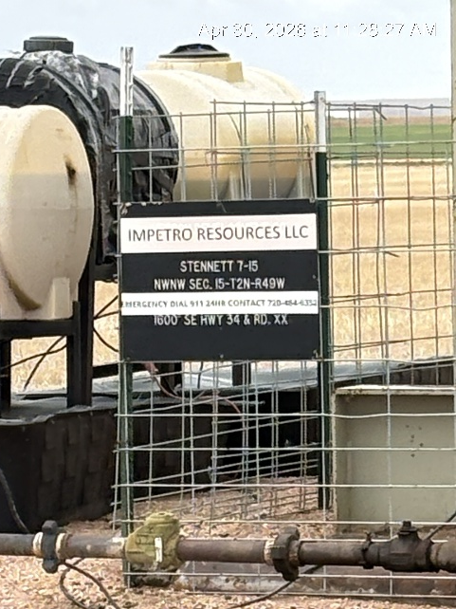
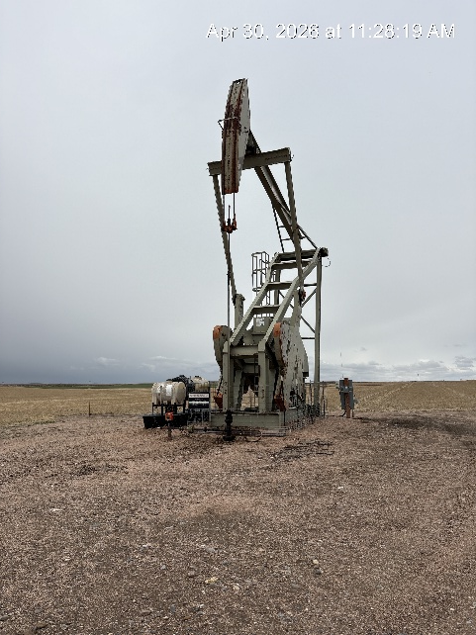
Impetro Resources LLC #10690
STENNETT 7-15 121-10314
SIGN AT WH
PJ PM WH SIGNAGE

