Slide 1
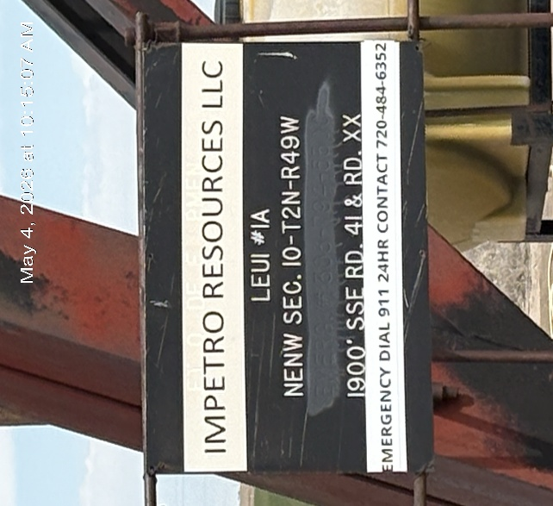
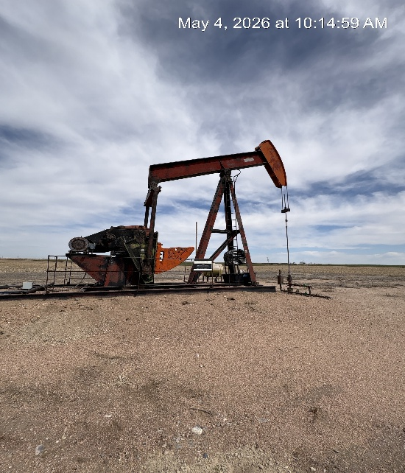
IMPETRO RESOURCES LLC #10690
LEUI 1-A 121-08481
SIGN AT WH
PJ PM WH SIGNAGE

Slide 2
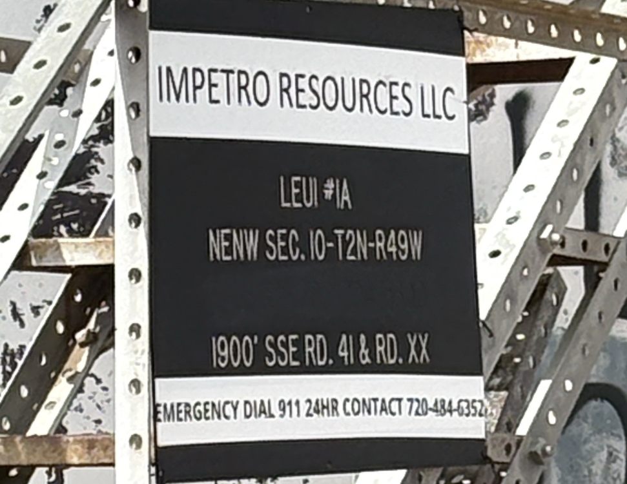
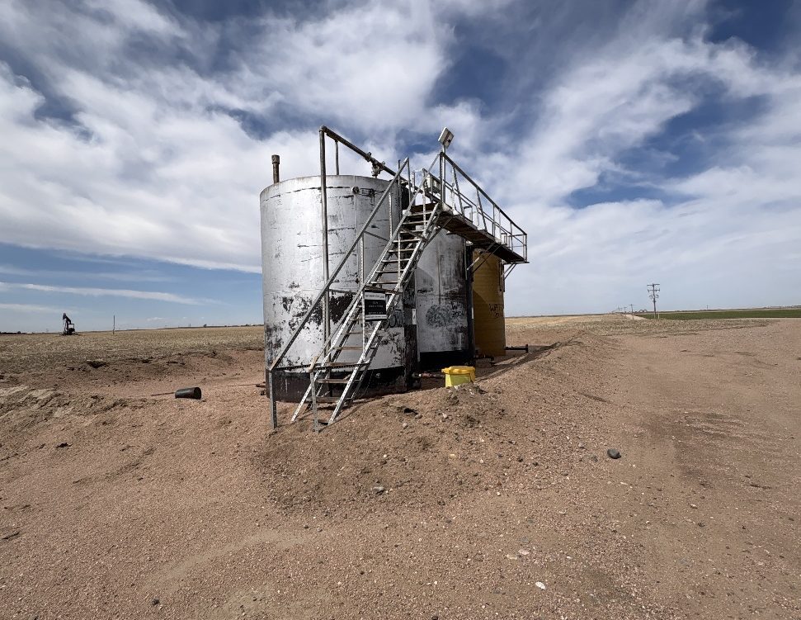
IMPETRO RESOURCES LLC #10690
SIGN AT TANK BATTERY
TANK BATTERY

Slide 3
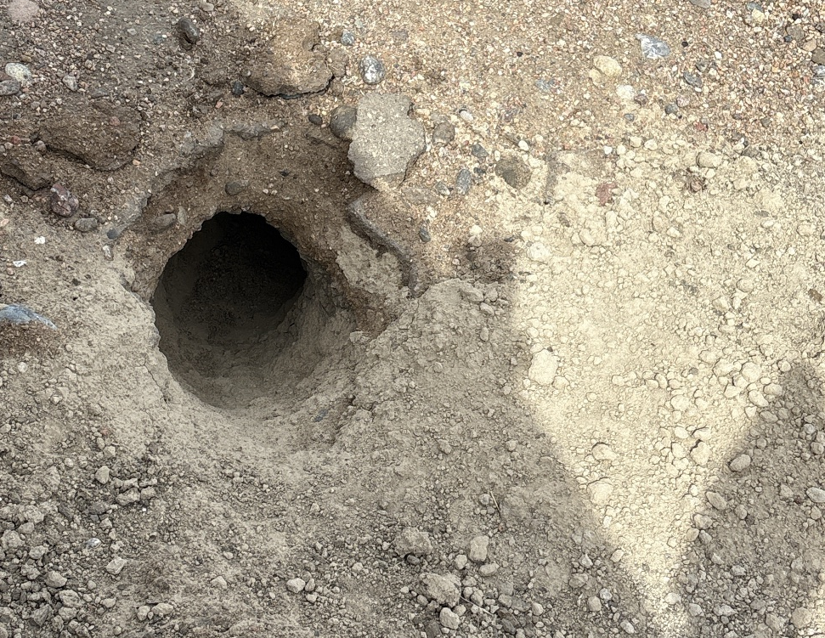
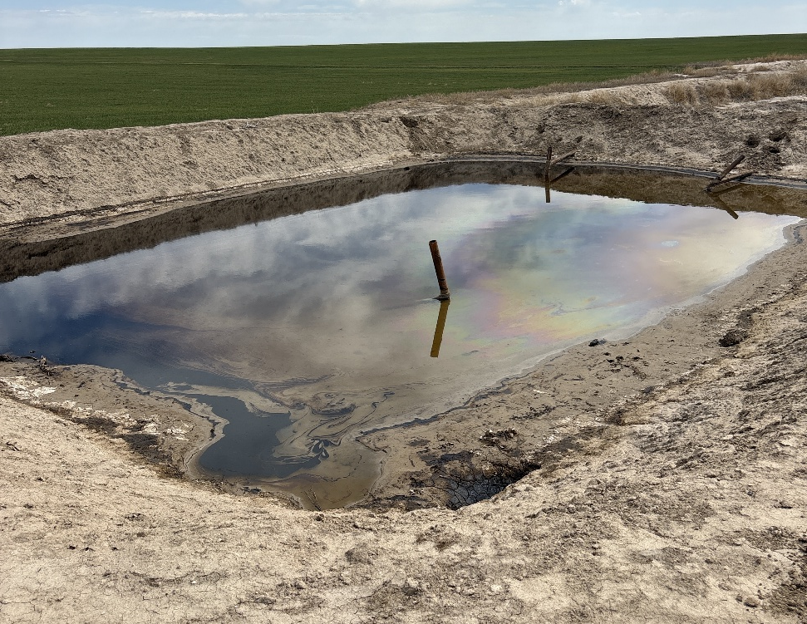
IMPETRO RESOURCES LLC #10690
LEUI 1-A 121-08481
BADGER HOLE ADJACENT TO PJ
PW PIT – CRUDE ON SURFACE

Slide 4
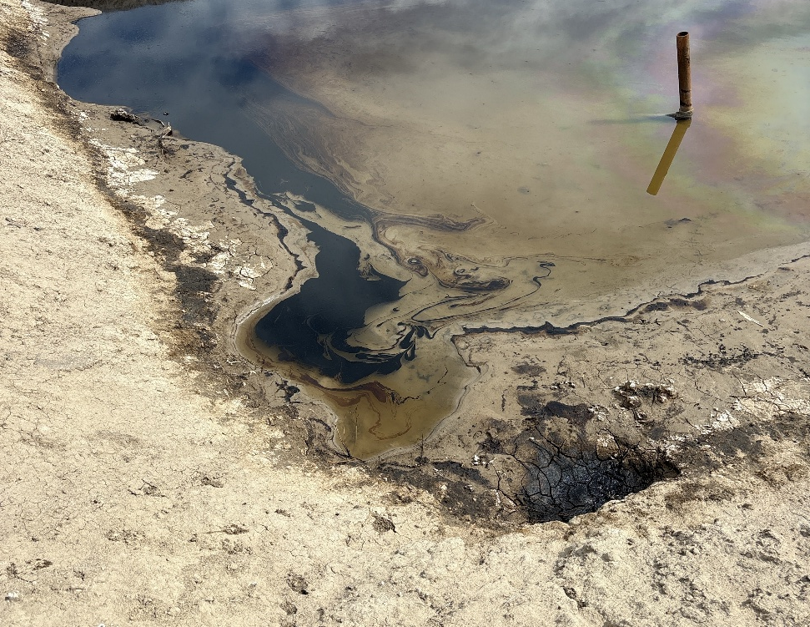
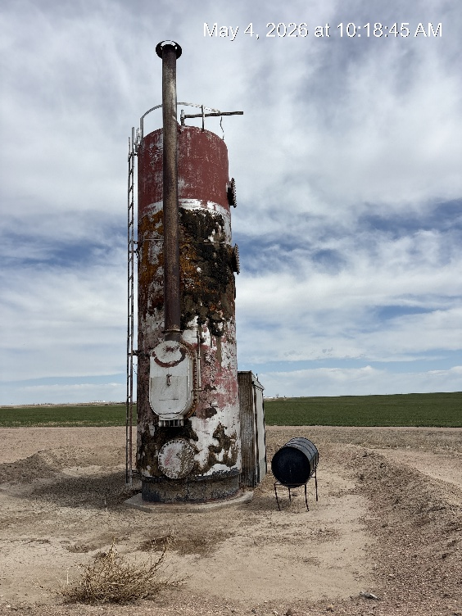
IMPETRO RESOURCES # 10690
LEUI 1-A 121-08481
PW PIT – CRUDE SPILL
SEPARATOR: NO CONTAINMENT UNDER ADDITIVE TANK

