Slide 1
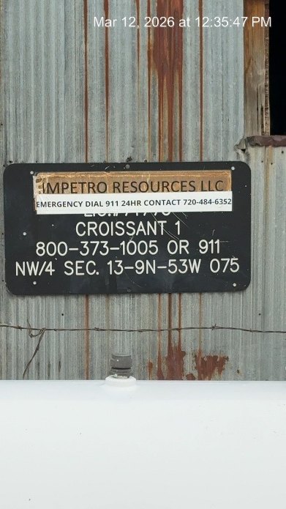
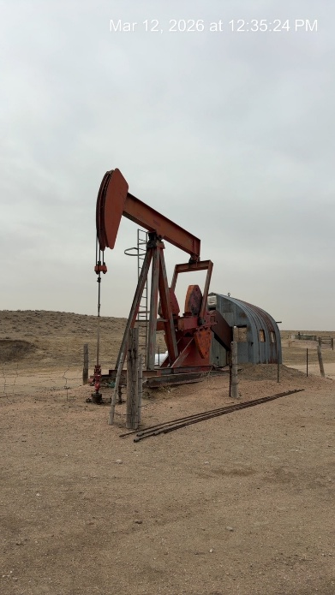
IMPETRO RESOURCES LLC #10690
CROISSANT 1 075-06512
SIGNAGE AT WH
WH - PJ

Slide 2
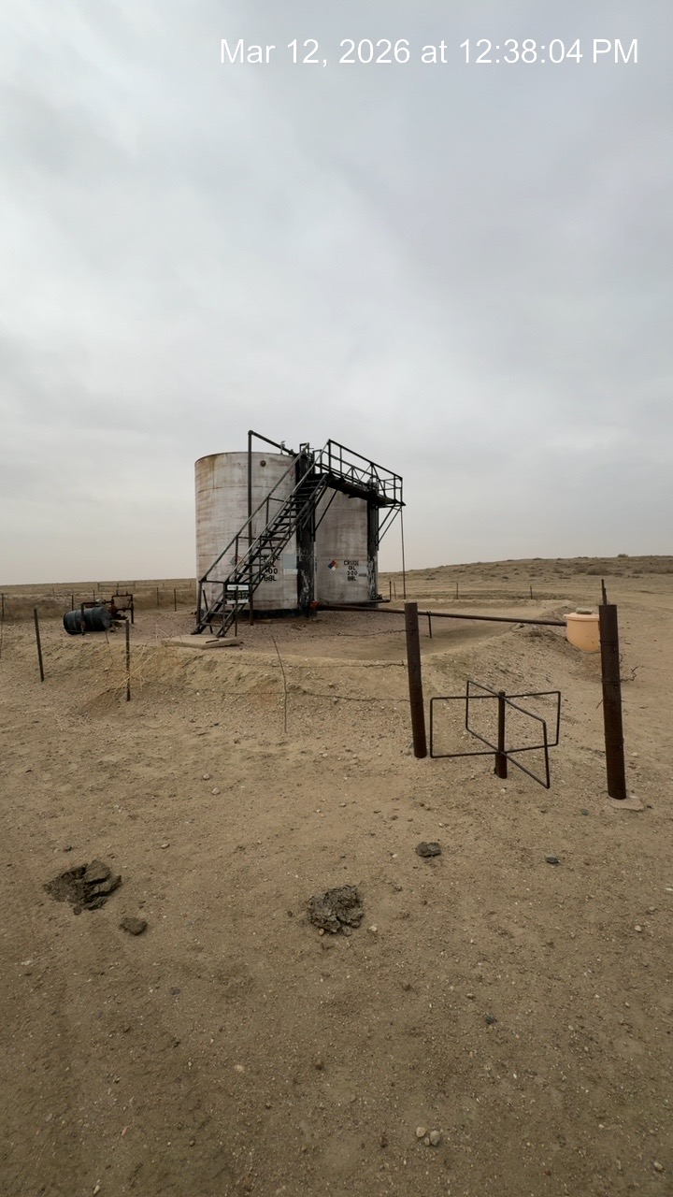
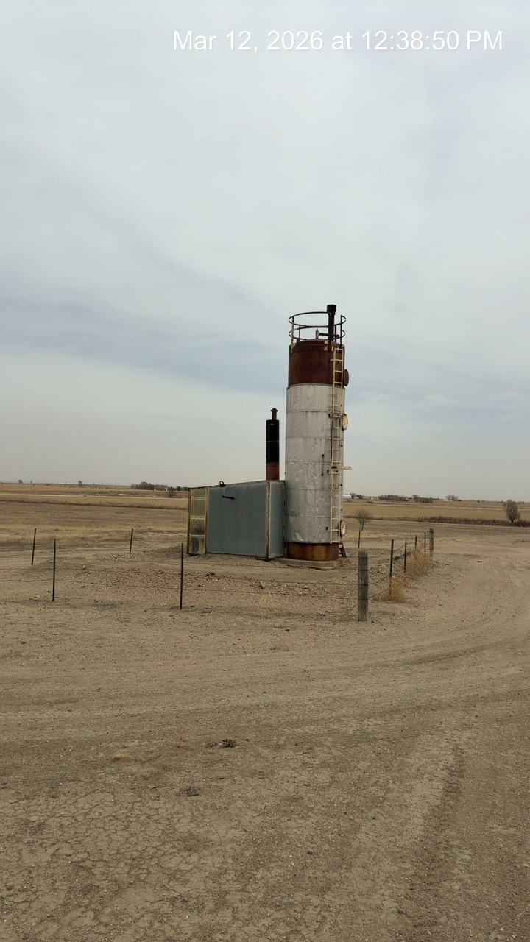
CROISSANT 1 075-06512
CRUDE TANKS
SEPARATOR

Slide 3
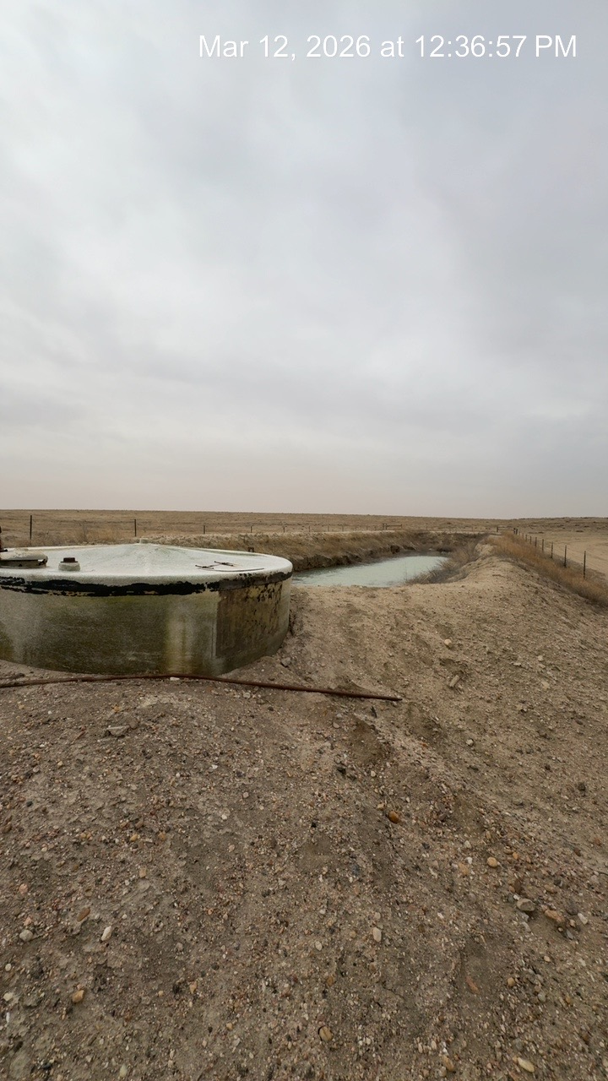
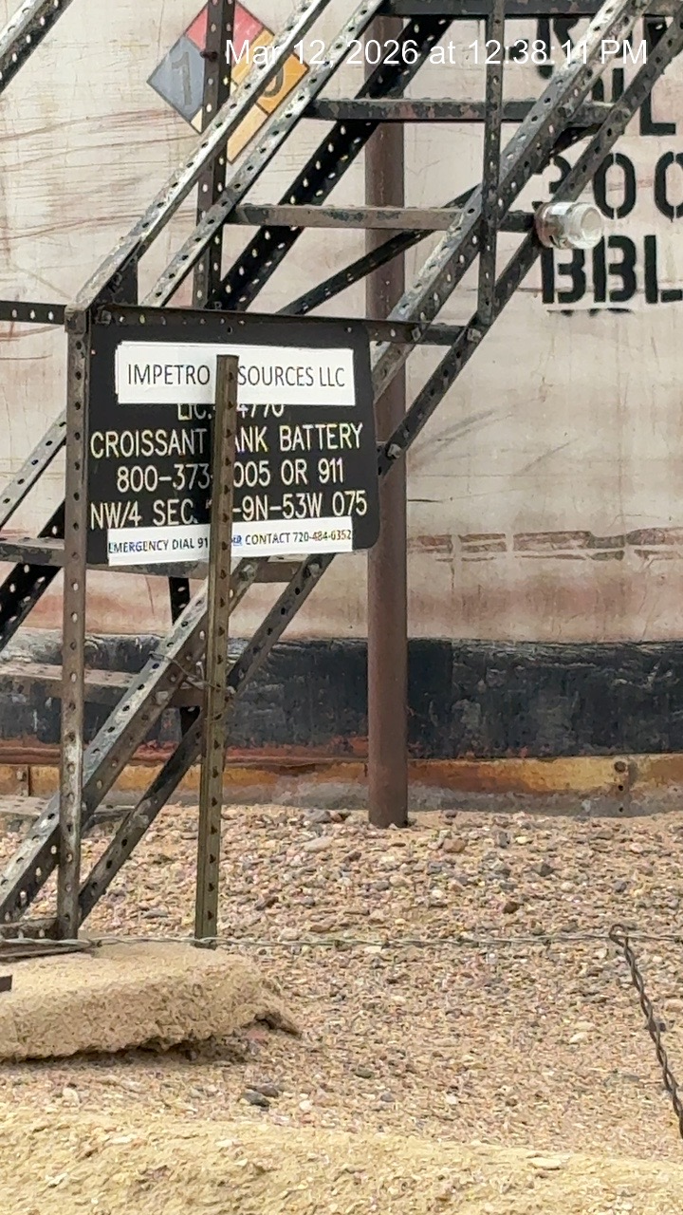
CROISSANT 1 075-06512
SKIM TANK AND PW PIT
SIGN AT BATTERY

