Slide 1
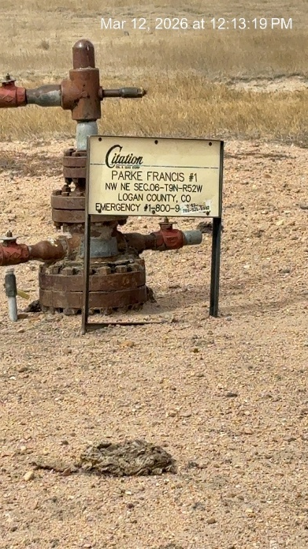
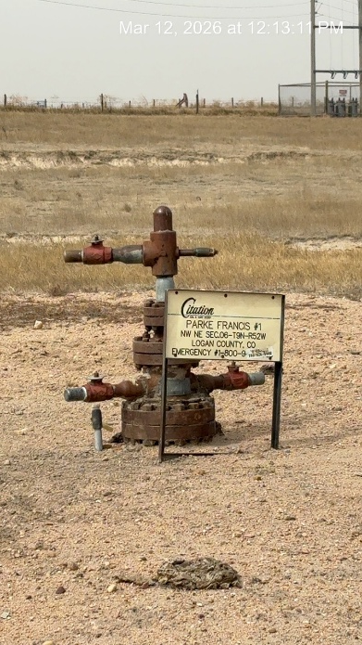
CITATION OIL AND GAS CORP. # 17180
FRANCIS PARKE 1 075-06653
SIGNAGE AT WH
WH

