Slide 1
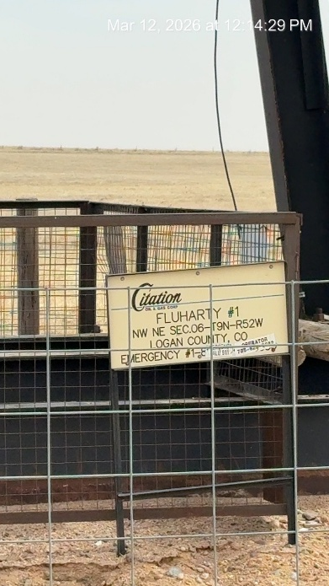
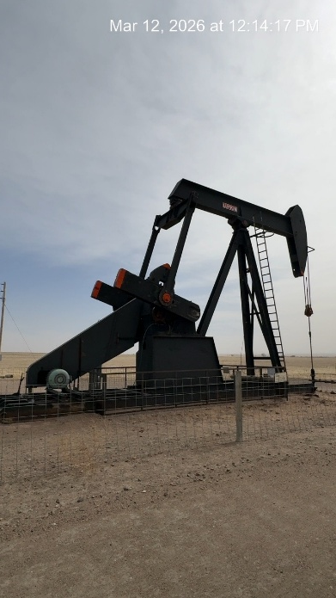
CITATION OIL AND GAS CORP. # 17180
FLUHARTY 1 075-09333
SIGNAGE AT WH
WH

