Slide 1
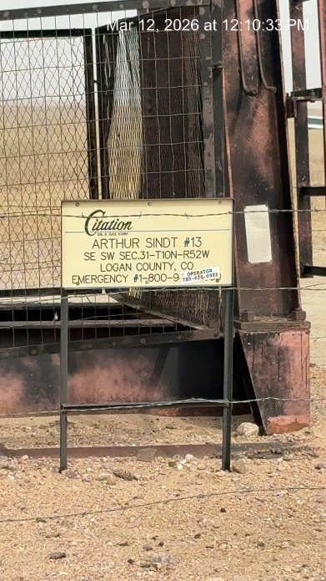
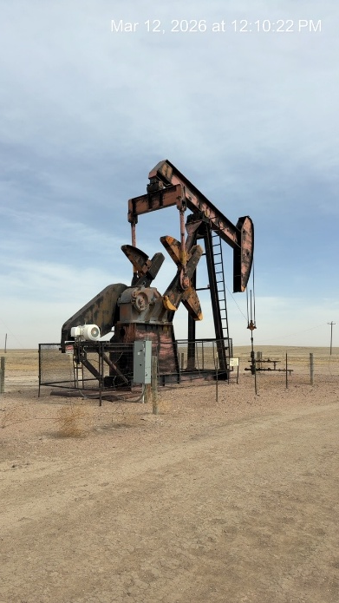
CITATION OIL AND GAS CORP. # 17180
ARTHUR SINDT 13 075-09340
SIGNAGE AT WH-PJ
WH - FENCE

