Slide 1
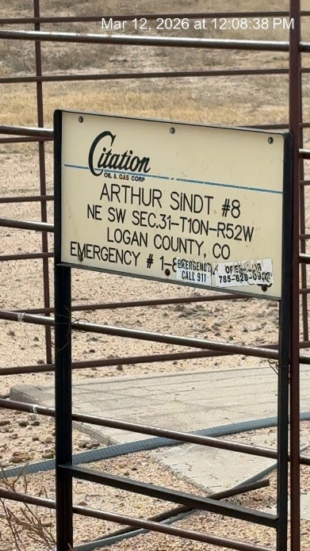
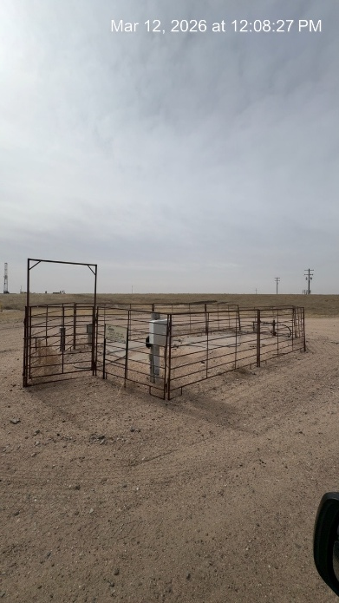
CITATION OIL AND GAS CORP. # 17180
ARTHUR SINDT 8 075-06675
SIGNAGE AT WH-PJ
WH - FENCE

