Slide 1

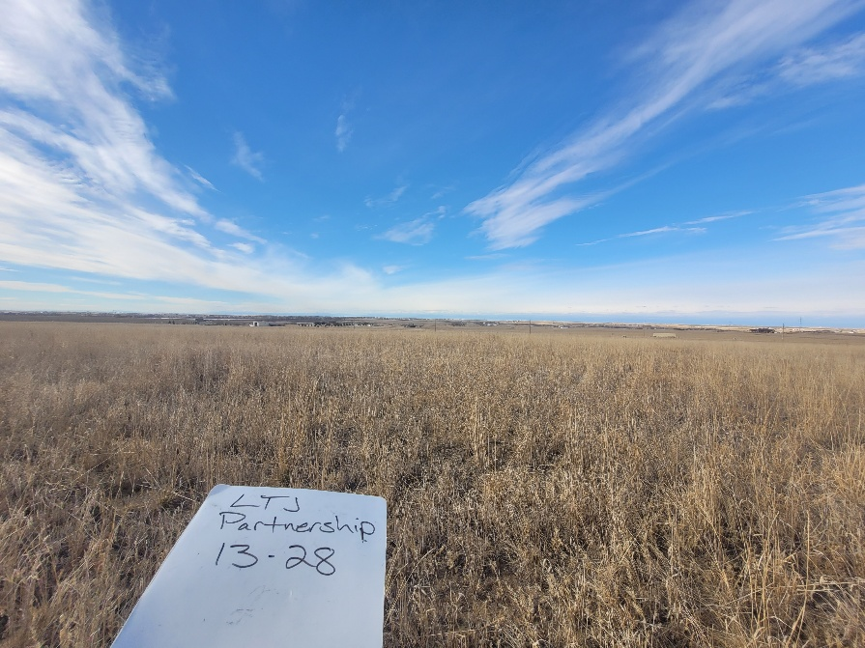
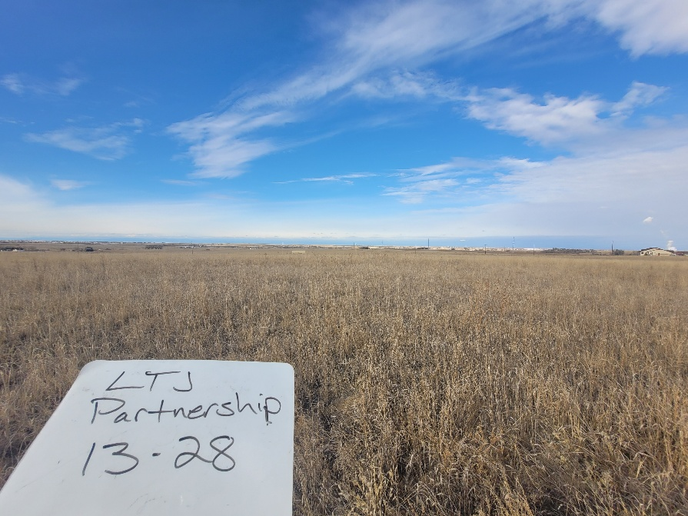
Inspection Photos
LTJ Partnership 13-28
Location ID: 407613
Operator Name/ Number: ORM EXPLORATION CO- 66360
All related facilities and remediation are closed and resolved. Location is stabilized and consistent with surrounding land use (Ag-land). No evidence of well or related facilities observed. Weeds not observed.
Inspection Number: 718400042

Slide 2
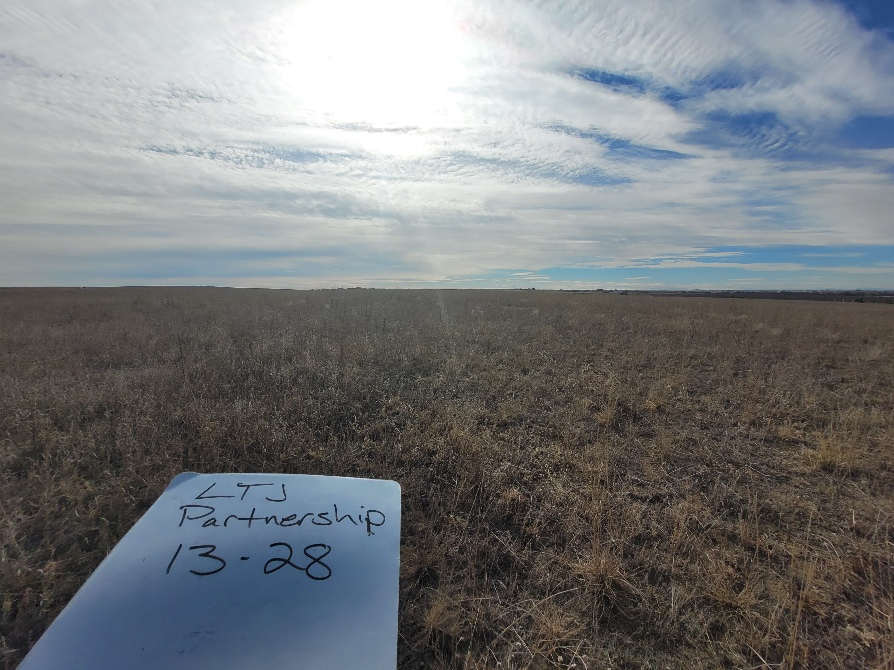
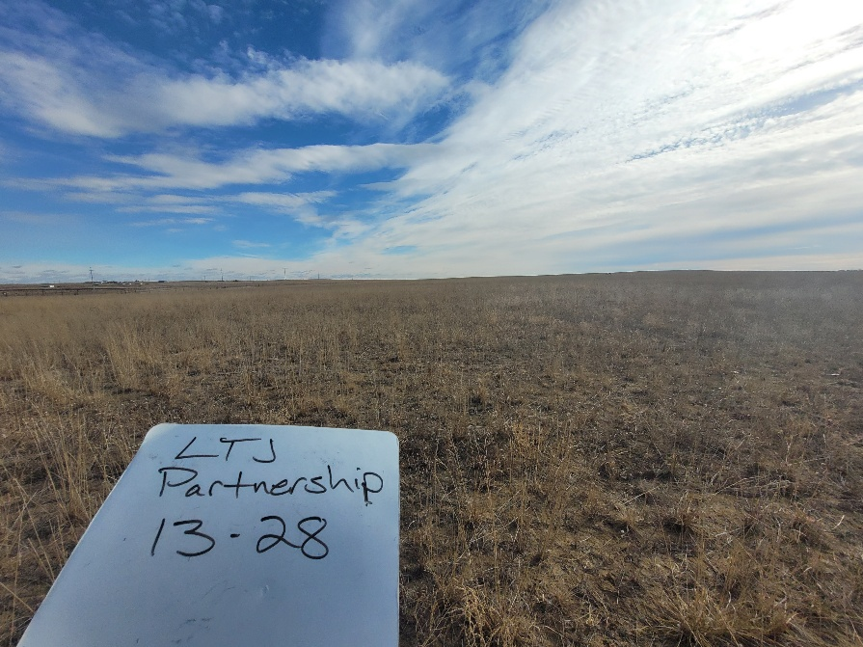
Inspection Photos
LTJ Partnership 13-28
Location ID: 407613
Operator Name/ Number: ORM EXPLORATION CO- 66360
All related facilities and remediation are closed and resolved. Location is stabilized and consistent with surrounding land use (Ag-land). No evidence of well or related facilities observed. Weeds not observed.
Inspection Number: 718400042

