Slide 1
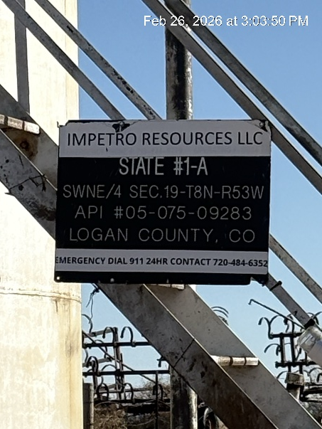
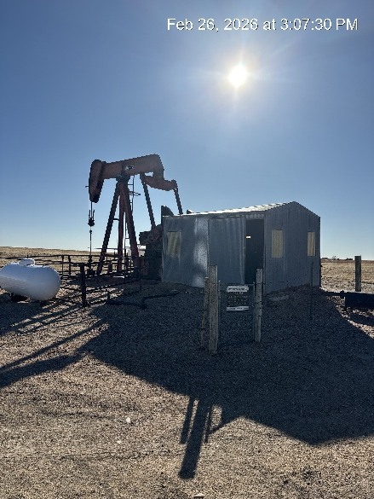
IMPETRO RESOURCES LLC # 10690
STATE 1-A 075-09283
SIGNAGE@BATTERY
WH – PJ – PM- PT SIGNAGE

Slide 2
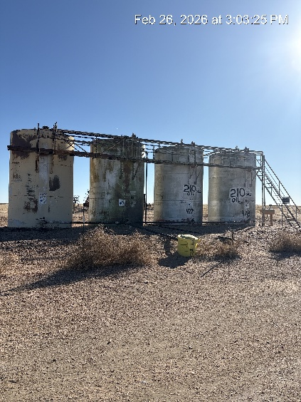
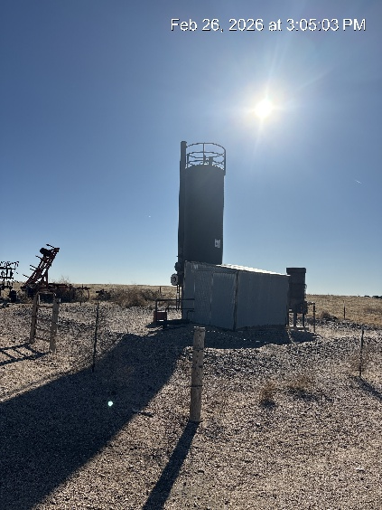
IMPETRO RESOURCES LLC #10690
STATE 1-A 075-09283
TANK BATTERY - SIGNAGE
SEPARATOR - COMBUSTOR

Slide 3
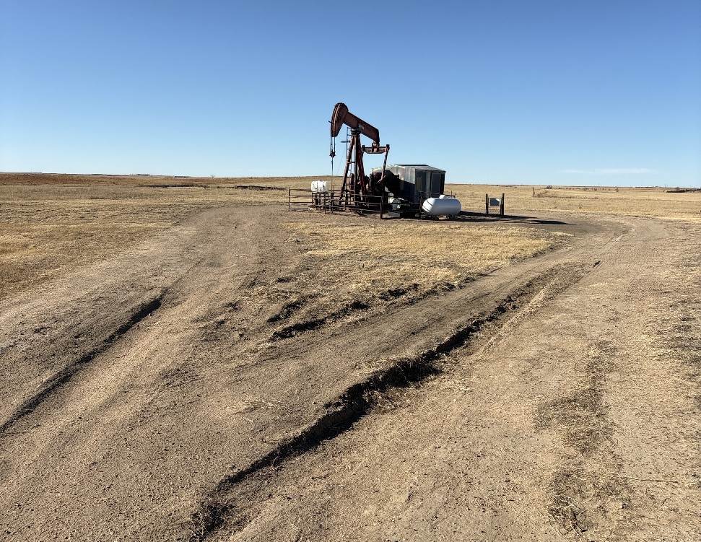
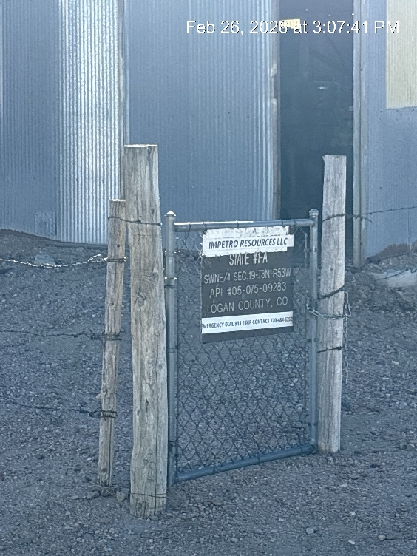
IMPETRO RESOURCES LLC #10690
STATE 1-A 075-09283
SIGNAGE PJ
LEASE ROAD RUTTING

Slide 4
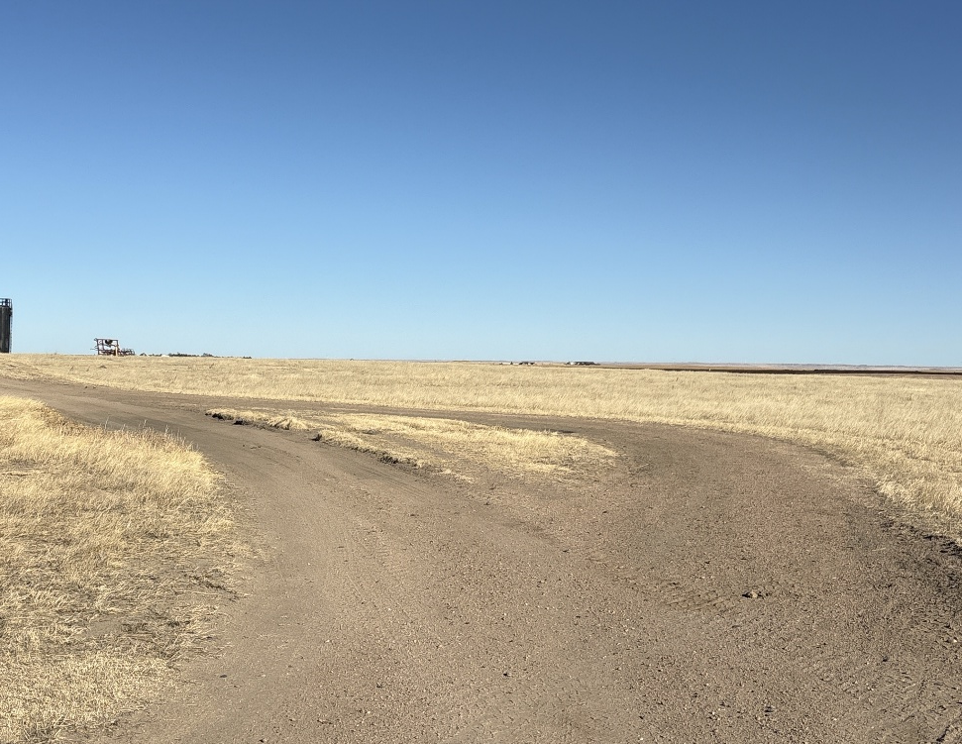
IMPETRO RESOURCES LLC #10690
STATE 1-A 075-09283
SECONDARY LEASE ROAD CREATED

