Slide 1
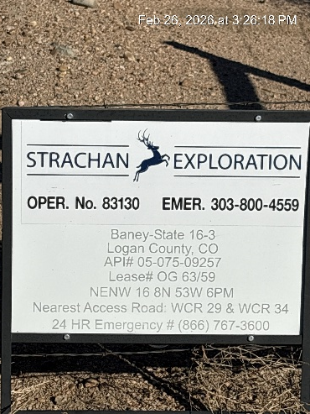
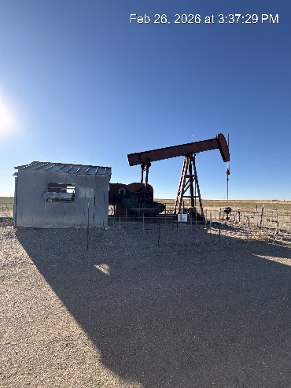
STRACHAN EXPLORATION INC. #83130
BANEY-STATE 16-3 075-09257
SIGNAGE@BATTERY
PJ – PM - WH

Slide 2
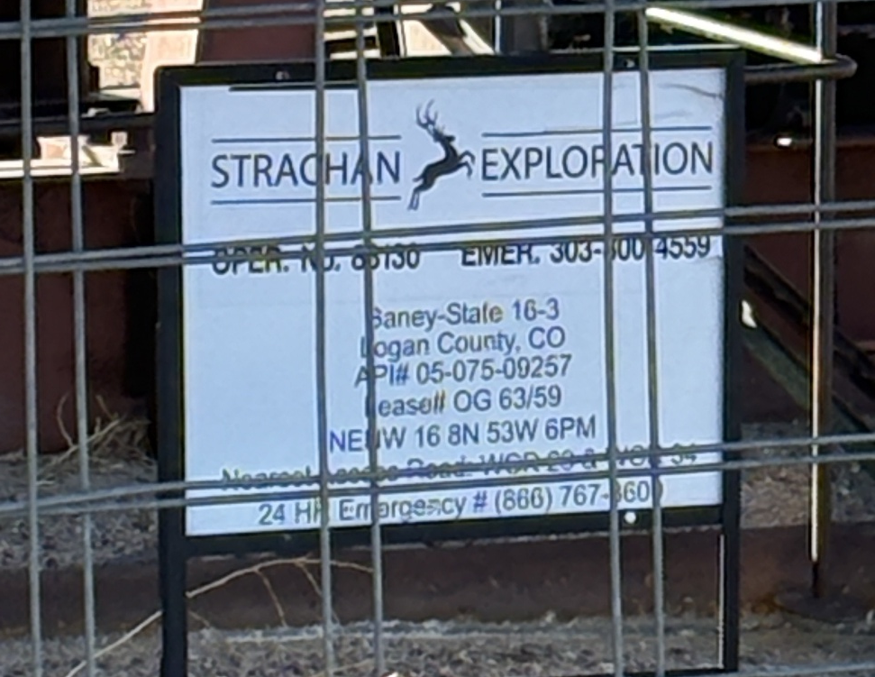
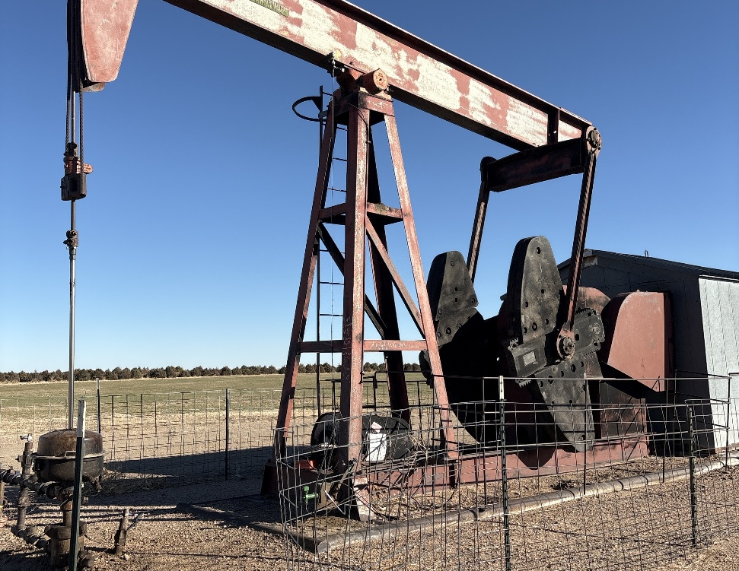
STRACHAN EXPLORATION INC.
BANEY-STATE 16-3
SIGNAGE PJ
PJ – WH - PM

Slide 3
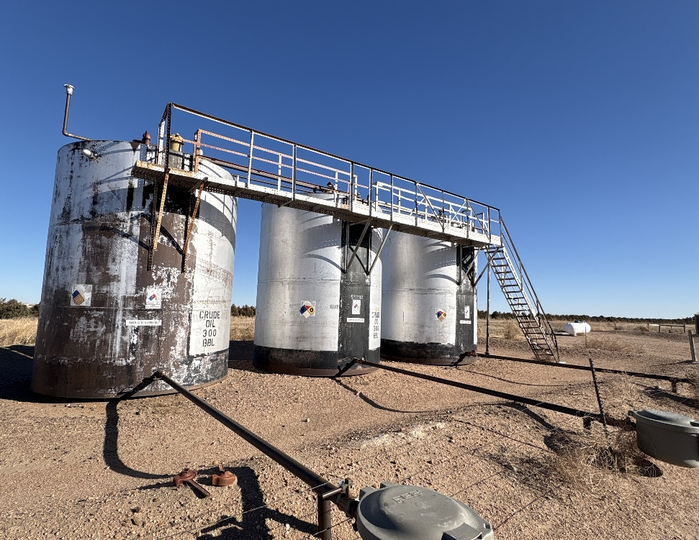
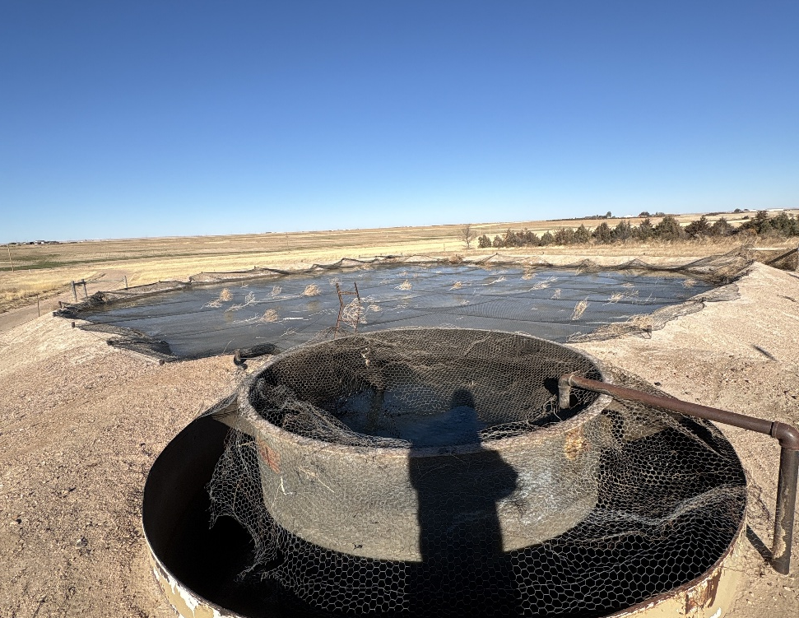
STRACHAN EXPLORATION
BANEY-STATE 16-3 075-09257
TANK BATTERY – LOAD OUT
SKIM TANK – PW PIT - NETTING

Slide 4
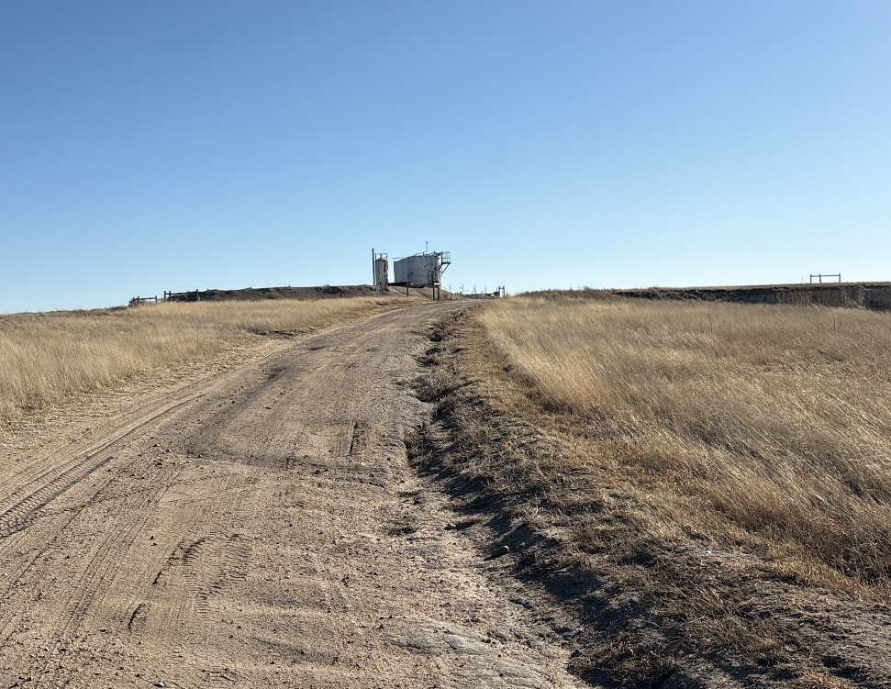
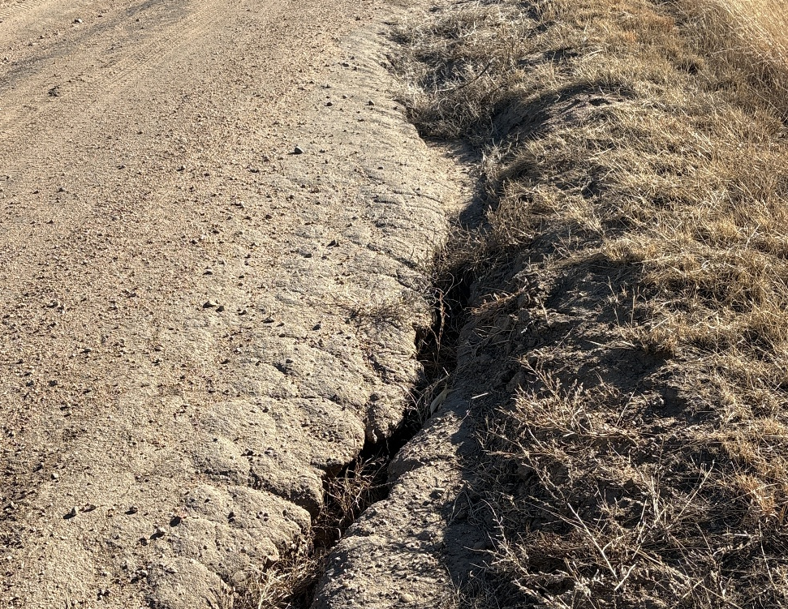
STRACHAN EXPLORATION
BANEY-STATE 16-3 075-09257
LEASE ROAD STORMWATER EROSION
LEASE ROAD EROSION

