Slide 1
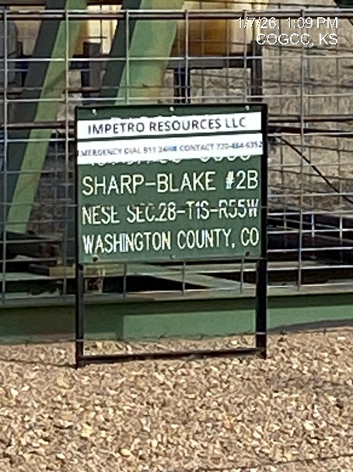
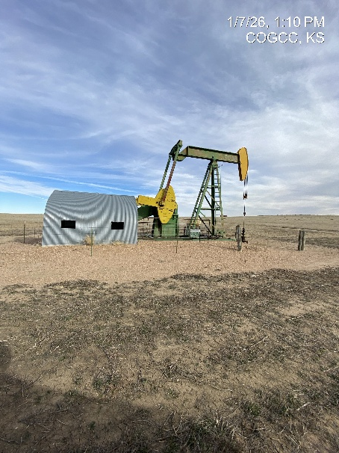
IMPETRO ENERGY LLC
SHARP-BLAKE 2B 121-10597
SIGNAGE@WH
WH-PJ-PM

Slide 2
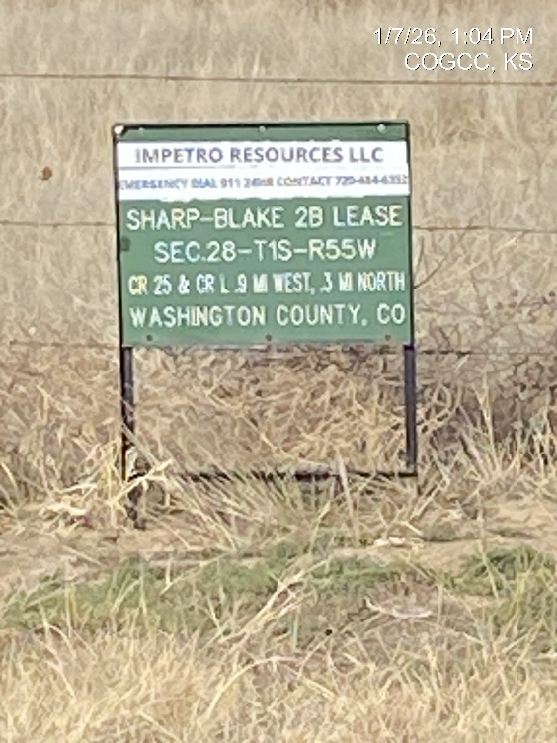
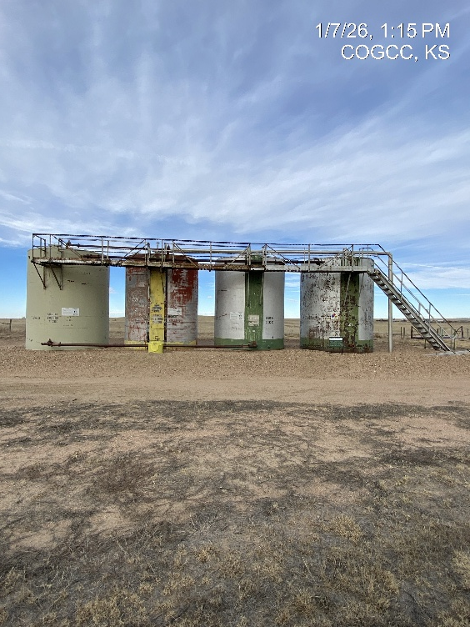
IMPETRO ENERGY LLC
SHARP-BLAKE 2B 121-10597
SIGNAGE
BATTERY – LO – SIGNAGE - BERM

