Slide 1
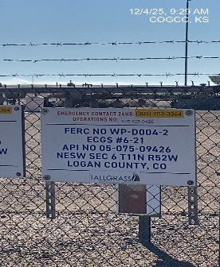
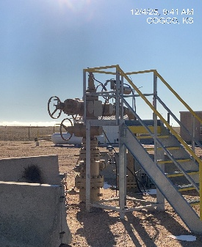
EAST CHEYENNE GAS STORAGE #10322
D004-2 075-09426
SIGNAGE@WH
WH

