Slide 1
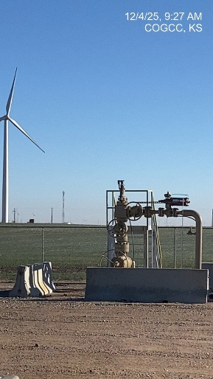
EAST CHEYENNE GAS STORAGE #10322
LC – M009 075-07121
SIGNAGE@WH
WH - Signage

