Slide 1
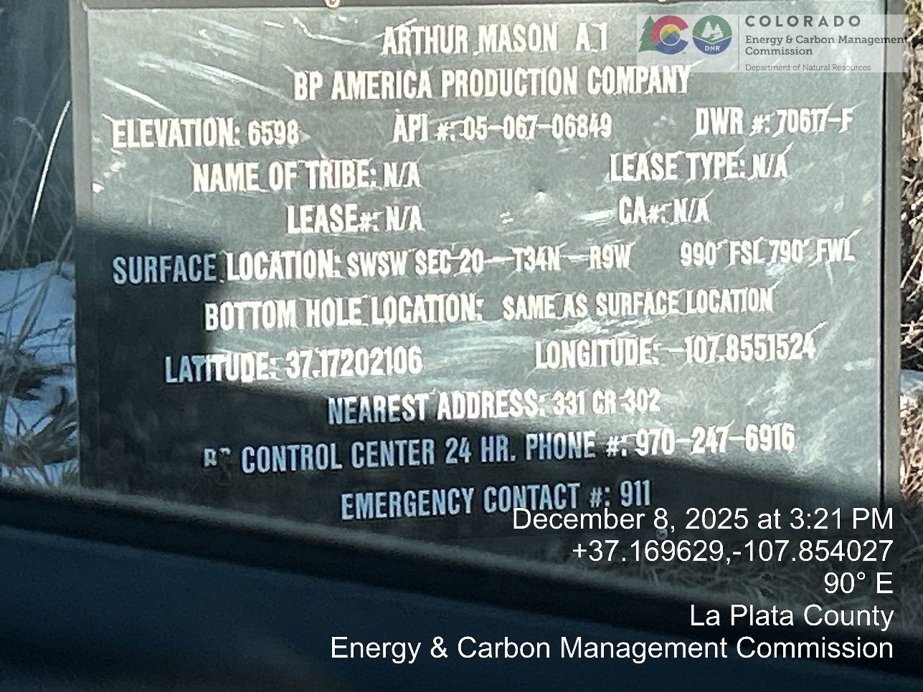
Inspection Photos
Location Name: Simcoe – Arthur Mason A1
API # 05-067-06849
1). Well Sign for Arthur Mason A1 Well, API-05-067-06849. 24 Hour Contact = 970-247-6916. Emergency Contact + 911. Sign is located a hundred yards south of the well. Well Location from GIS: 37.172021°N -107.855152°N.

Slide 2
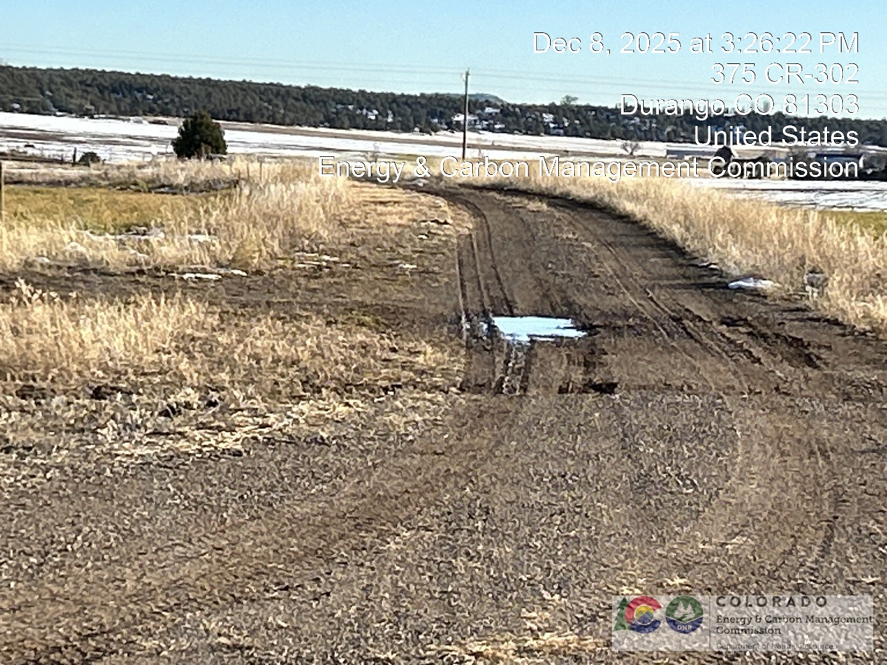
Inspection Photos
Location Name: Simcoe – Arthur Mason A1
API # 05-067-06849
2.) View looking north along well pad access road toward well pad from near entrance by well sign.

Slide 3
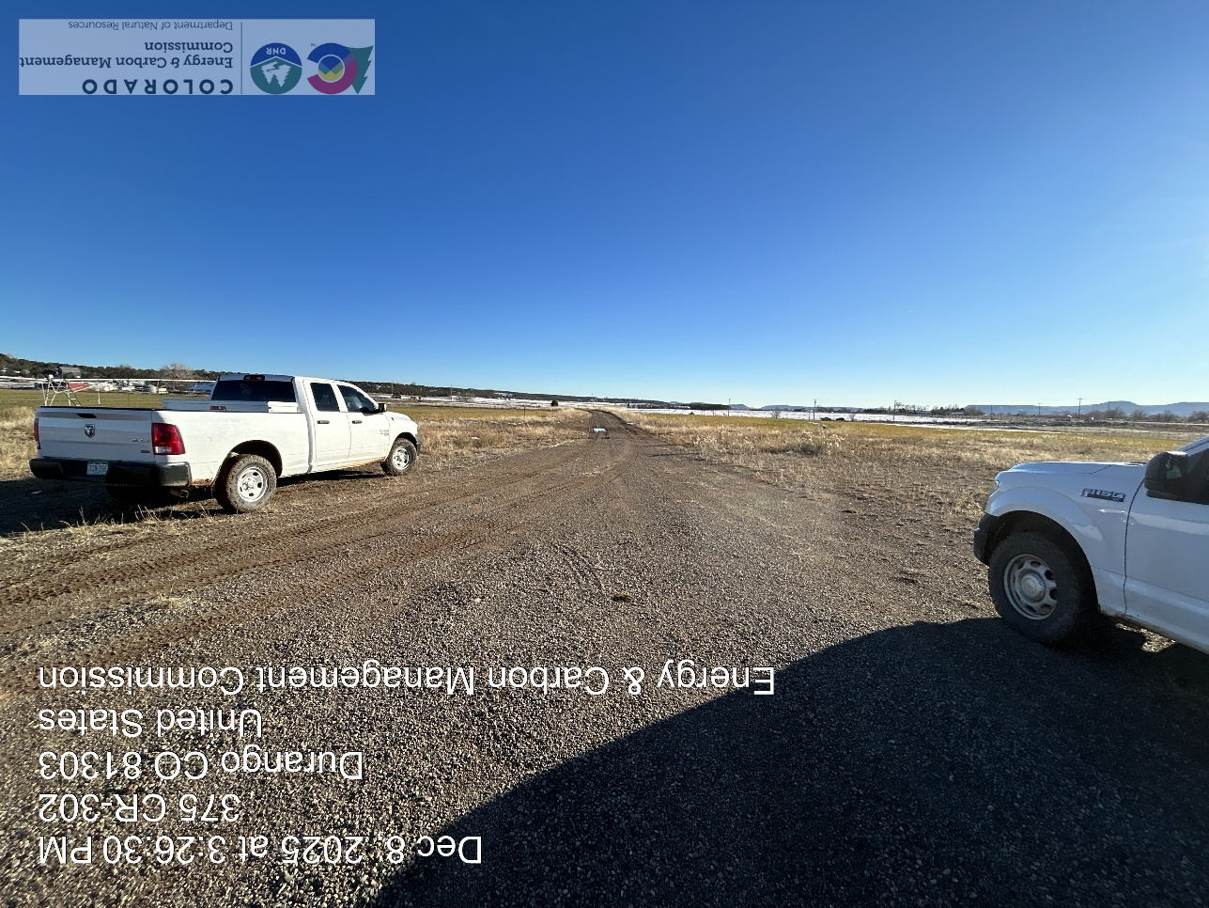
Inspection Photos
Location Name: Simcoe – Arthur Mason A1
API # 05-067-06849
3.) View looking south along well pad access road from well pad.

Slide 4
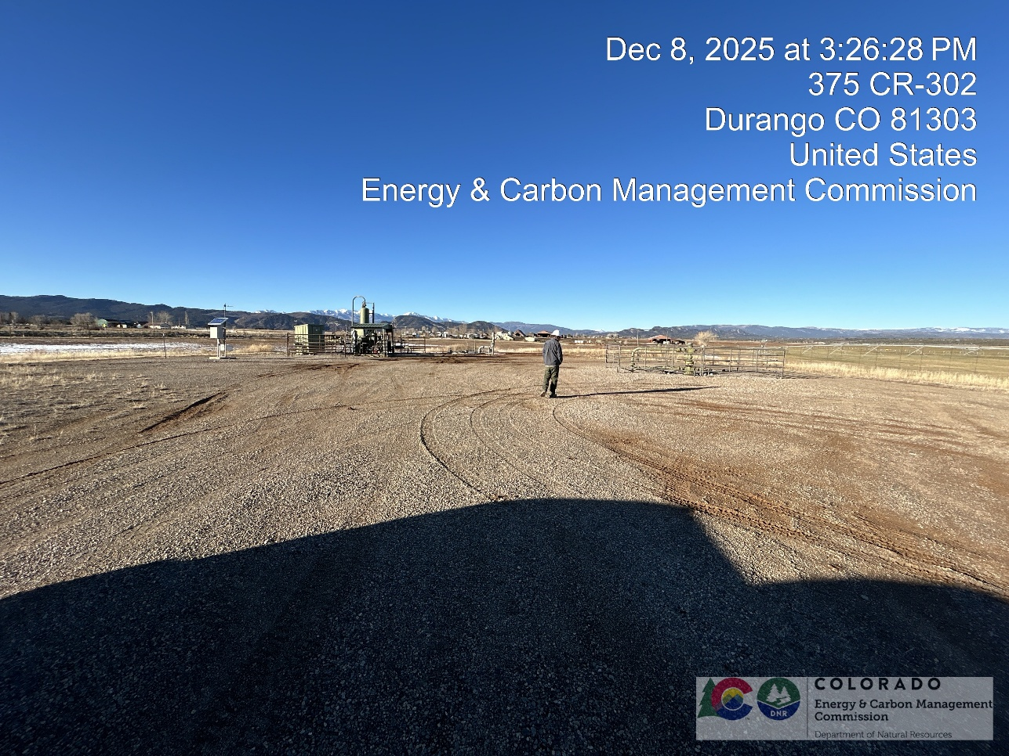
Inspection Photos
Location Name: Simcoe – Arthur Mason A1
API # 05-067-06849
4.) View looking north across well pad. The well head is inside the panel fence on the right and the separator and tank are in the panel fence on the left.

Slide 5
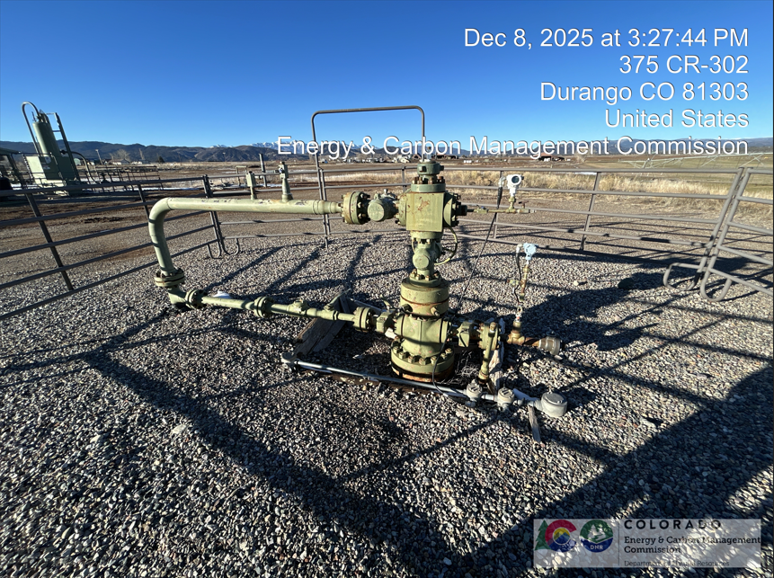
Inspection Photos
Location Name: Simcoe – Arthur Mason A1
API # 05-067-06849
5.) Well head assembly. Note that the well is producing under natural pressure, there is no well pumping unit or plunger lift.

Slide 6
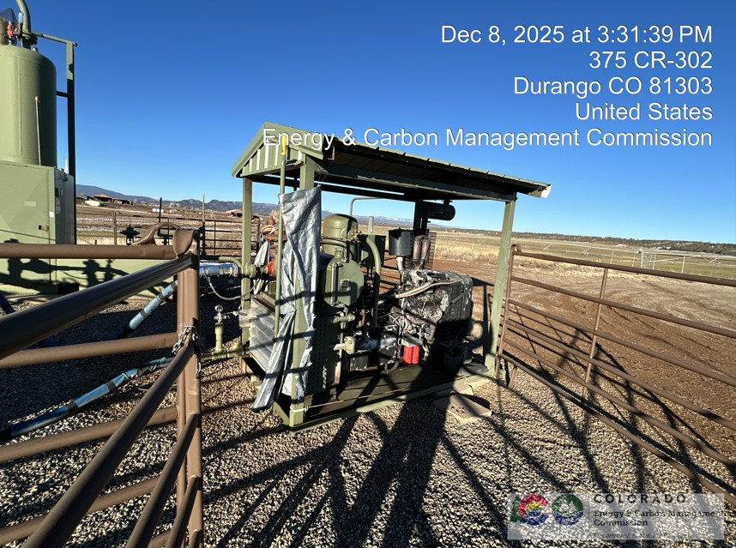
Inspection Photos
Location Name: Simcoe – Arthur Mason A1
API # 05-067-06849
6.) Compressor system driven off of well gas next to separator.

Slide 7
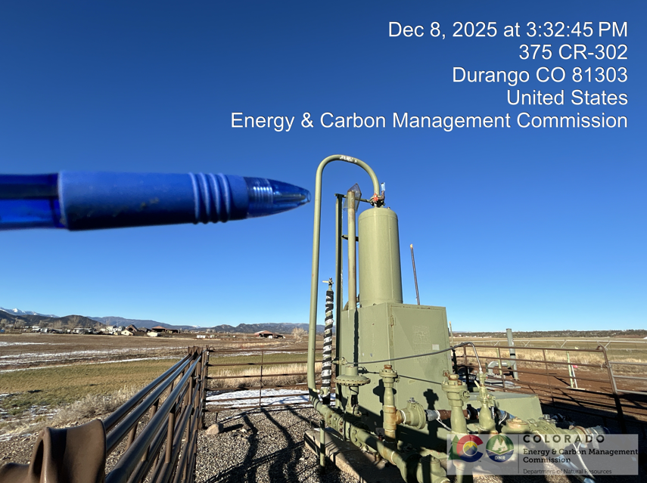
Inspection Photos
Location Name: Simcoe – Arthur Mason A1
API # 05-067-06849
7.) Separator and combuster inside of panel fence. Bird protector is visible on vent tube (pen tip).

Slide 8
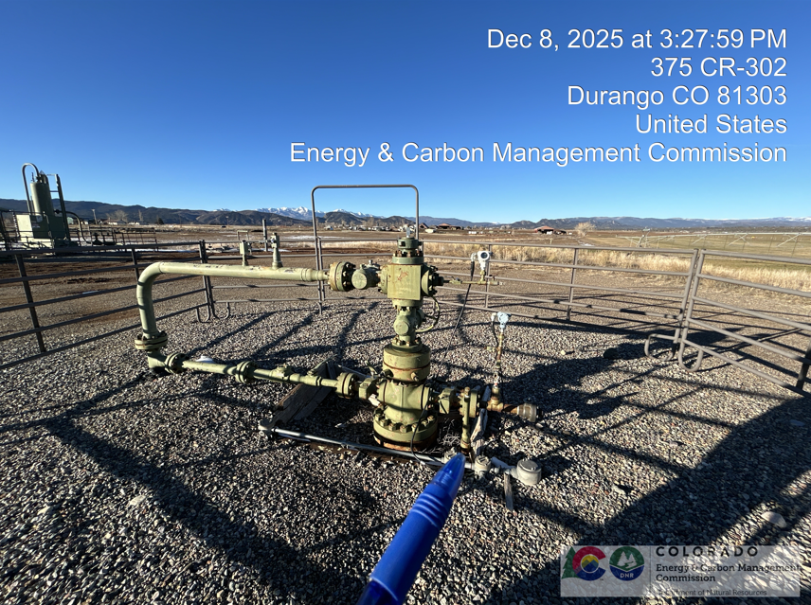
Inspection Photos
Location Name: Simcoe – Arthur Mason A1
API # 05-067-06849
8.) Well head looking north.

Slide 9
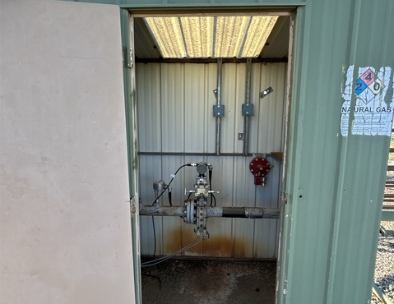
Inspection Photos
Location Name: Simcoe – Arthur Mason A1
API # 05-067-06849
9.) Meter equipment structure. Card indicates testing on 3/18/2025

Slide 10
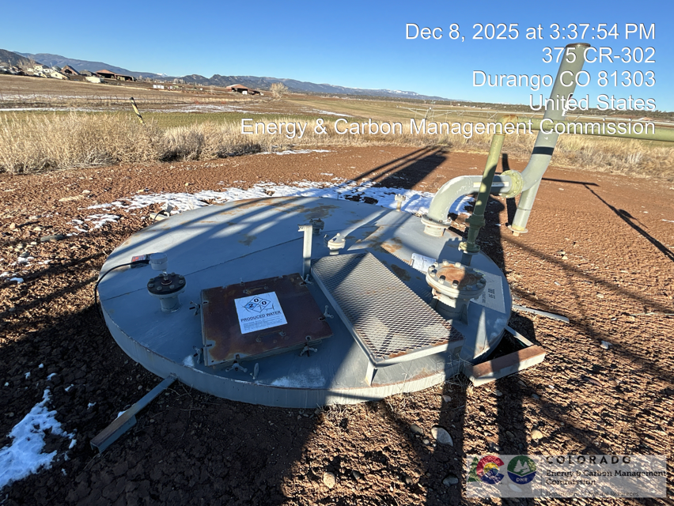
Inspection Photos
Location Name: Simcoe – Arthur Mason A1
API # 05-067-06849
10.) Produced Water Tank. The tank is double walled and does not need a secondary containment structure. There are two placards on the tank, one indicating that the material stored is non-flammable and one that indicates it is highly flammable. Both cannot be correct.

Slide 11
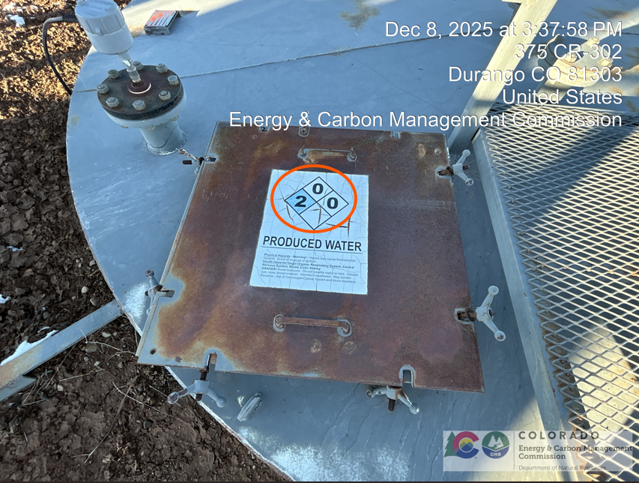
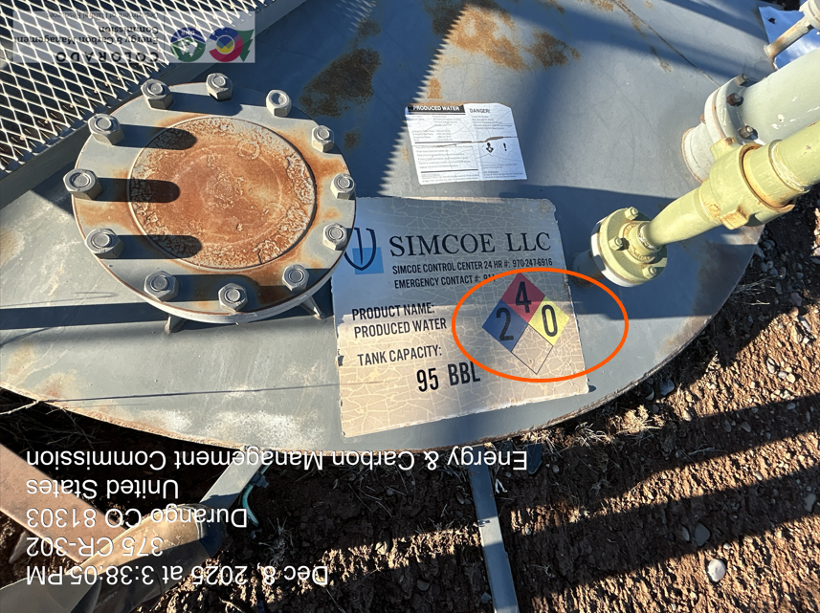
11.) Detail photo showing one of two HazCom placards indicating fire danger level of zero for produced water.
12.) Detail photo showing second of two HazCom labels indicating fire danger four from produced water.

Slide 12
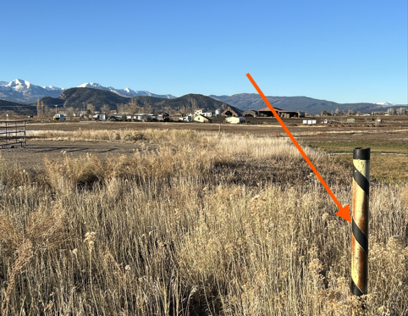
Inspection Photos
Location Name: Simcoe – Arthur Mason A1
API # 05-067-06849
13.) Deadman marker in interim reclamation area on SE corner of well pad. View looking north.

