Slide 1
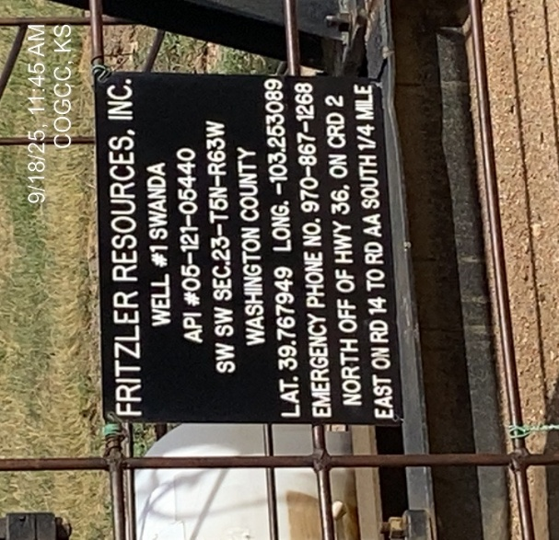
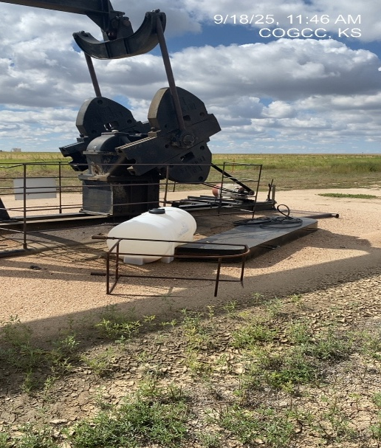
Fritzler Resources Inc. # 31257
Swanda 1 - 121-05440
SIGNAGE-WH
WH-PJ-PM-barrel containment- unused equipment

Slide 2
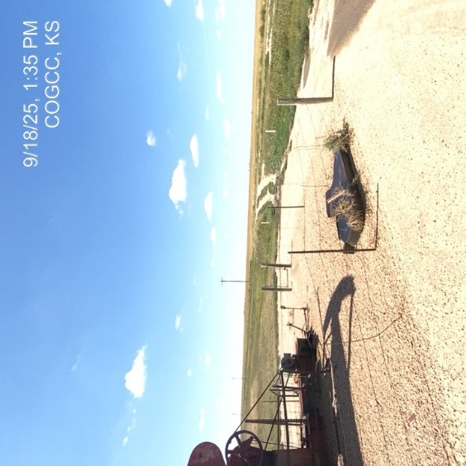
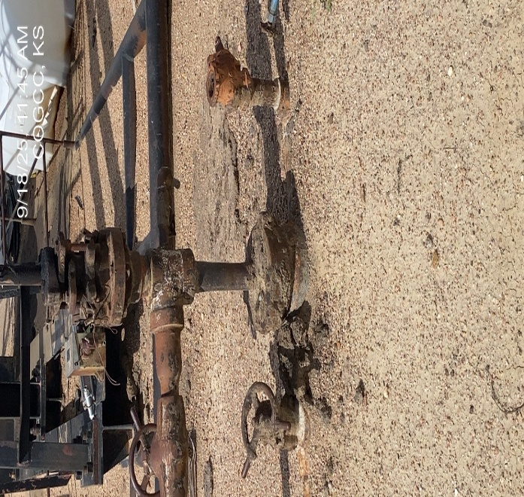
Fritzler Resources Inc. # 31257
Swanda 1 - 121-05440
Unused equipment- debris
Stained/Saturated soil at WH

Slide 3
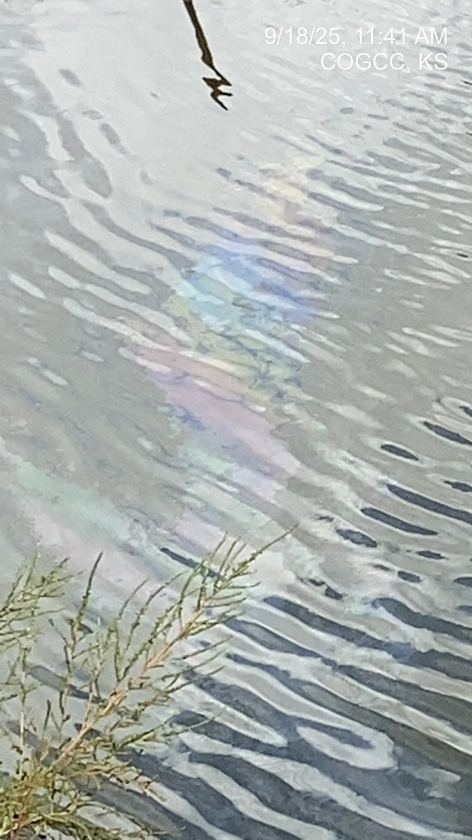
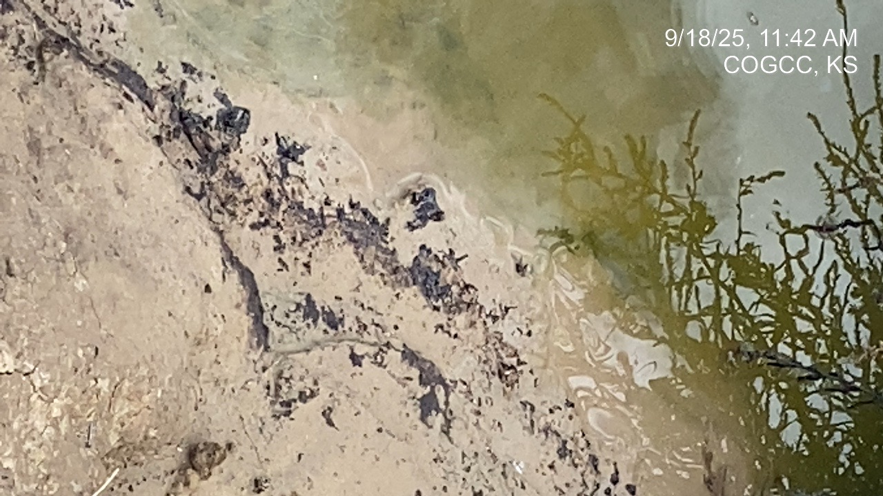
Fritzler Resources Inc. #31257
Swanda 1 - 121-05440
CO stained soils @ PW pit
CO rainbow sheen on PW pit

Slide 4
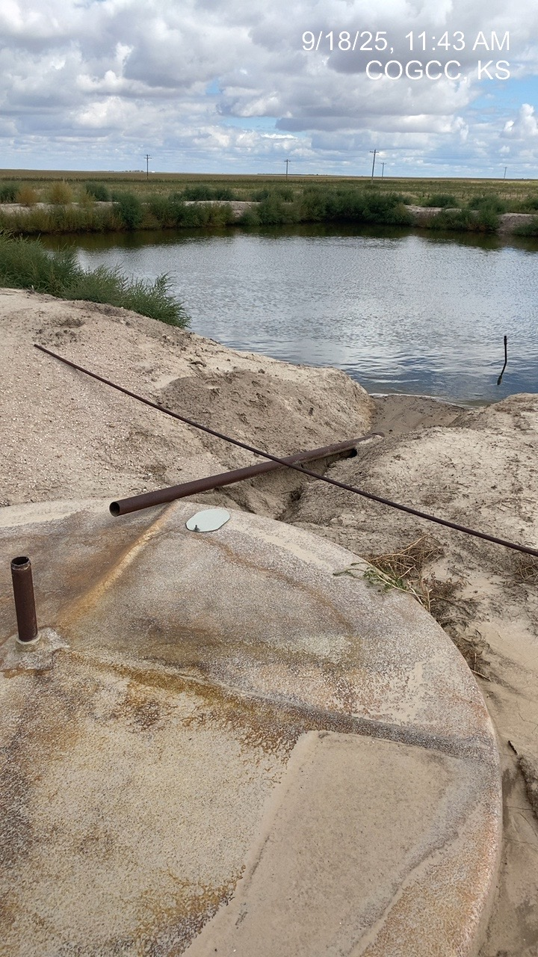
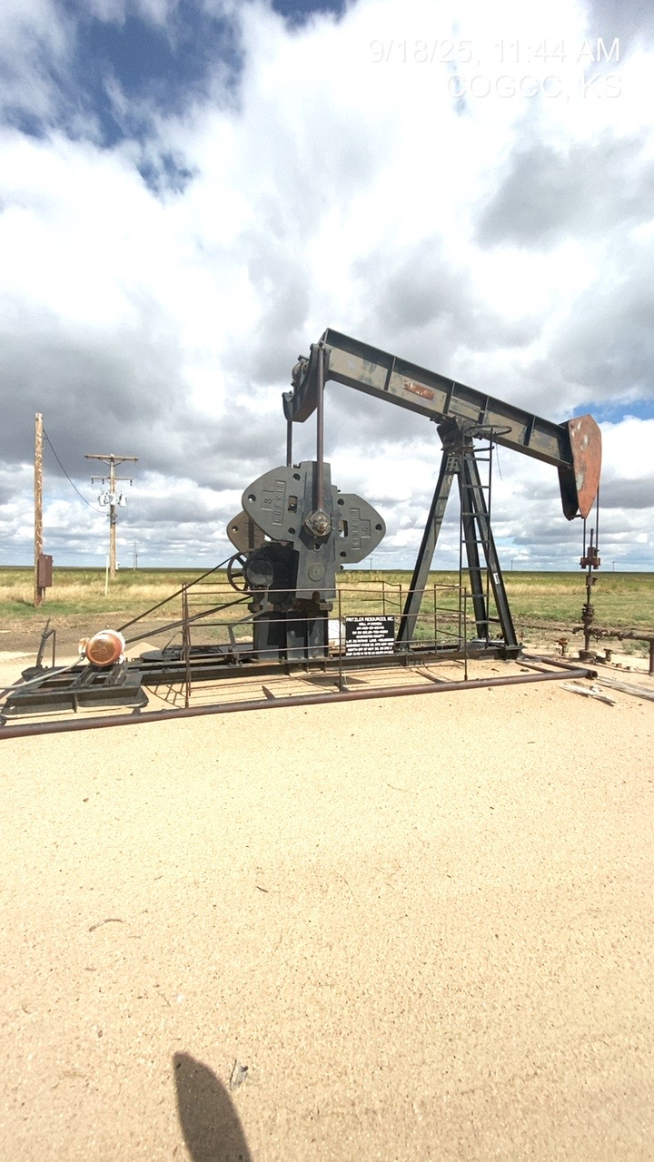
Fritzler Resources Inc. #31257
Swanda 1 - 121-05440
PW/skim tank – discharge disconnected – erosion from uncontrolled discharge
Signage WH – PJ – PM – barrel containment

Slide 5
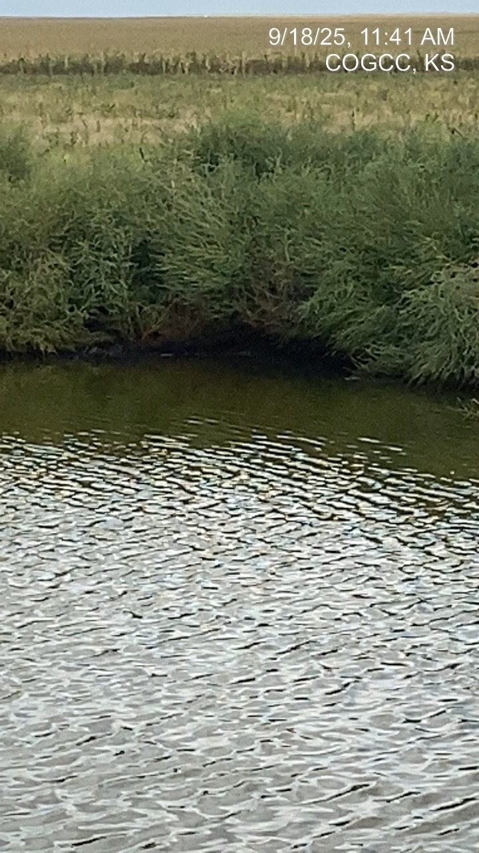
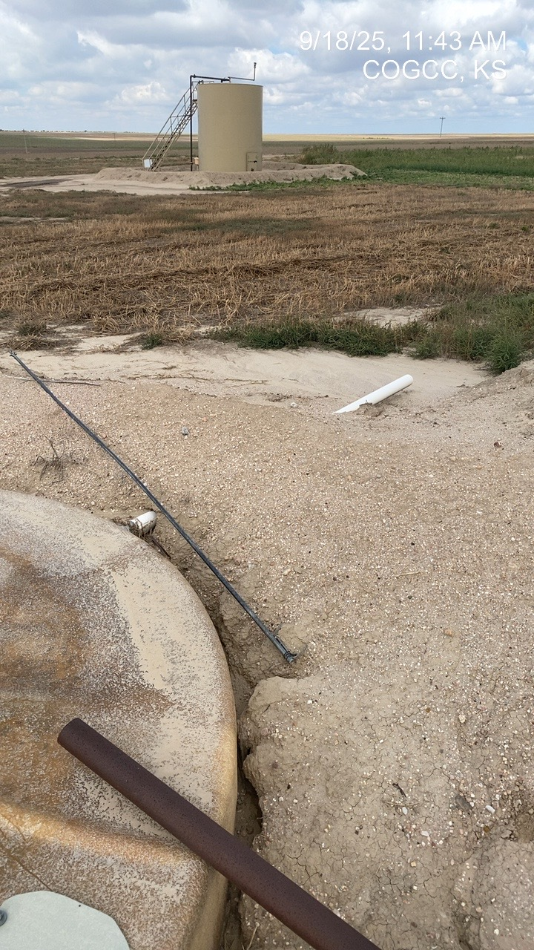
Fritzler Resources Inc. #31257
Swanda 1 - 121-05440
Weeds – spill @ PW pit
Erosion from discharge – discharge not designated to PW pit -

