Slide 1
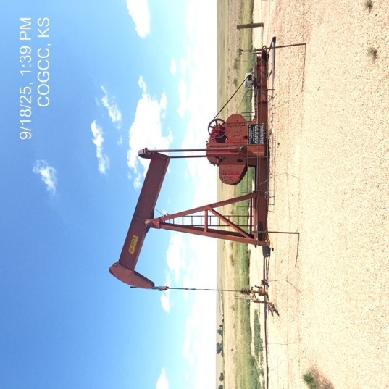
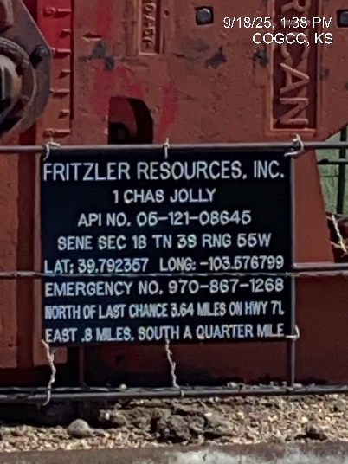
Fritzler Resources Inc. # 31257
Chas Jolly 1
SIGNAGE-WH
WH-PJ-PM

Slide 2
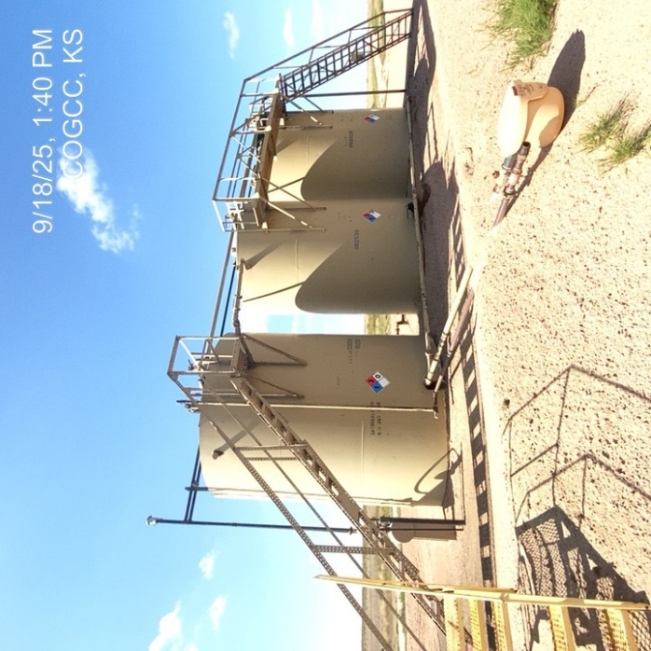
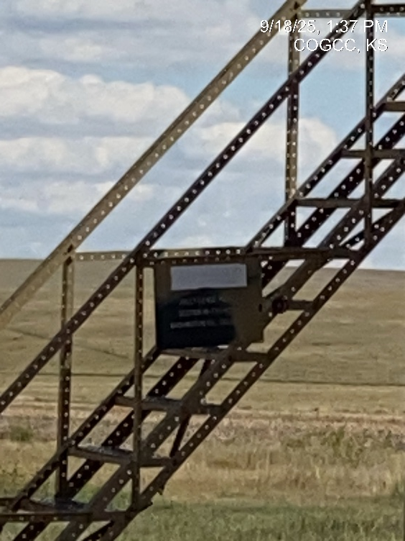
Fritzler Resources Inc. # 31257
Chas Jolly 1 – 121-08645
Signage at tank battery
CO Tank battery – placarding - signage

Slide 3
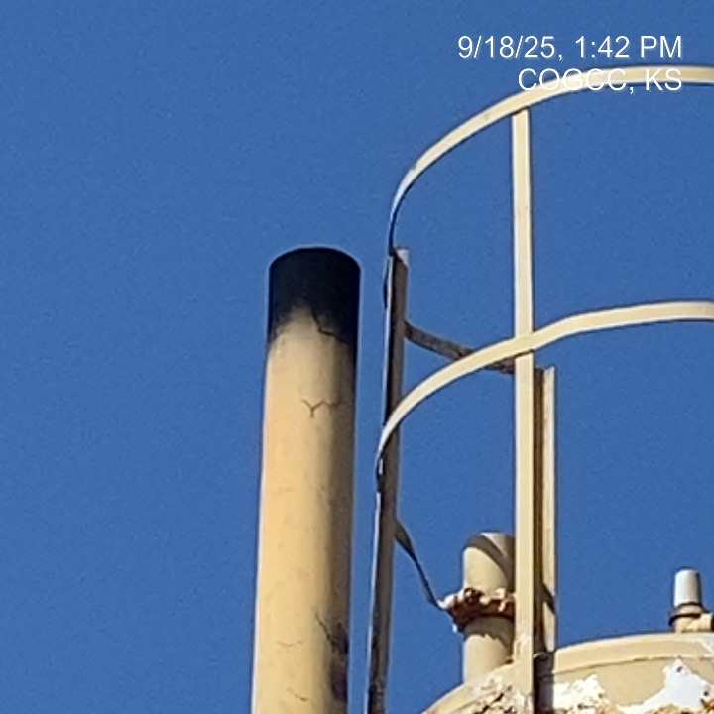
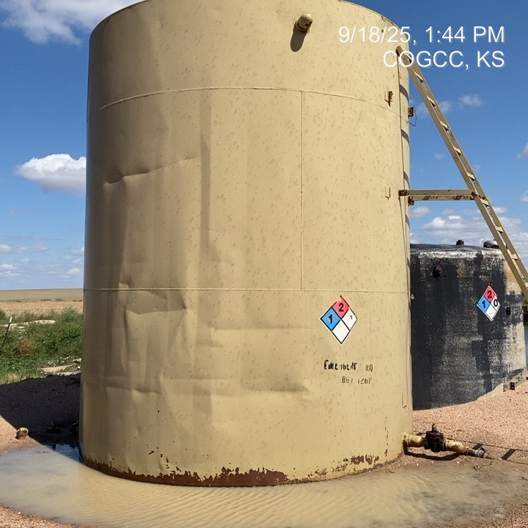
Fritzler Resources Inc. # 31257
Chas Jolly 1 – 121-08645
No bird screen @ sep./treater
PW tank - placarding

Slide 4
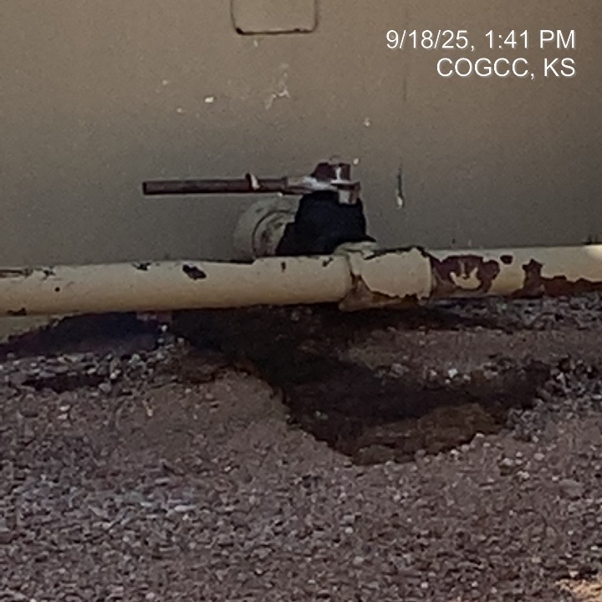
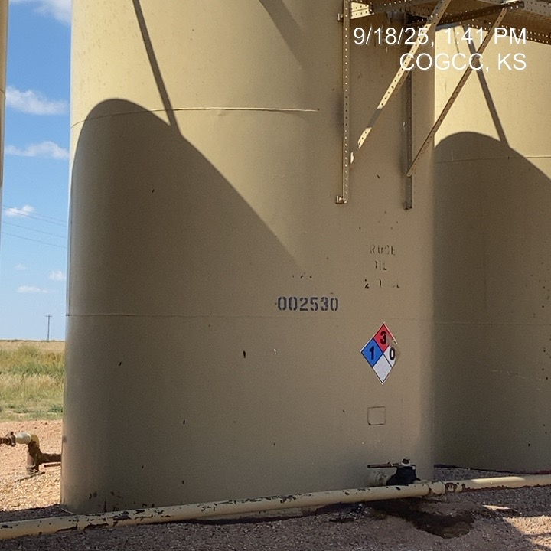
Fritzler Resources Inc. # 31257
Chas Jolly 1 – 121-08645
CO spill at loadout
Placarding on CO tank battery

Slide 5
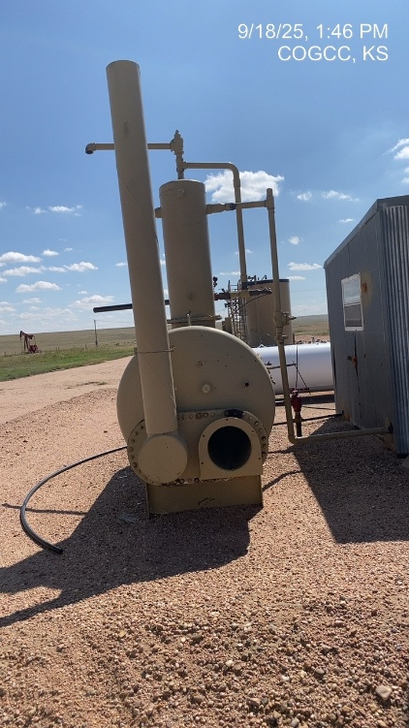
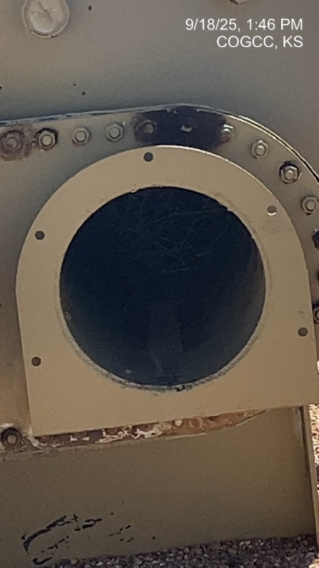
Fritzler Resources Inc. # 31257
Chas Jolly 1 – 121-08645
Unused equipment
Open port hatch – equipment not in use

Slide 6
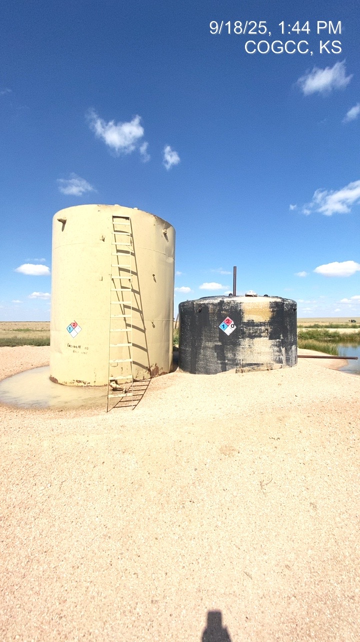
Fritzler Resources Inc. #31257
Chas Jolly 1 – 121-08645
PW tank – unused equipment – placarding- berms

