Slide 1
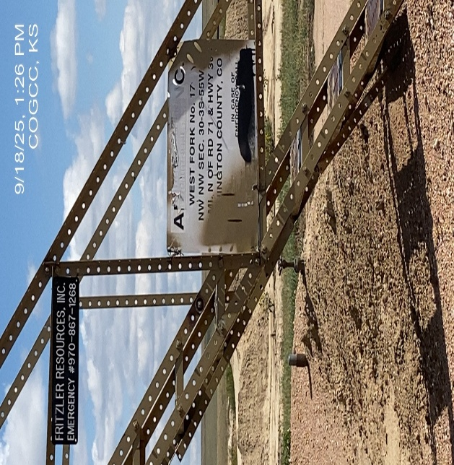
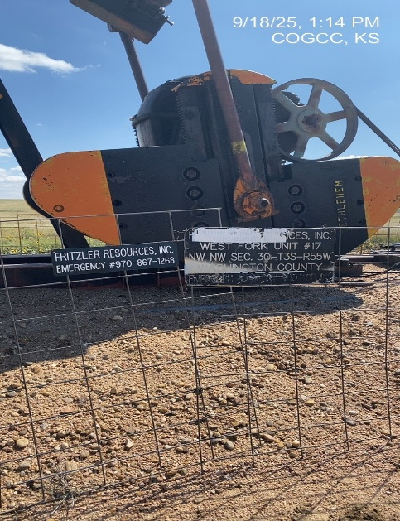
Fritzler Resources Inc. # 31257
West Fork Unit 17 121-05439
SIGNAGE-WH - unlegible
SIGNAGE BATTERY – unlegible

Slide 2
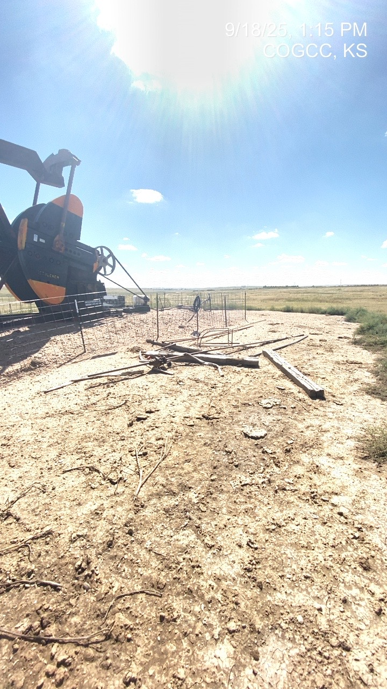
Fritzler Resources Inc. # 31257
West Fork Unit 17 121-05439
Debris @ WH

