Slide 1
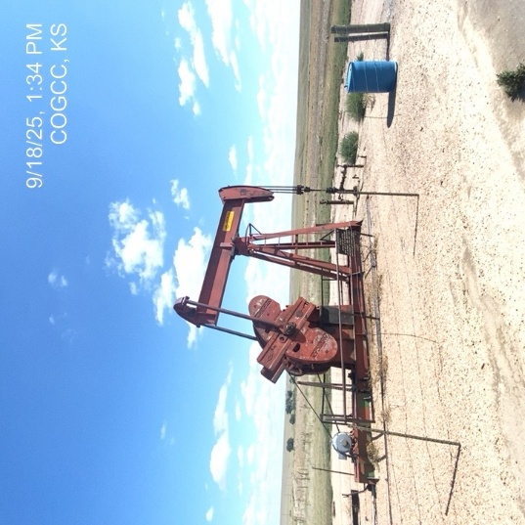
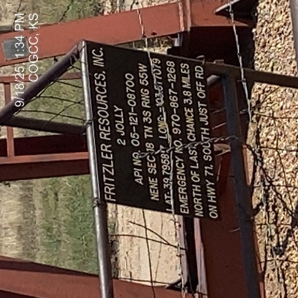
Fritzler Resources Inc. # 31257
Jolly 2 - 121-08700
SIGNAGE-WH
WH-PJ-PM-barrel containment

Slide 2
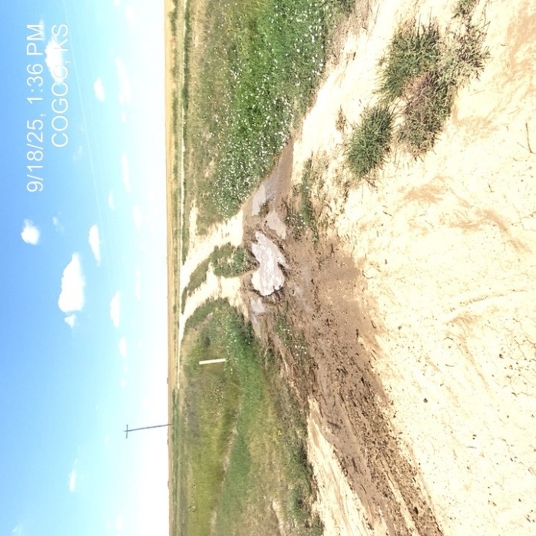
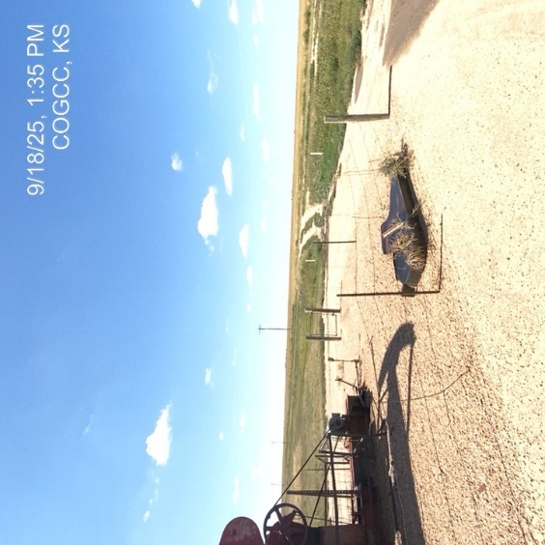
Fritzler Resources Inc. # 31257
Chas Jolly 2 - 121-08700
Unused equipment- debris
Lease road erosion-rutting

