Slide 1
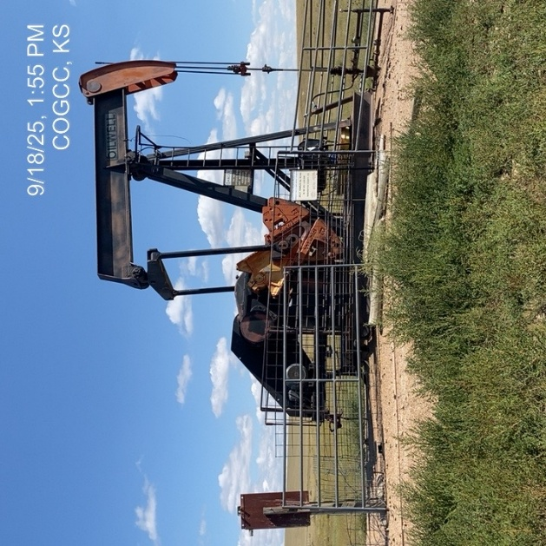
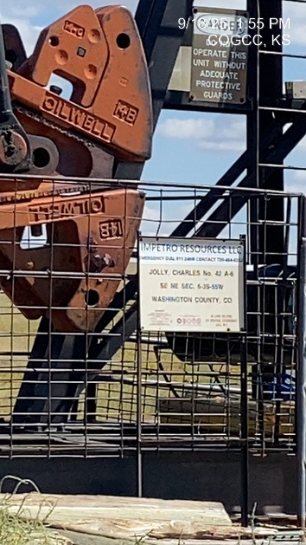
Impetro Resources LLC #10690
Charles Jolly 42A-6 121-09919
SIGNAGE-WH -
PJ-PM-Fence-Signage

Slide 2
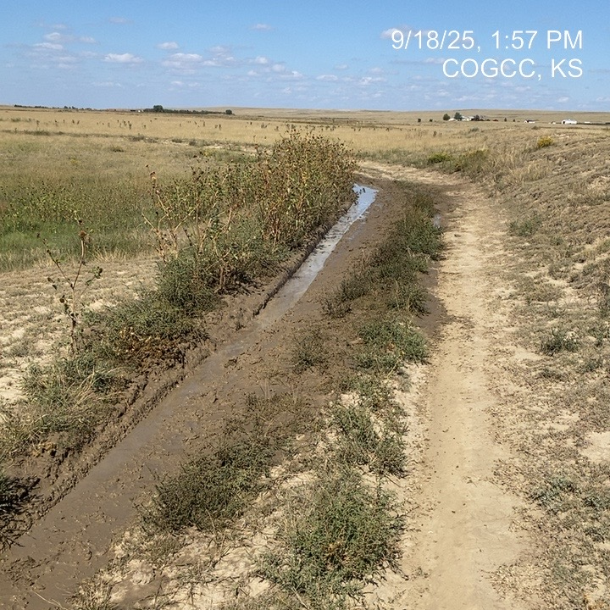
Impetro Resources LLC #10620
Charles Jolly 42A-6 121-09919
Lease road condition

