Slide 1
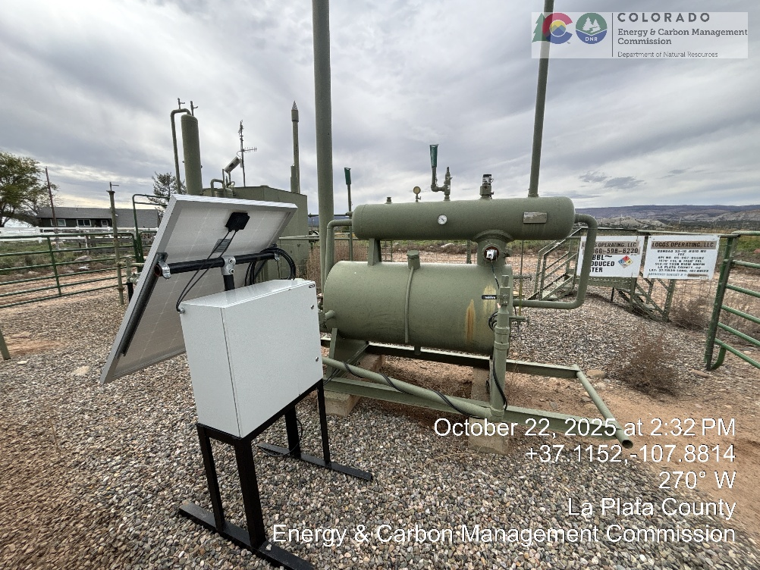
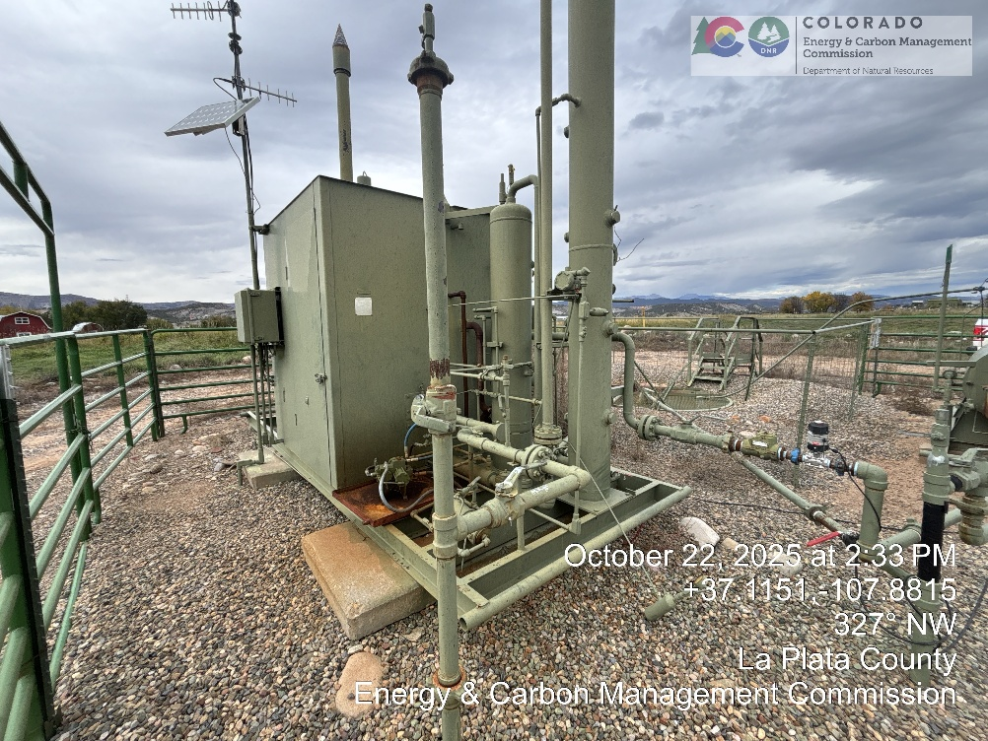
Inspection Photos
LOCATION NAME: BONDAD 33-10 10 ADD PICS
LOCATION ID: 325197

Slide 2
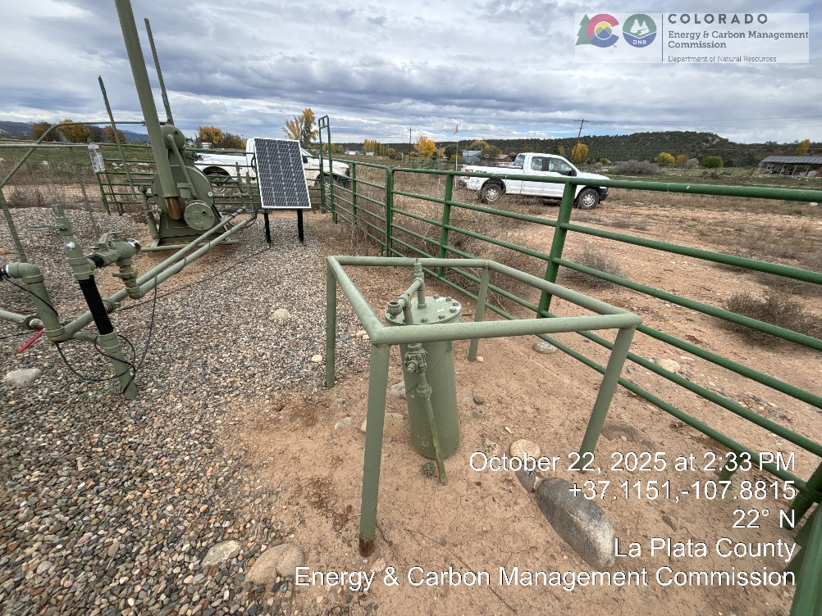
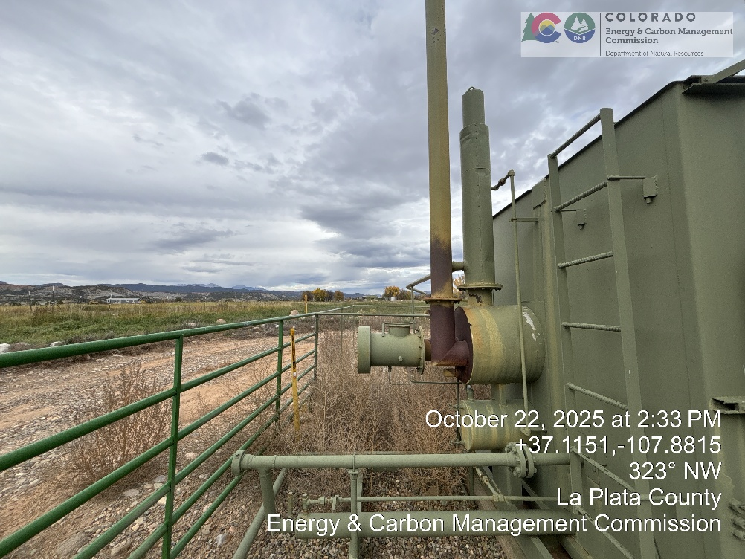
Inspection Photos
LOCATION NAME: BONDAD 33-10 10 ADD PICS
LOCATION ID: 325197

