Slide 1
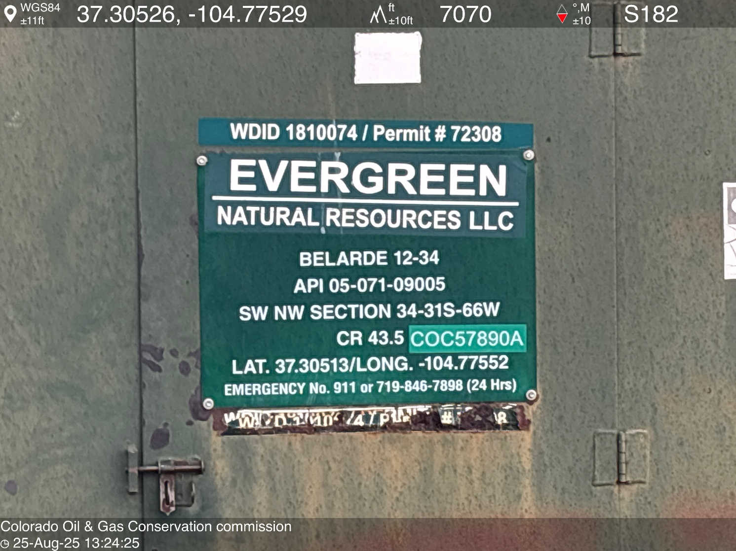
WELL NAME: BELARDE 12-34, API #: 071-09005, INSP. # 716301430
PHOTO 1: WELL SIGN

Slide 2
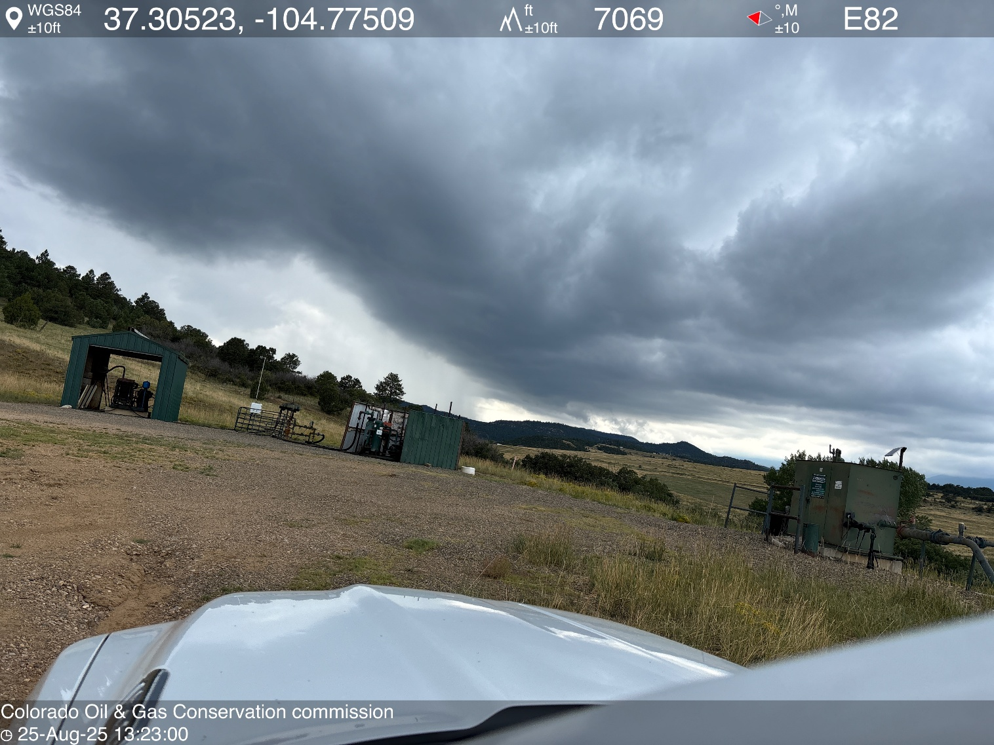
PHOTO 2: LOCATION.

Slide 3
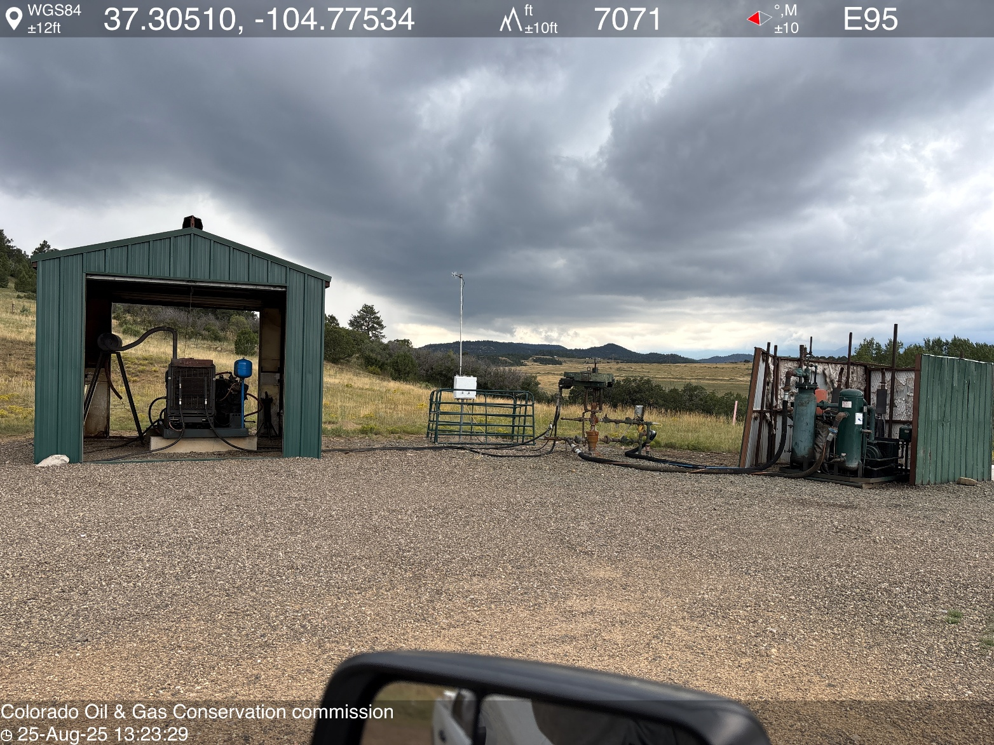
PHOTO 3: WELLHEAD AND EQUIPMENT.

Slide 4
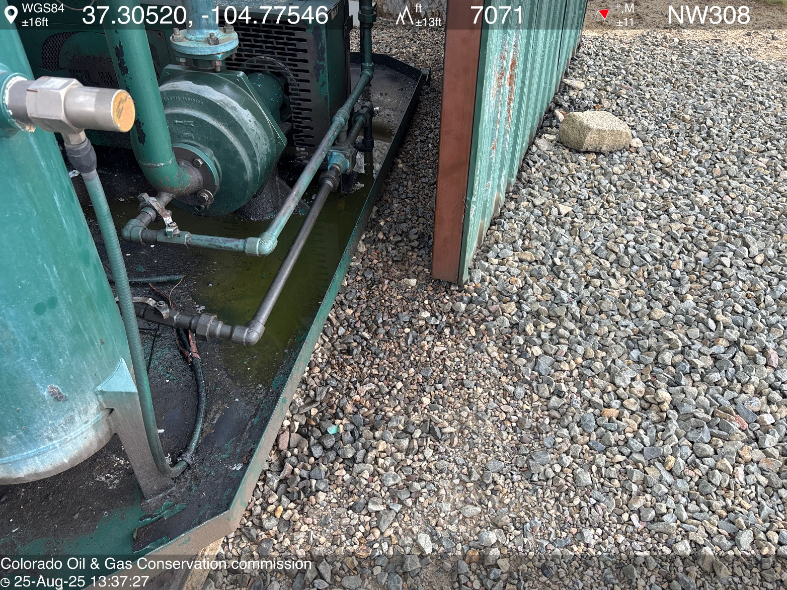
PHOTO 4: AREA OF IMPACTED SOIL NEAR COMPRESSOR SKID. Conduct maintenance on equipment, cleanup stained material and review self inspection processes. COMPLY WITH RULE 1002,.(2).D. CA DATE 9-25-2025.

Slide 5
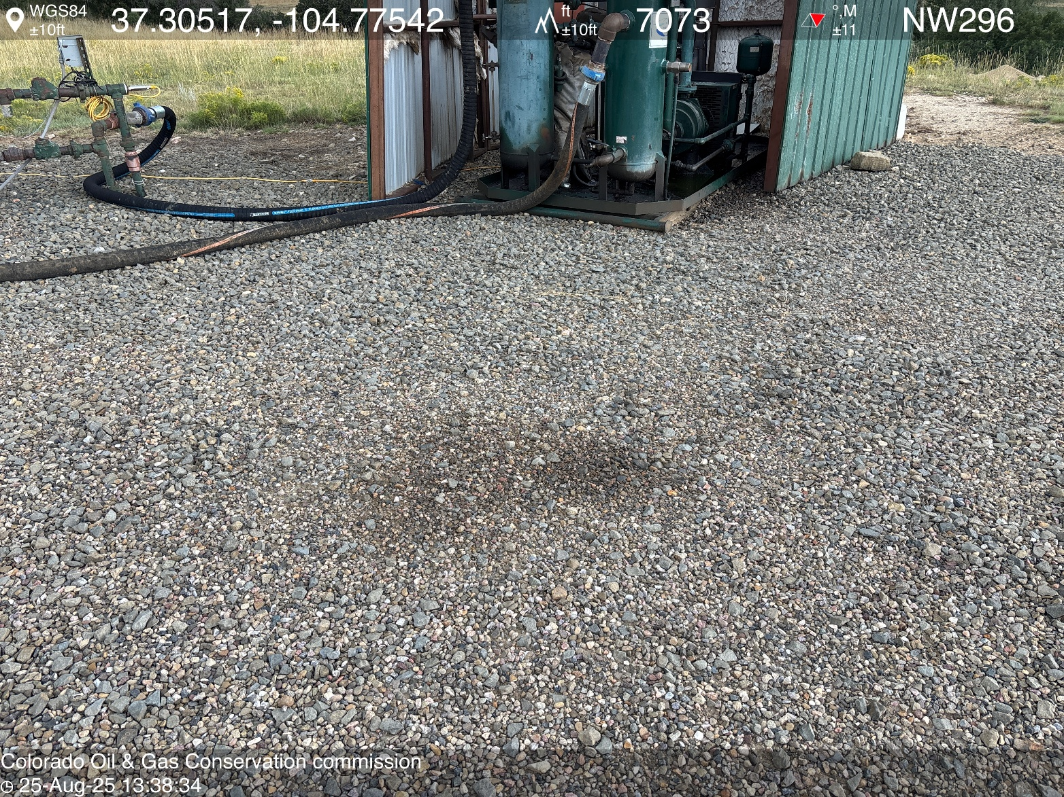
PHOTO 5: AREA OF IMPACTED SOIL NEAR COMPRESSOR SKID. Conduct maintenance on equipment, cleanup stained material and review self inspection processes. COMPLY WITH RULE 1002,.(2).D. CA DATE 9-25-2025.

Slide 6
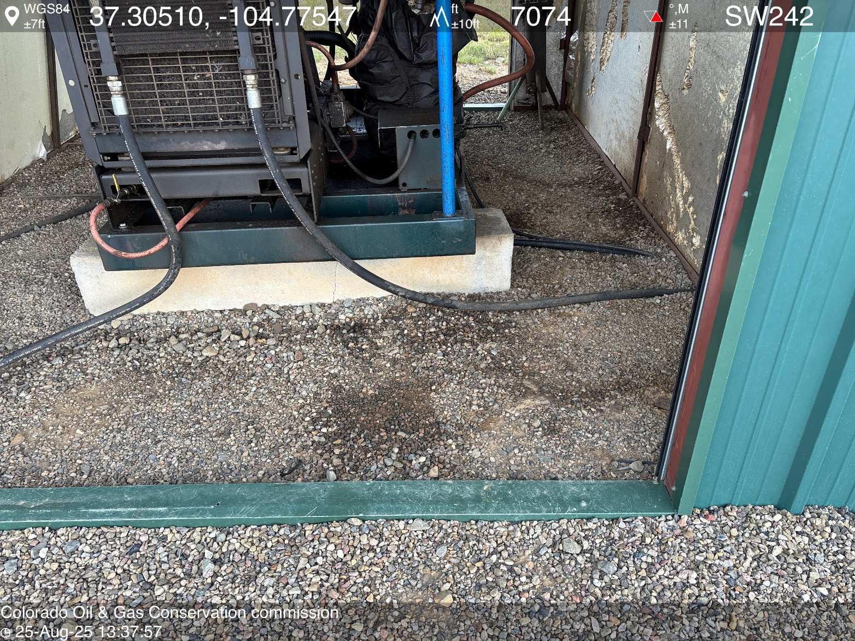
PHOTO 6: AREA OF IMPACTED SOIL NEAR PRIME MOVER ENGINE SKID. Conduct maintenance on equipment, cleanup stained material and review self inspection processes. COMPLY WITH RULE 1002,.(2).D. CA DATE 9-25-2025.

Slide 7
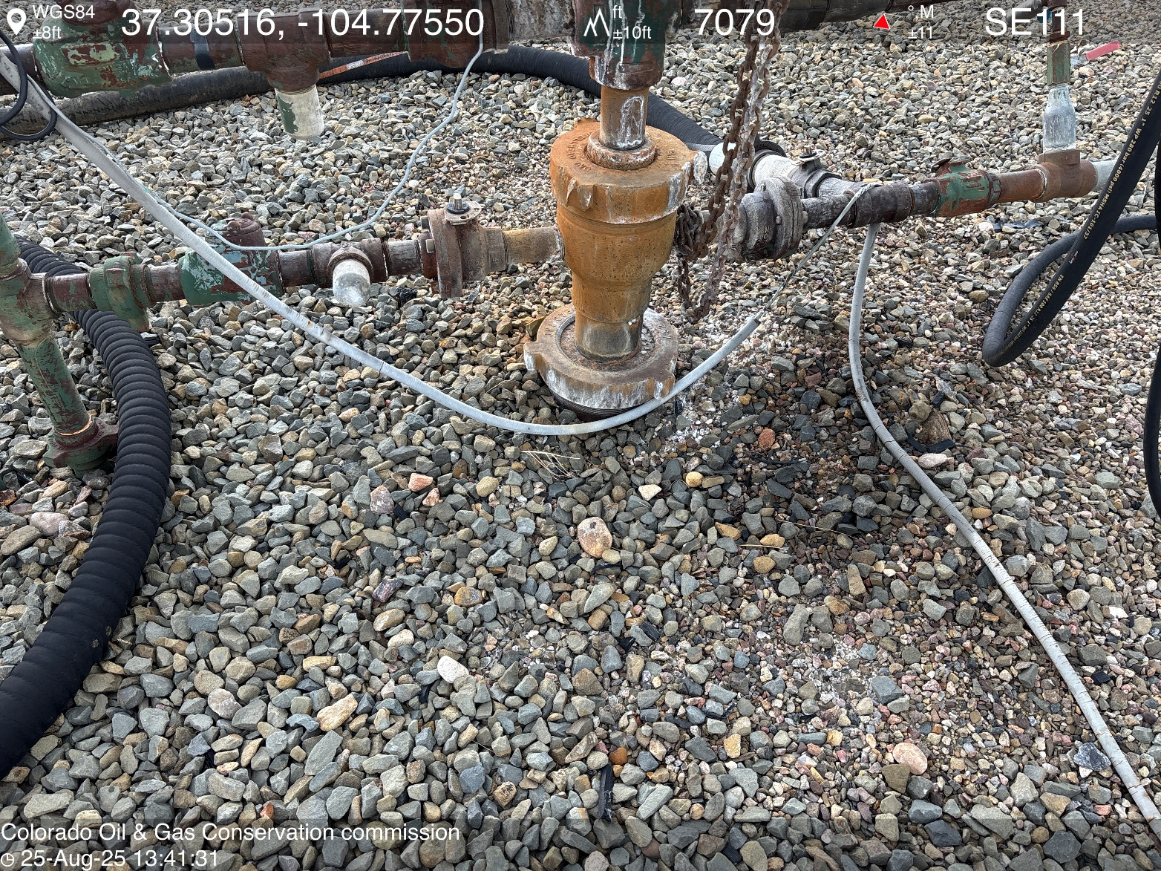
PHOTO 7: AREA OF IMPACTED SOIL NEAR WELLHEAD. Conduct maintenance on equipment, cleanup stained material and review self inspection processes. COMPLY WITH RULE 1002,.(2).D. CA DATE 9-25-2025.

Slide 8
PHOTO 8: Bradenhead inaccessible. Install appropriate fittings to allow bradenhead visual inspection as per Rule 419.a.(1), (2) THIS IS THE SECOND NOTICE FOR THIS CORRECTIVE ACTION, IMMEDIATE ACTION IS REQUIRED.

Slide 9
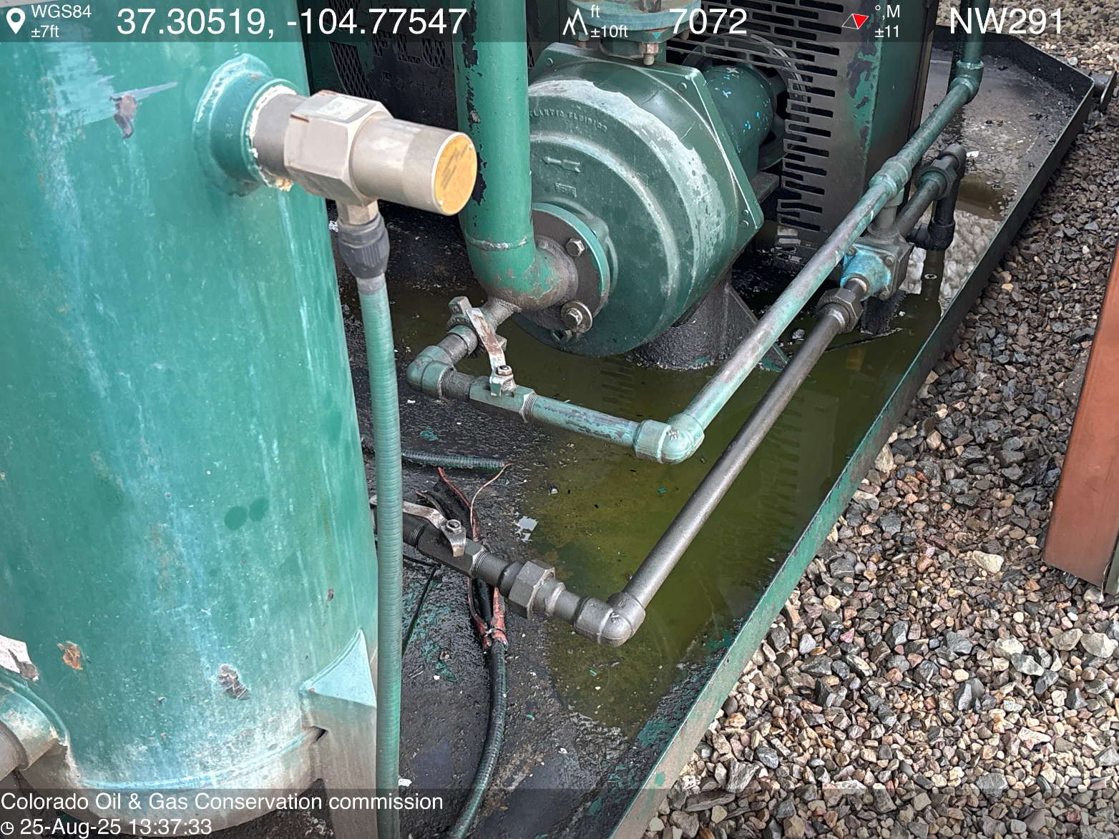
PHOTO 9: APPEARS TO BE ANTIFREEZE AND OILY WASTE IN COMPRESSOR SKID. DRAIN OILY WASTE REPAIR ALL LEAKS AND REMOVE IMPACTED SOIL PER RULE 1002..(2).D & 1002.f.(2)B, Comply with general provisions of the oil and gas act for wildlife protection AND SB-181. THIS IS THE SECOND NOTICE FOR THIS CORRECTIVE ACTION, IMMEDIATE ACTION IS REQUIRED.

