Slide 1
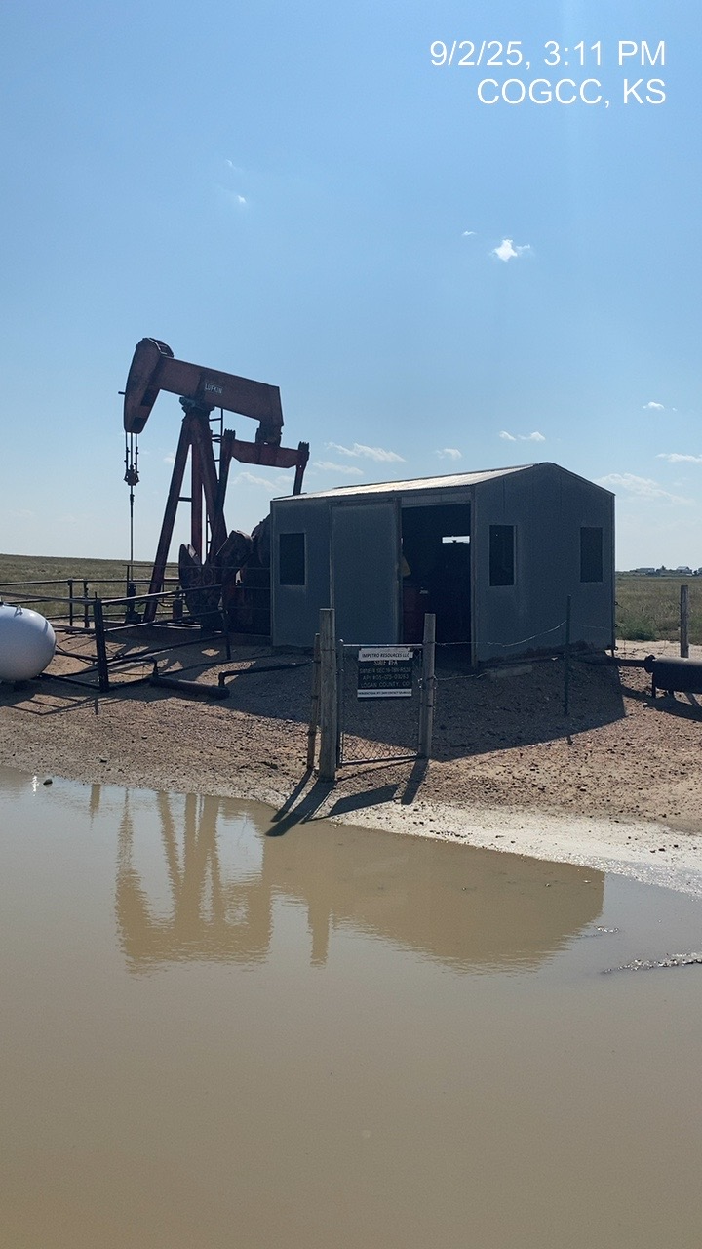
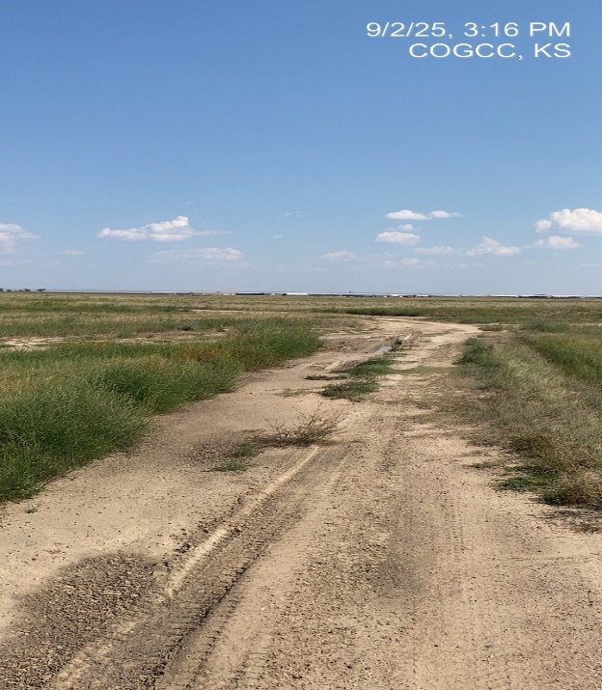
IMPETRO RESOURCES LLC # 10690
STATE 1-A 075-09283
SIGNAGE-PJ-PM
LEASE ROAD

