Slide 1
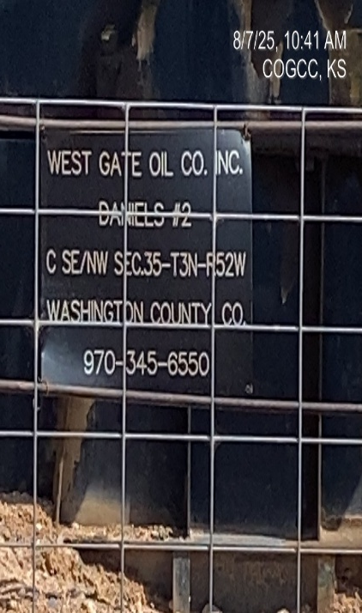
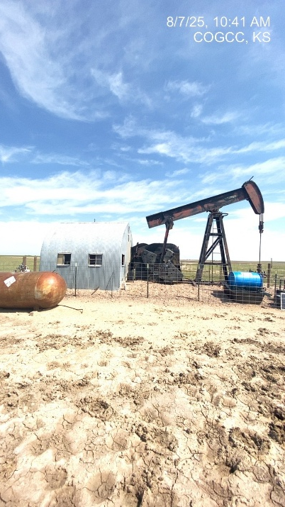
WESTGATE OIL CO. #95800
DANIELS 2 121-08606
SIGNAGE
PJ

