Slide 1
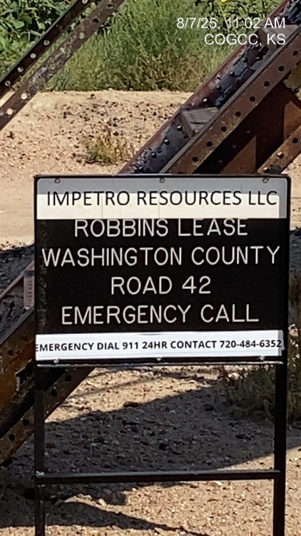
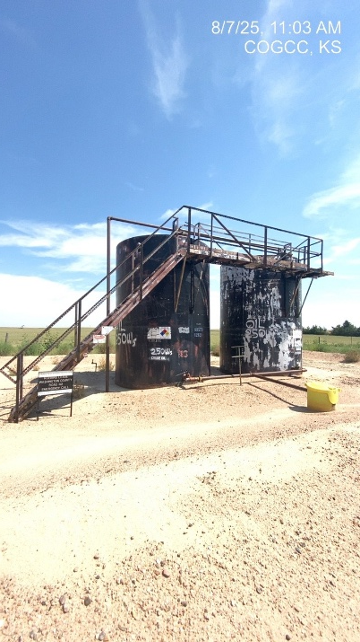
IMPETRO RESOURCES LLC # 10690
ROBBINS A-1 121-08221
SIGNAGE
BATTERY

