Slide 1
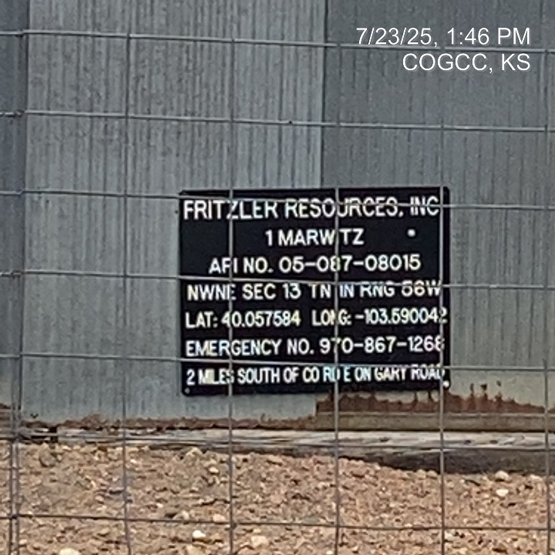
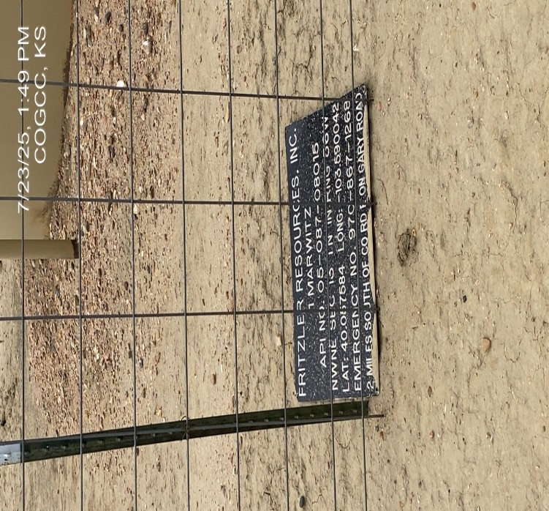
FRITZLER RESOURCES INC 31257
MARWITZ 1 087-08015
SIGN AT WH
SIGN AT BATTERY

Slide 2
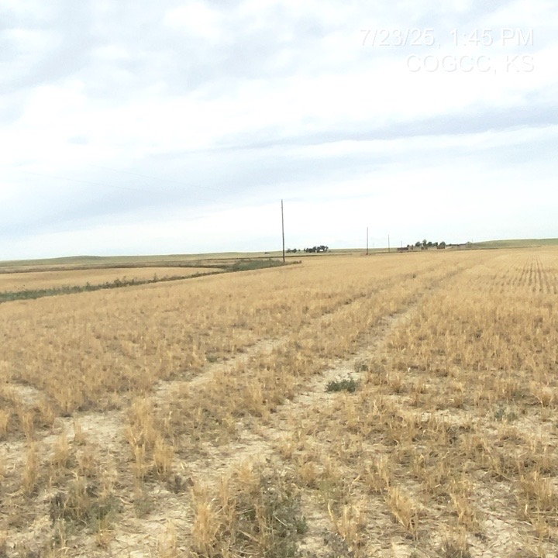
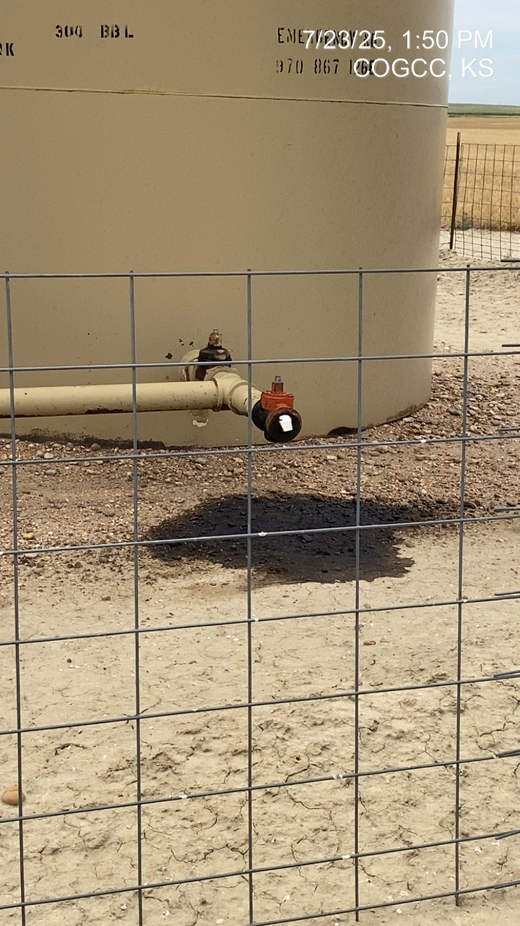
FRITZLER RESOURCES
MARWITZ 1 087-08015
LEASE ROAD THRU WHEAT CROP
SPILL AT LOAD OUT

Slide 3
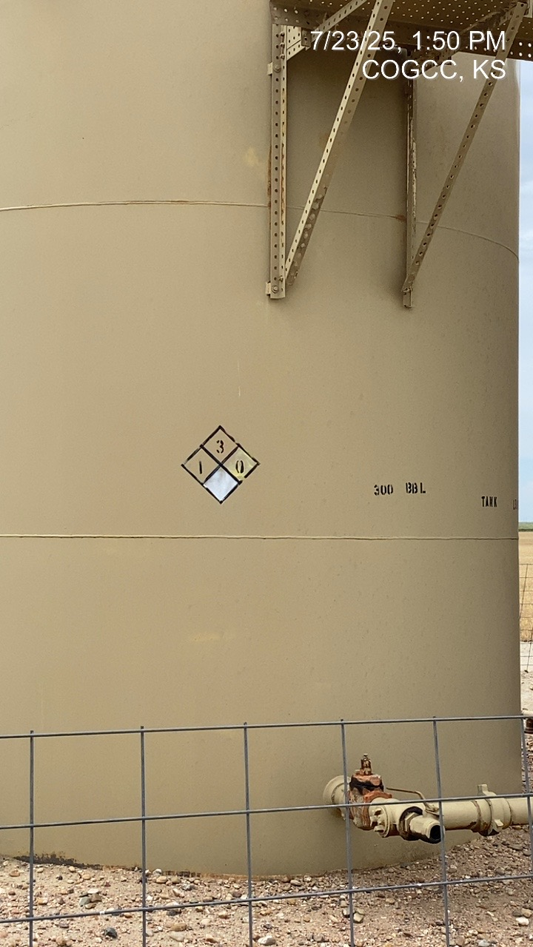
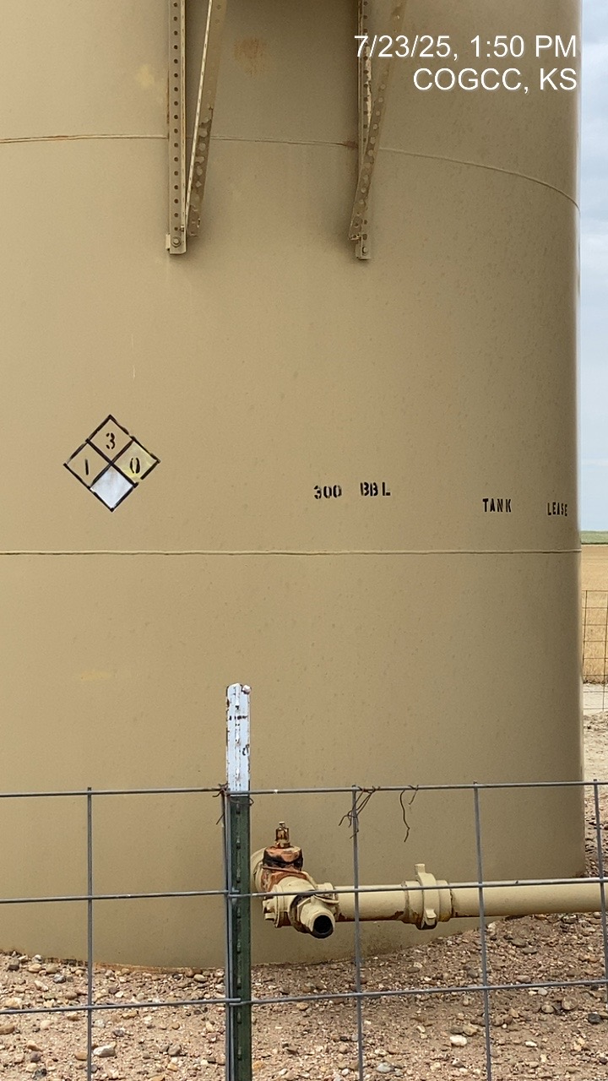
FRITZLER RESOURCES
MARWITZ 1 087-08015
TANK PLACARDING
TANK PLACARDING - 2

Slide 4
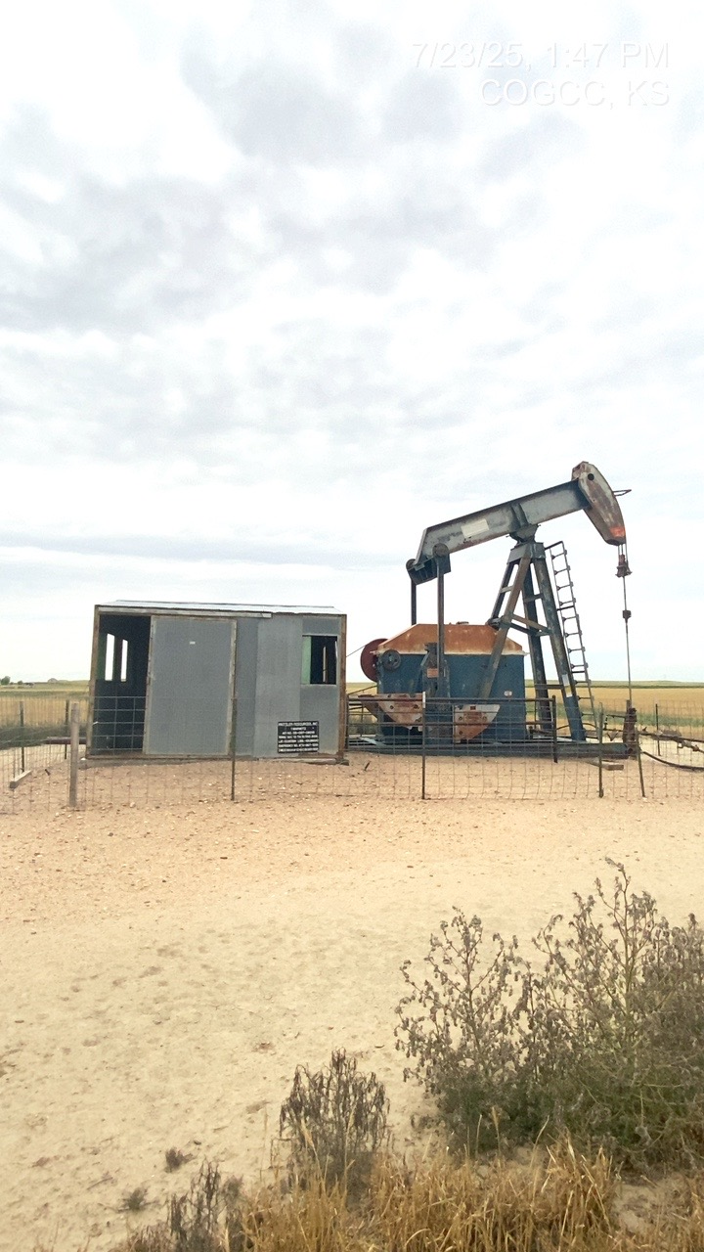
FRITZLER RESOURCES
MARWITZ 1 087-08015
PJ

