Slide 1
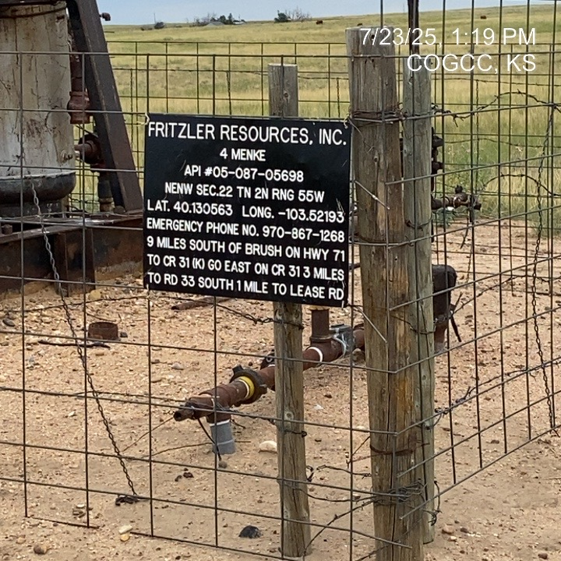
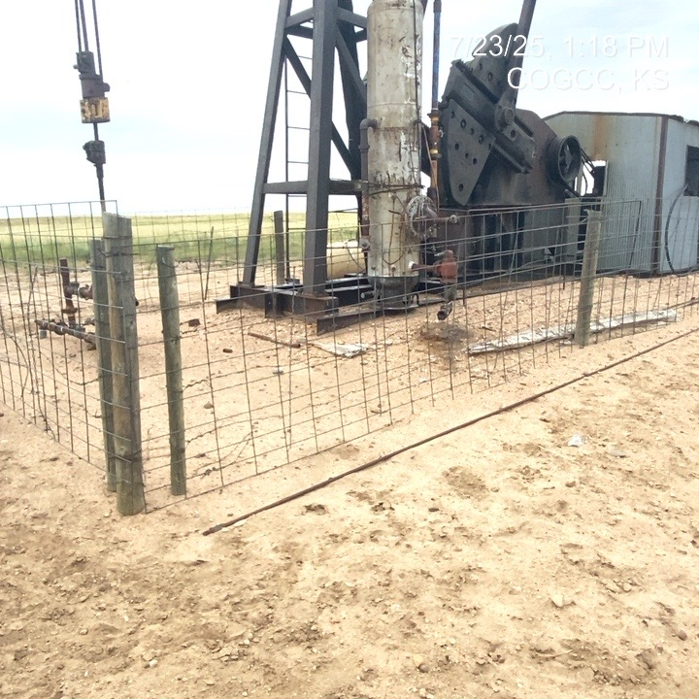
FRITZLER RESOURCES INC. 31257
MENKE 4 087-05698
SIGN AT WELLHEAD
UNUSED EQUIPMENT (ROD) LAYING ON GROUND - REMOVE

Slide 2
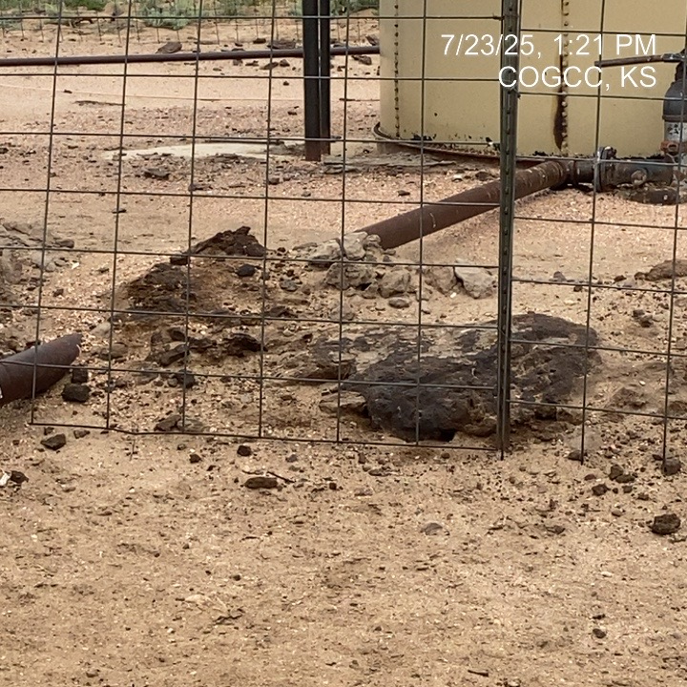
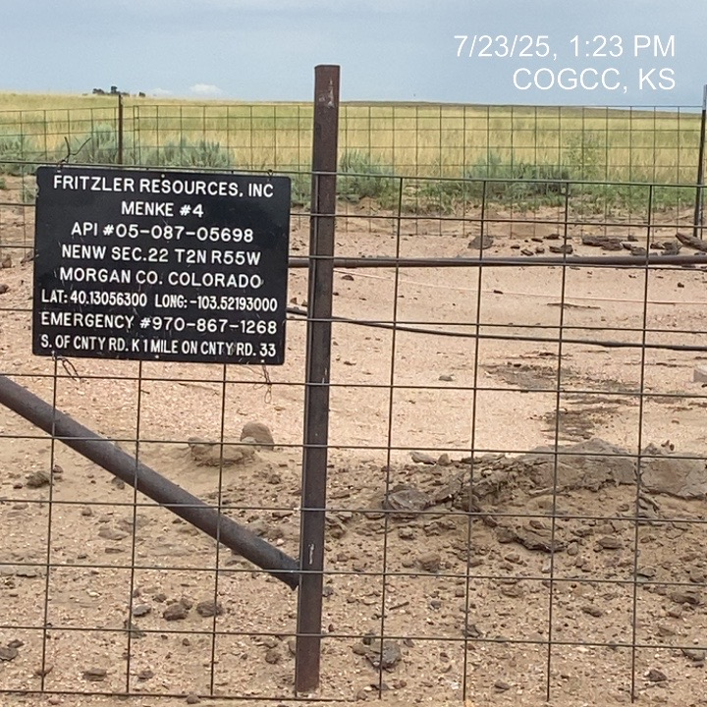
FRITZLER RESOURCES INC. 31257
MENKE 4 O87-05698
SATURATED SOIL BATTERY BERM (PREVIOUS UN-REMEDIATED SPILL/ TANK BOTTOMS)
SATURATED SOIL IN/ON BATTERY BERM BERM – PREVIOUS UN-REMEDIATED SPILL / TANK BOTTOMS INCORPORATED IN SOIL

Slide 3
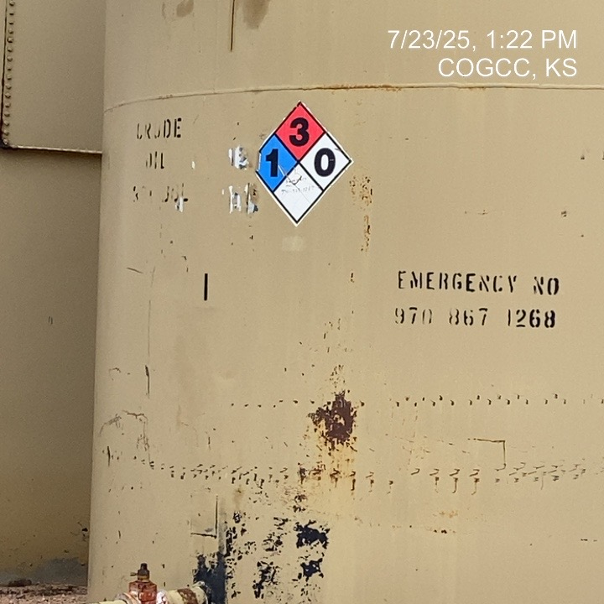
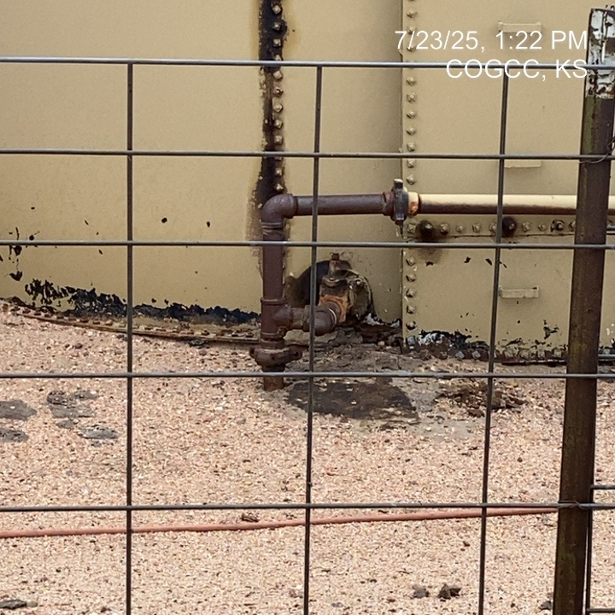
FRITZLER RESOURCES INC.
MENKE 4 087-05698
TANK PLACARDING
OIL SATURATED SOILS AT LOADOUT

Slide 4
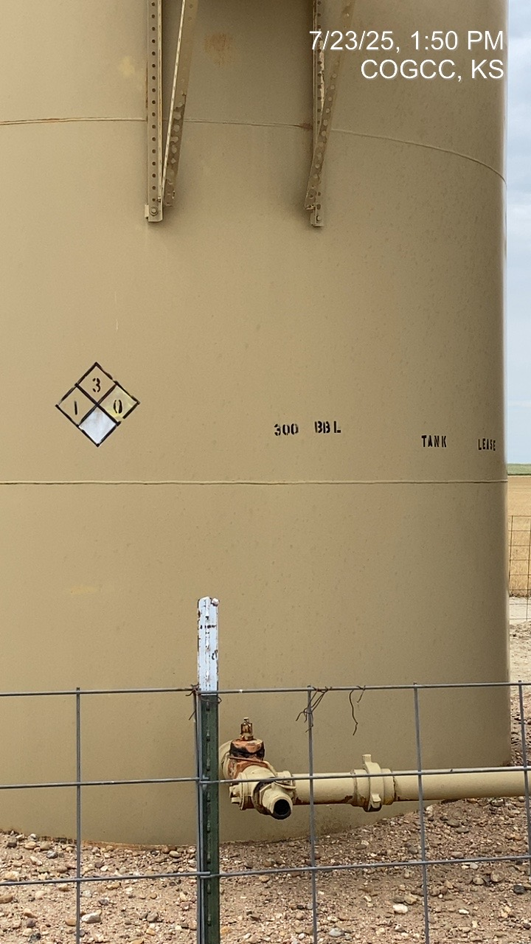
FRITZLER RESOURCES INC.
MENKE 4 - 087-05698
TANK PLACARDING

