Slide 1
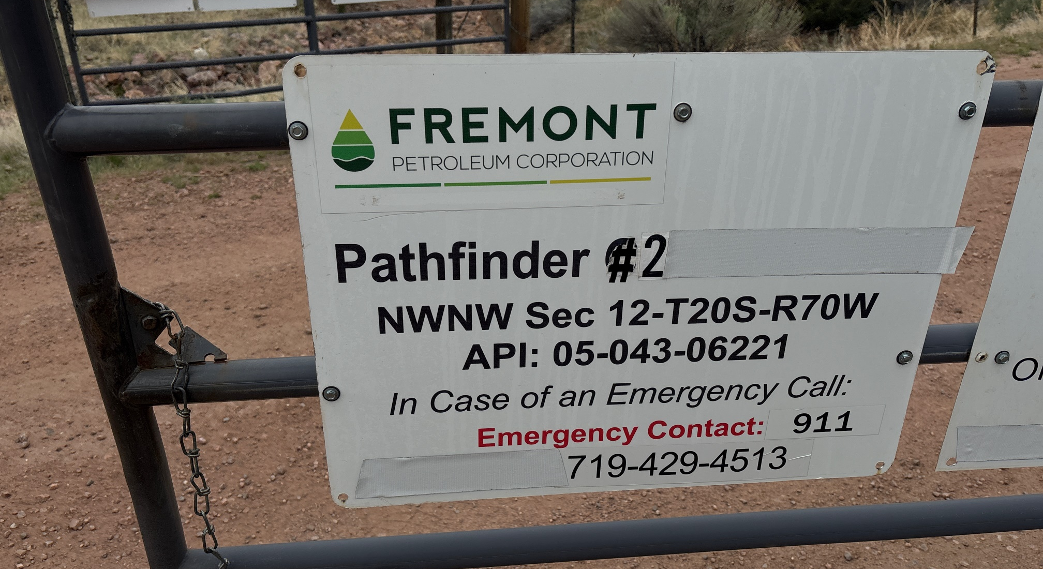
WELL NAME: PATHFINDER 2, API #: 043-06221, INSP. # 716300932
PHOTO 1: WELL SIGN

Slide 2
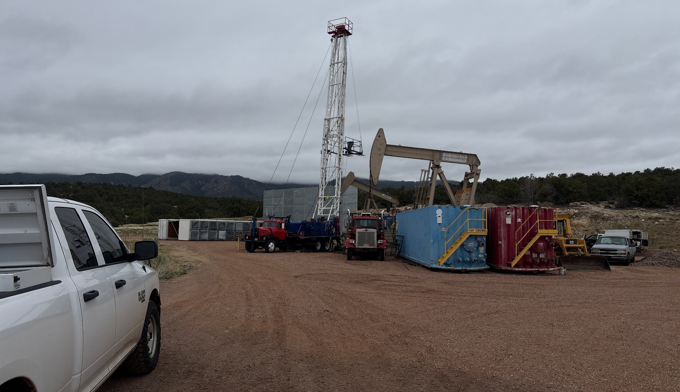
PHOTO 2: LOCATION.

Slide 3
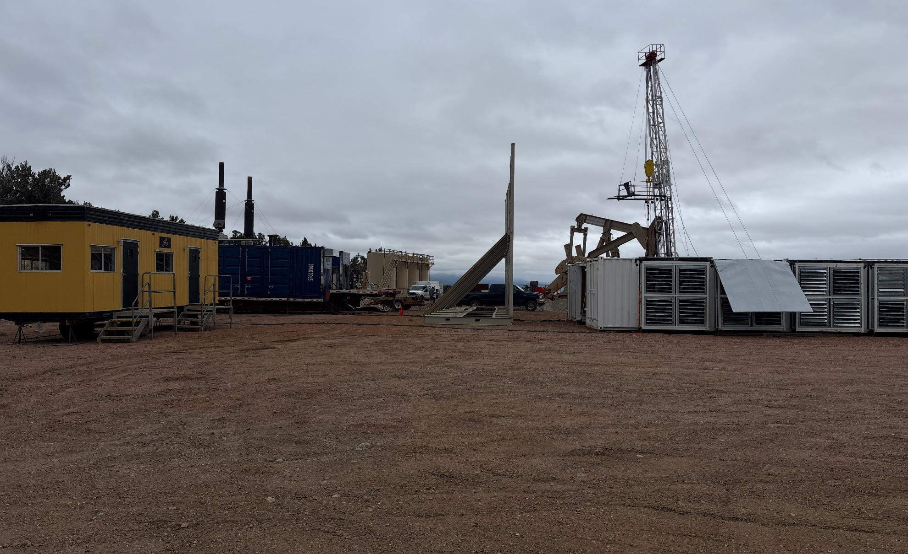
PHOTO 3: BIT COIN MINER CONEX’S, SOUND WALLS OFFICE AND GENERATORS.

Slide 4
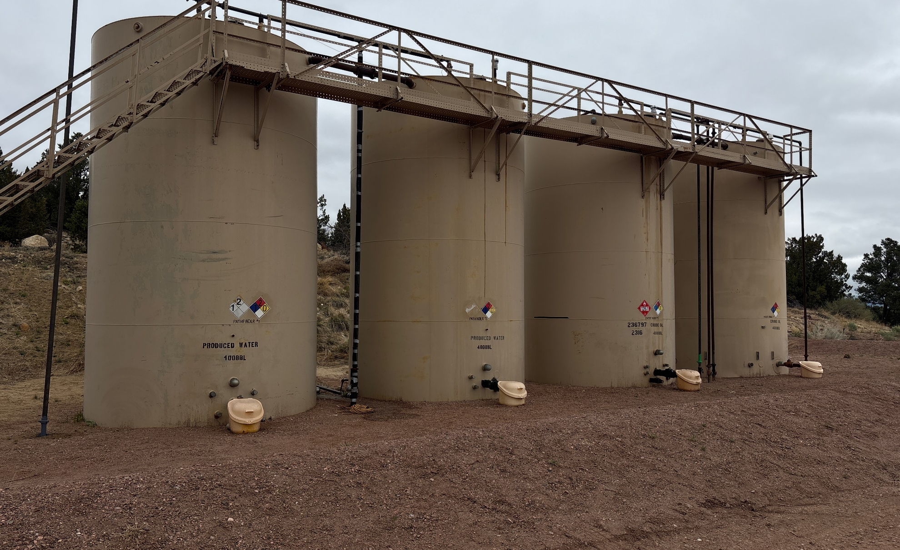
PHOTO 4: TANK BATTERY.

Slide 5
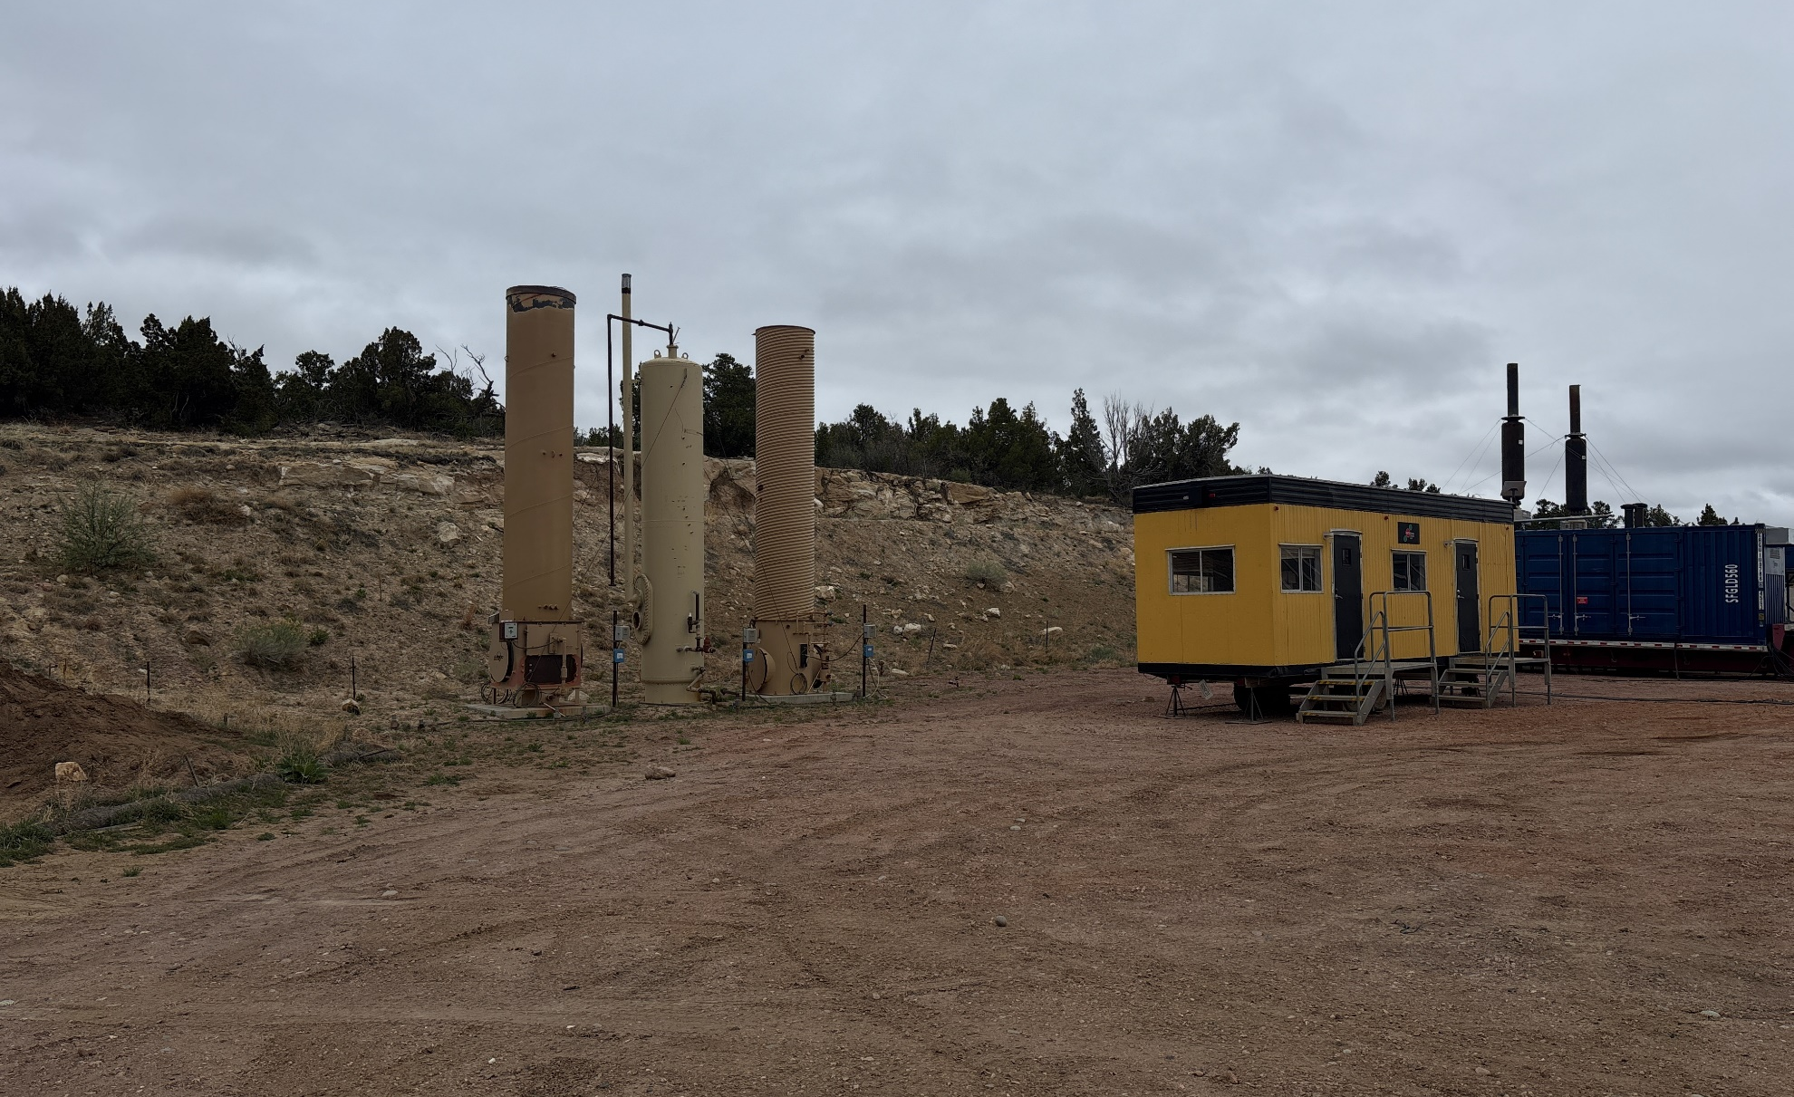
PHOTO 5: ECD’S.

