Slide 1

Inspection Photos
May 13, 2025
Operator: BMG Drilling - 7650
Location ID: 428734
Inspection Document #: 714002163
La Plata County, CO
Township: SENE 4 33N 10W N

Slide 2
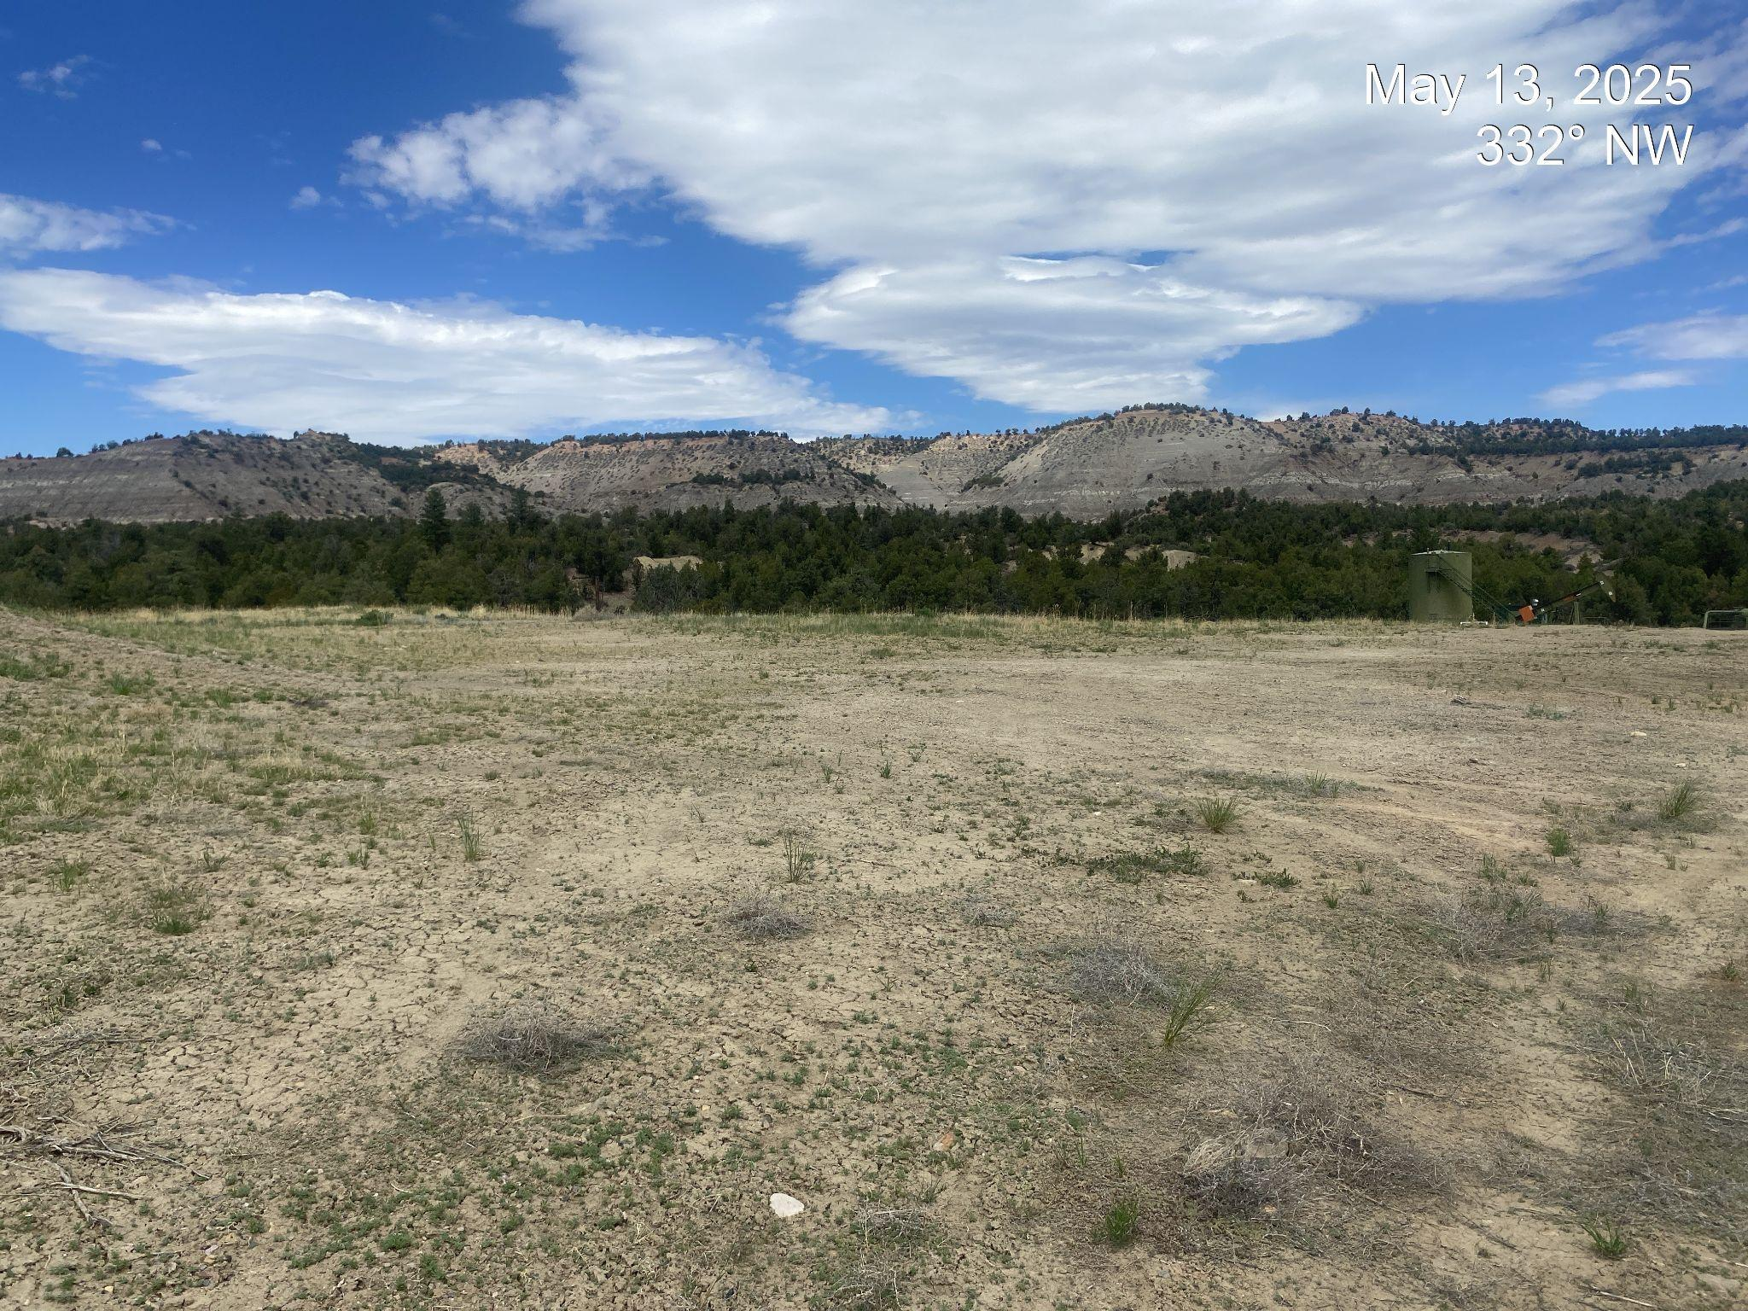
Inspection Photos
Location Name: Jacques 2
Location ID: 428734
Photo 1. View of project area taken from the southern edge facing center. Note: eastern portion of the pad remains with gravel and needs additional reclamation efforts.
API #: 067-06292

Slide 3
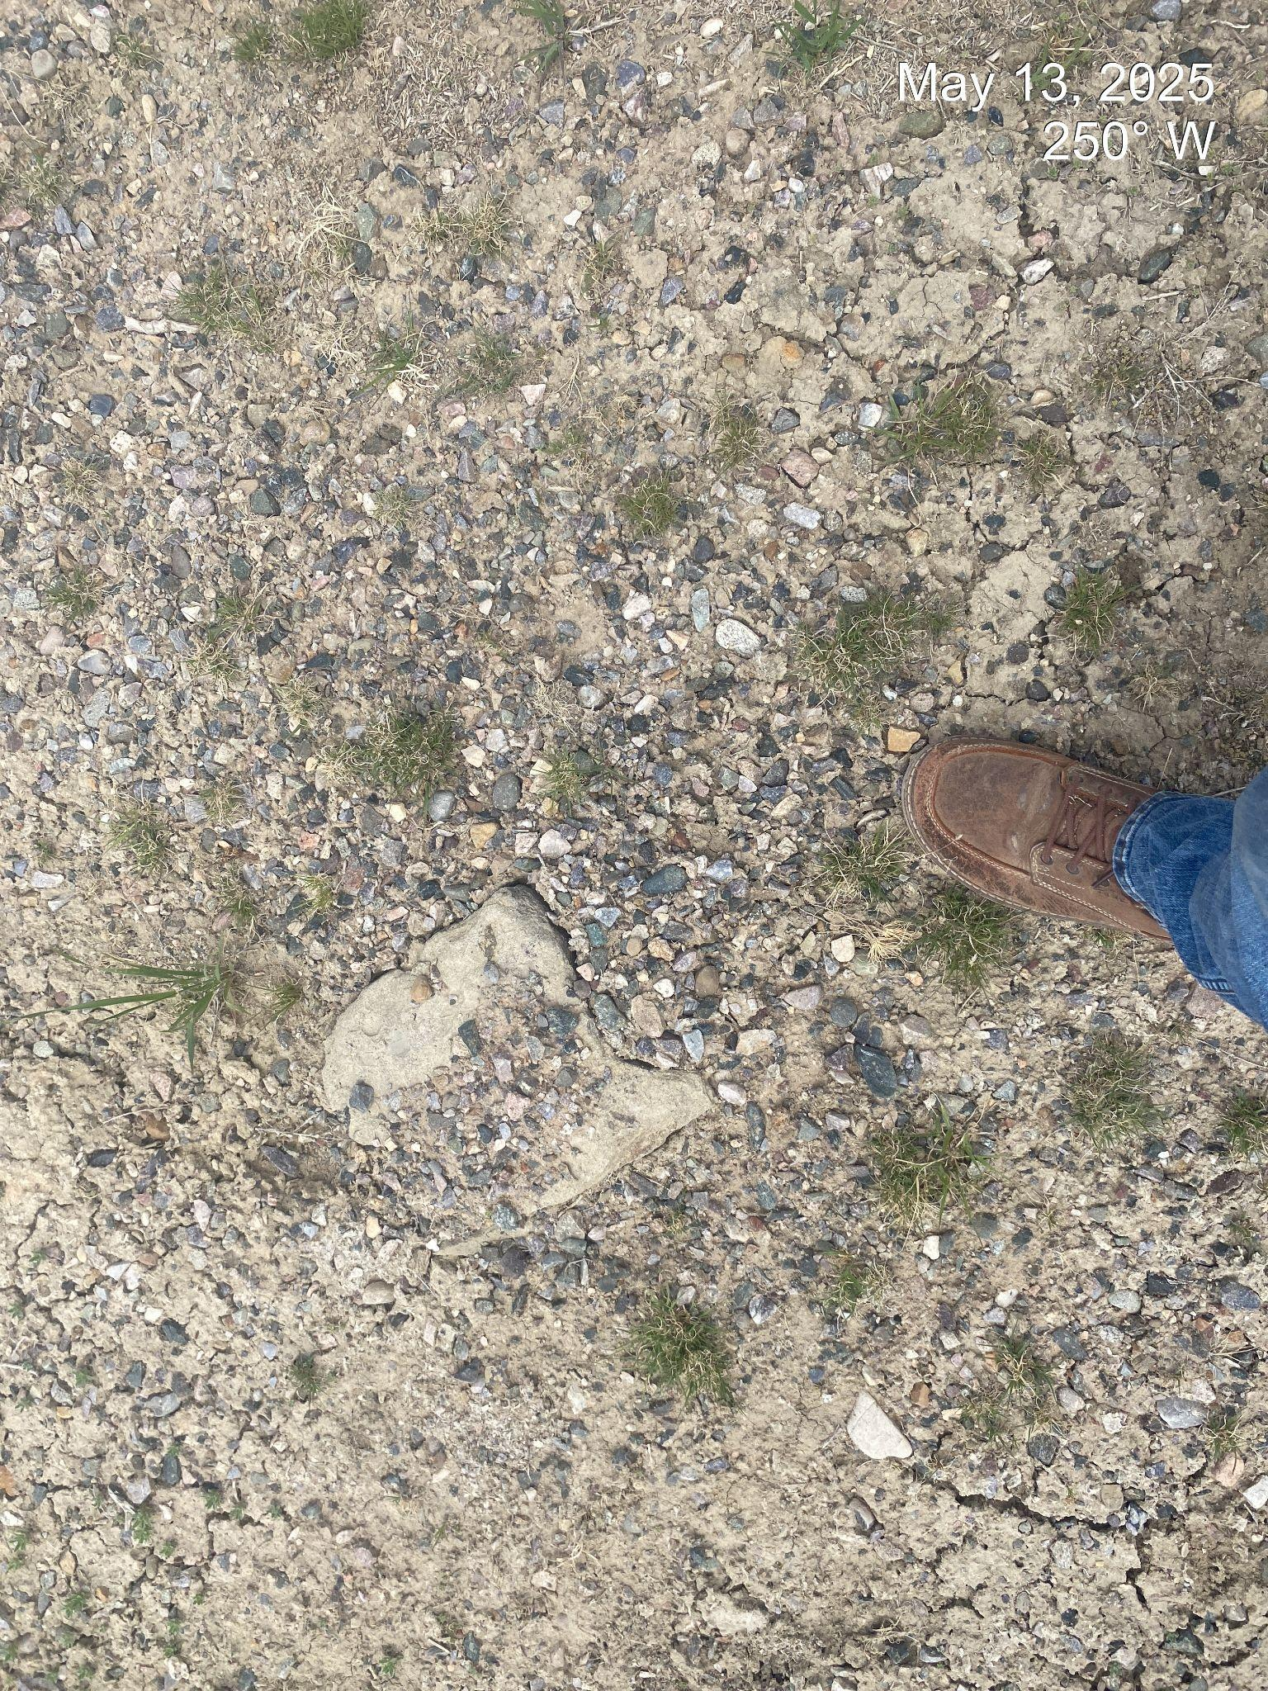
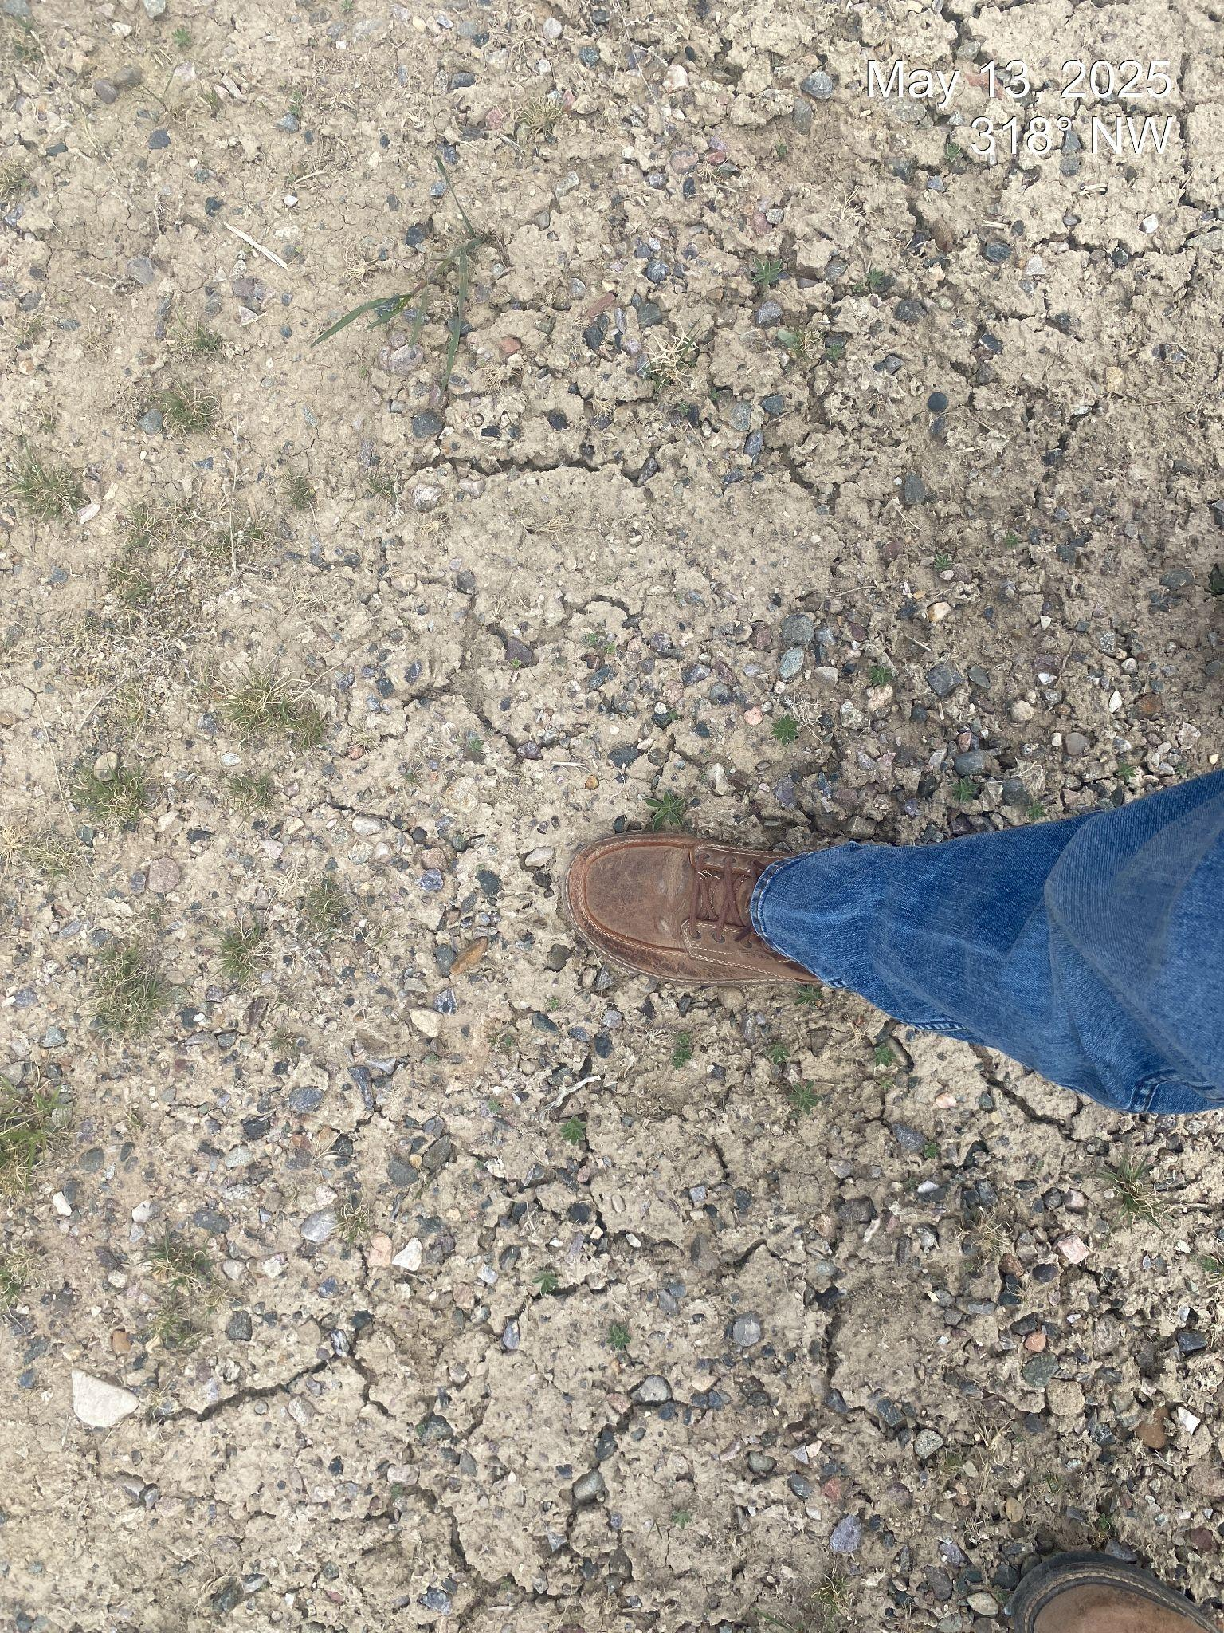
Inspection Photos
Location Name: Jacques 2
Location ID: 428734
Photo 2. Remnant gravel remains on the eastern edge of the disturbance.
API #: 067-06292

Slide 4
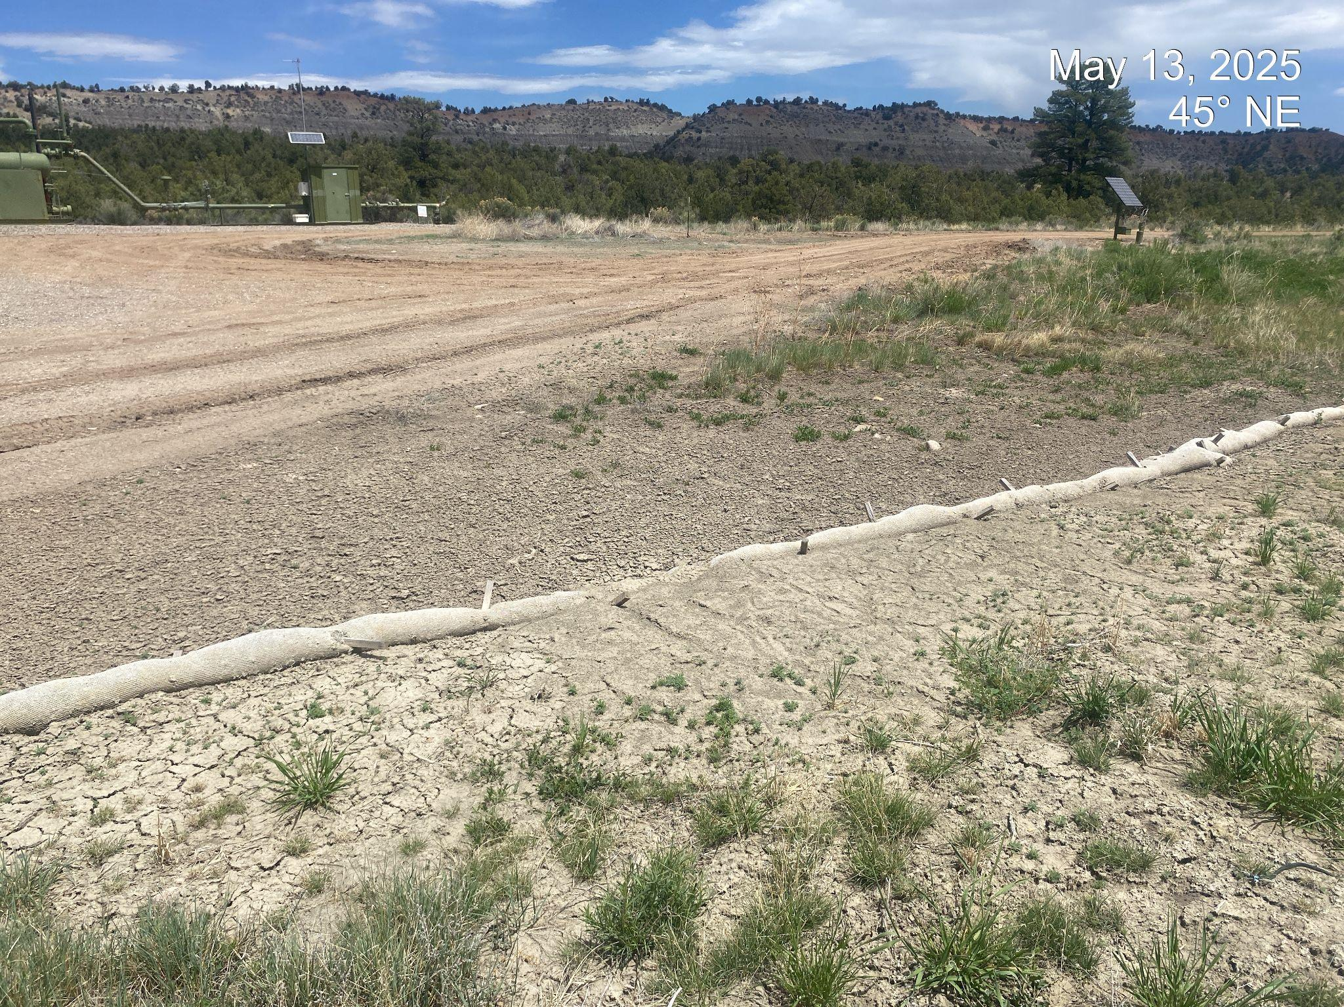
Inspection Photos
Location Name: Jacques 2
Location ID: 428734
Photo 3. Stormwater BMPs on the eastern portion of the project area are filled with sediment and require maintenance.
API #: 067-06292

Slide 5
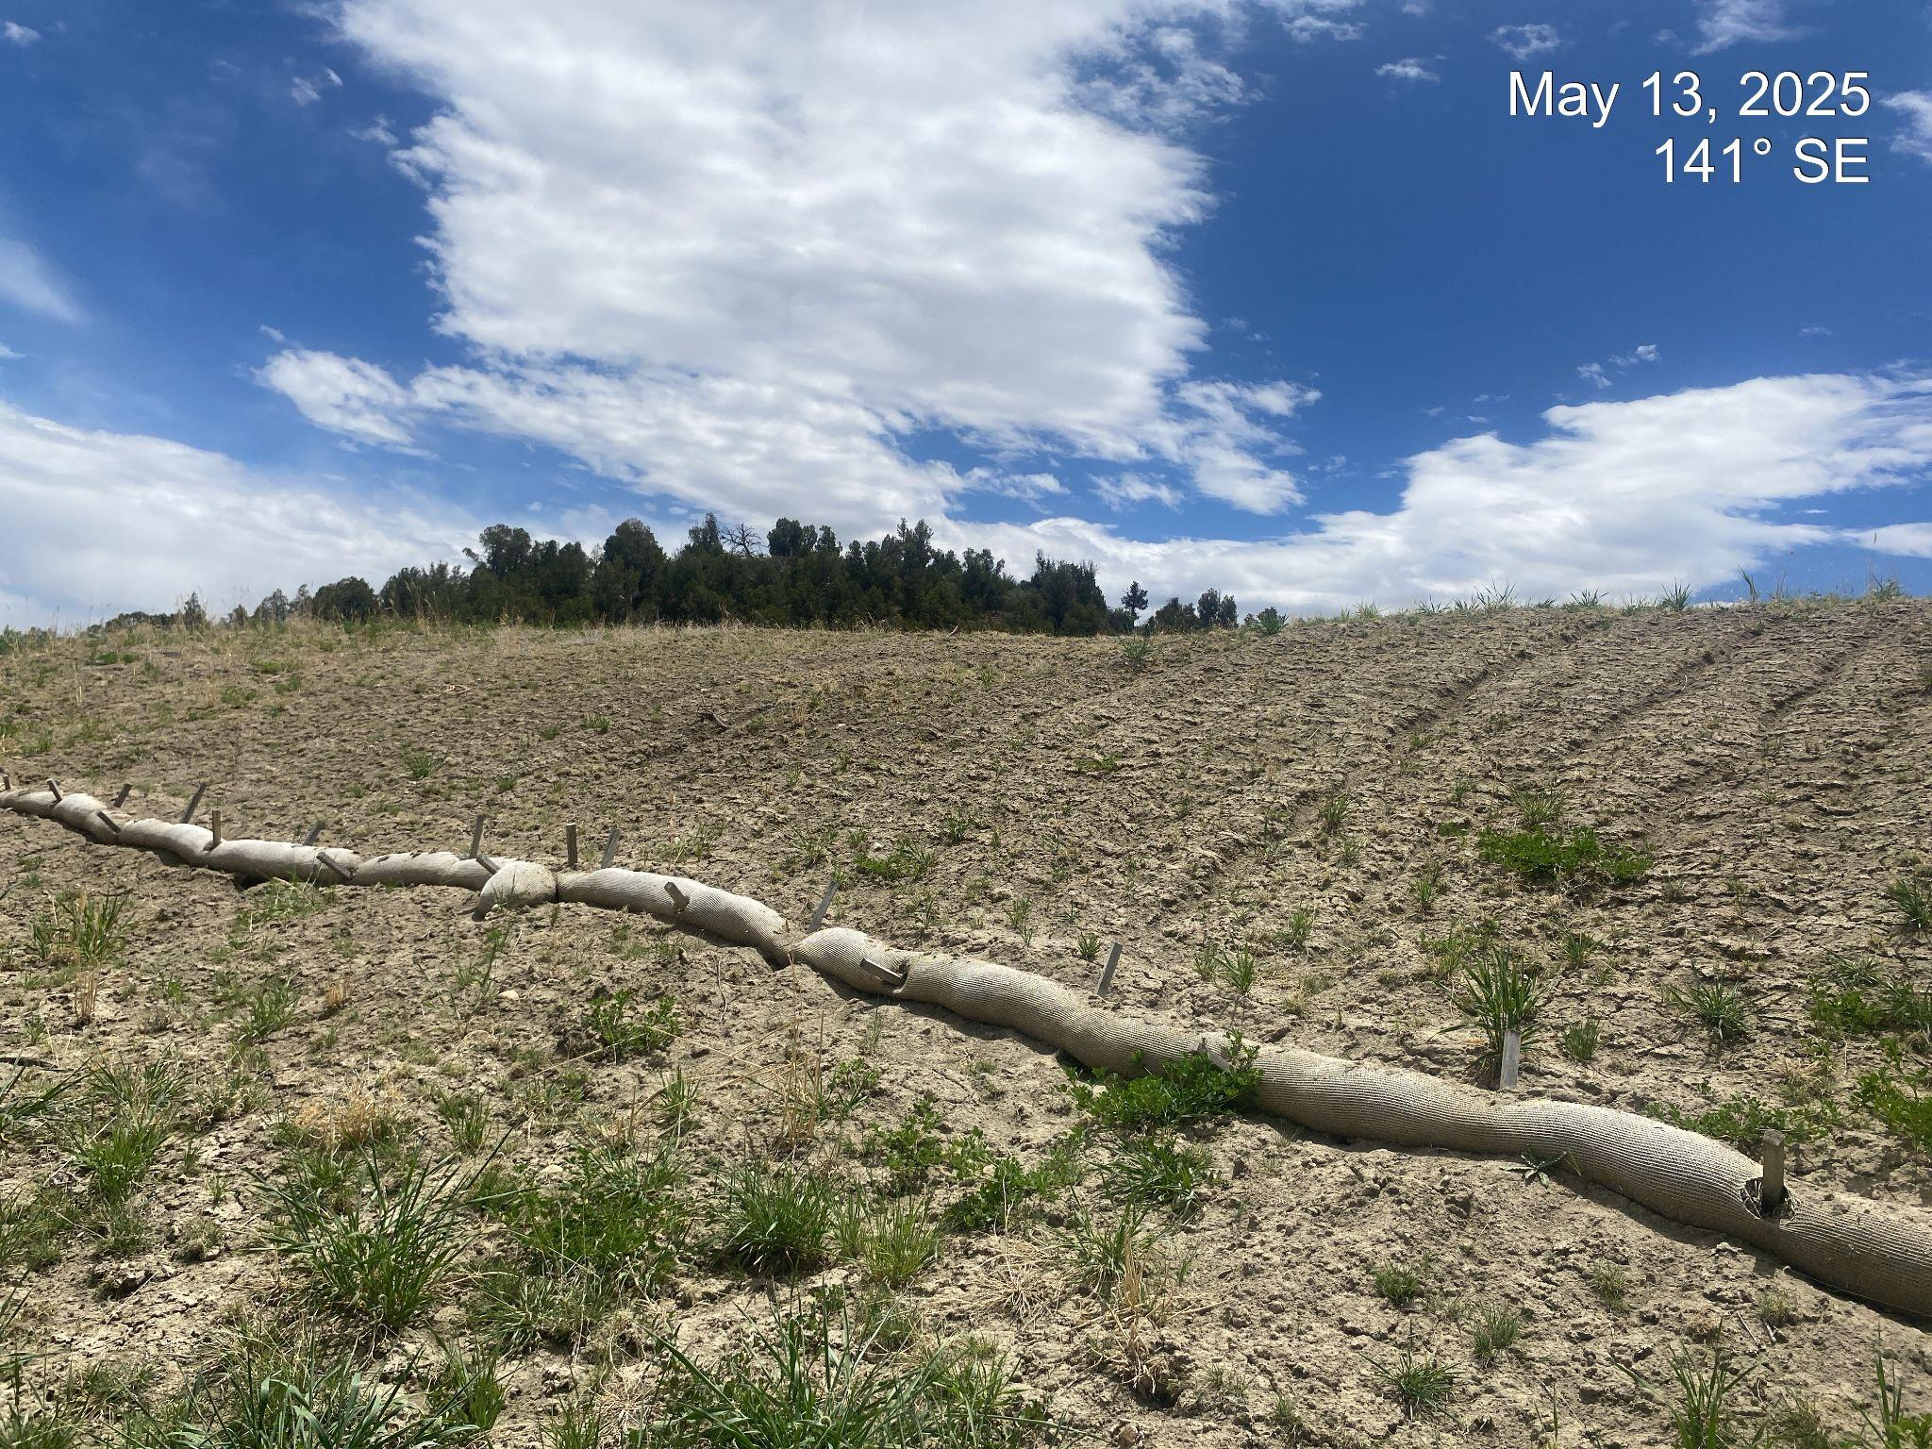
Inspection Photos
Location Name: Jacques 2
Location ID: 428734
Photo 4. View of project area fill slope. Additional stormwater BMPs are needed in this area and additional reclamation efforts may be needed.
API #: 067-06292

Slide 6
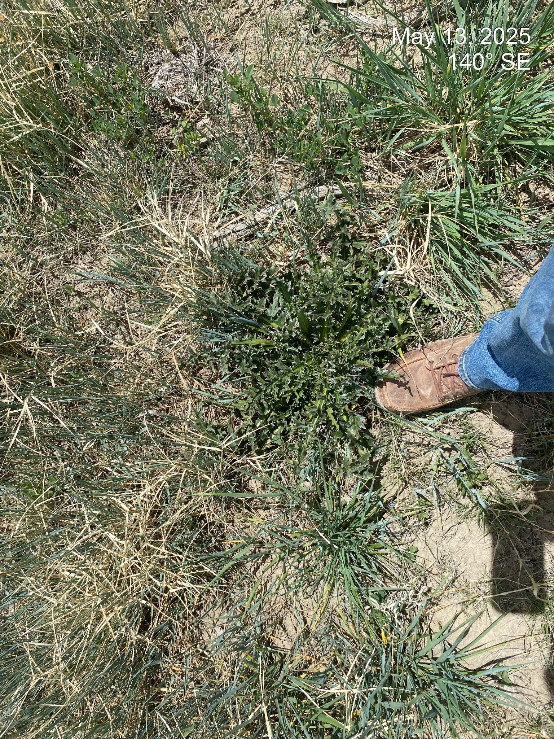
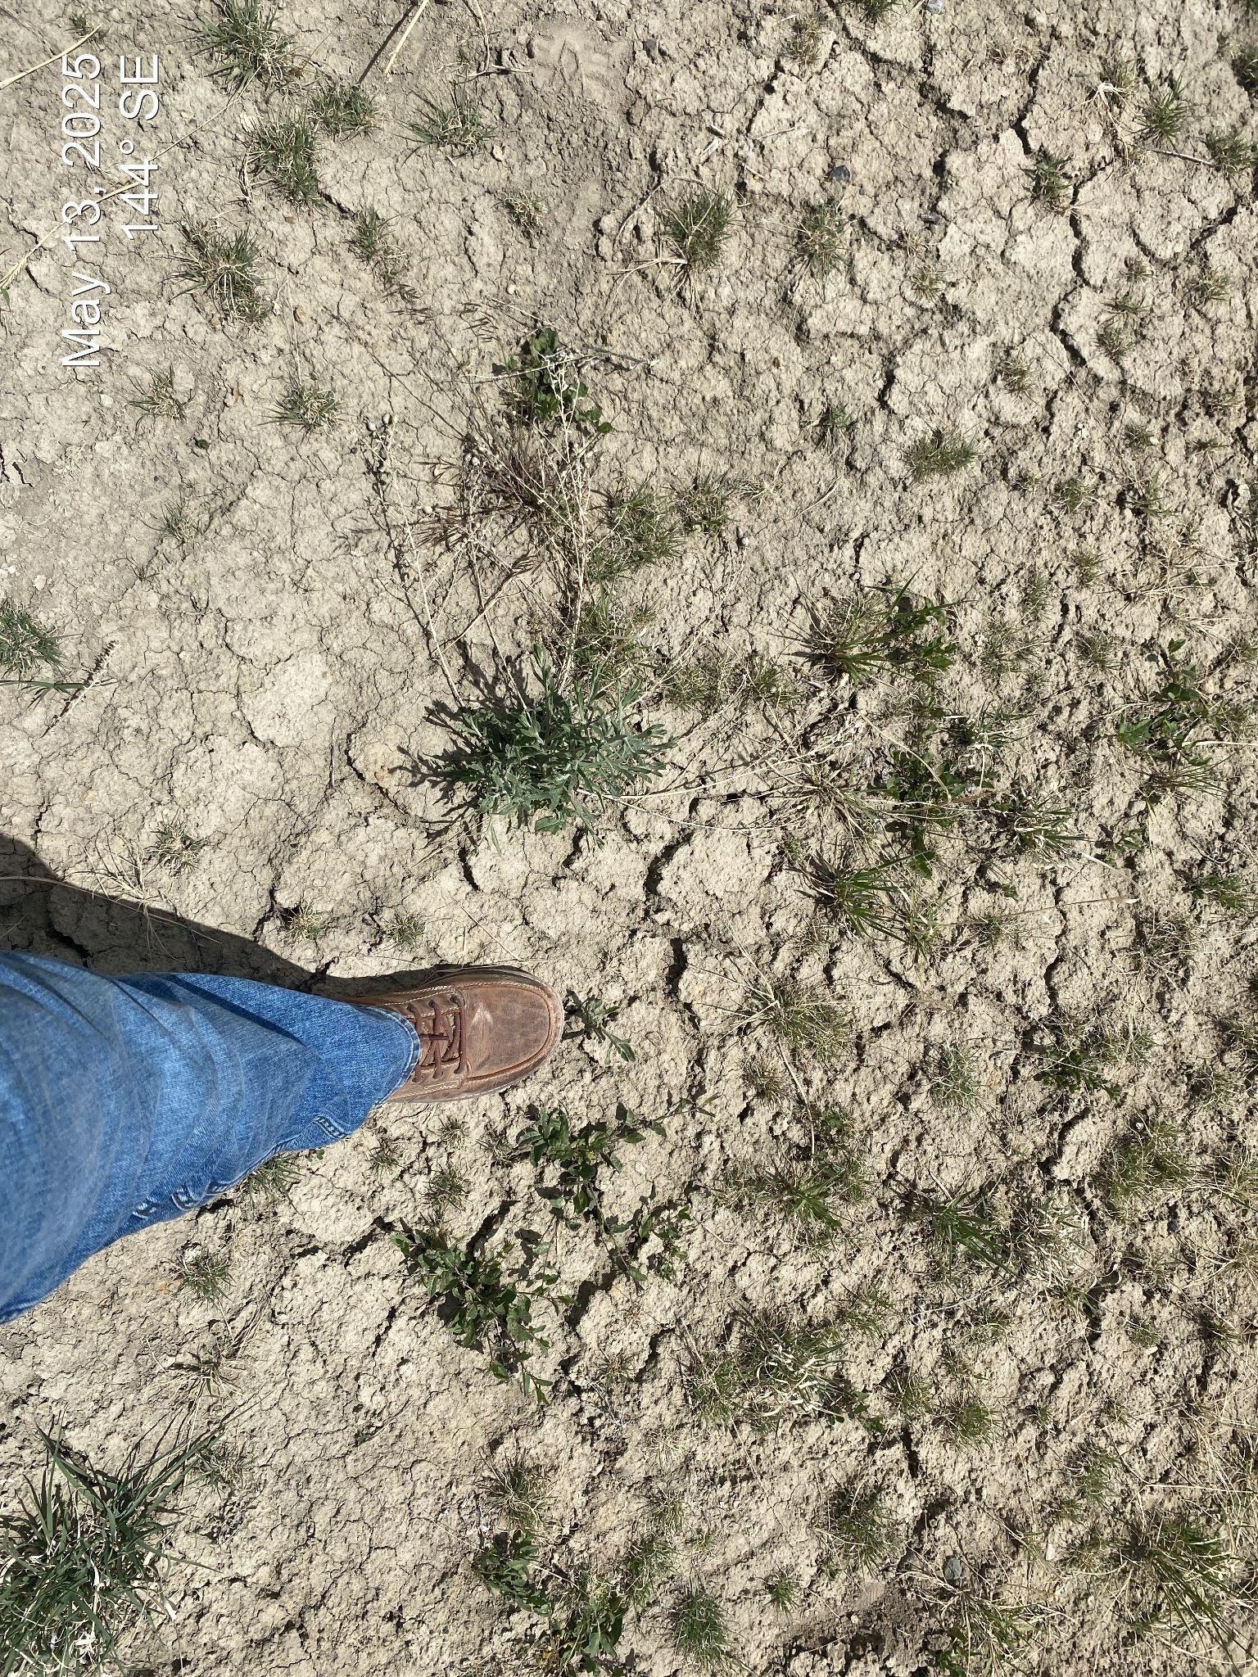
Inspection Photos
Location Name: Jacques 2
Location ID: 428734
Photo 5. Musk thistle, Russian Knapweed, Field Bindweed and Cheatgrass observed on the location.
API #: 067-06292

Slide 7
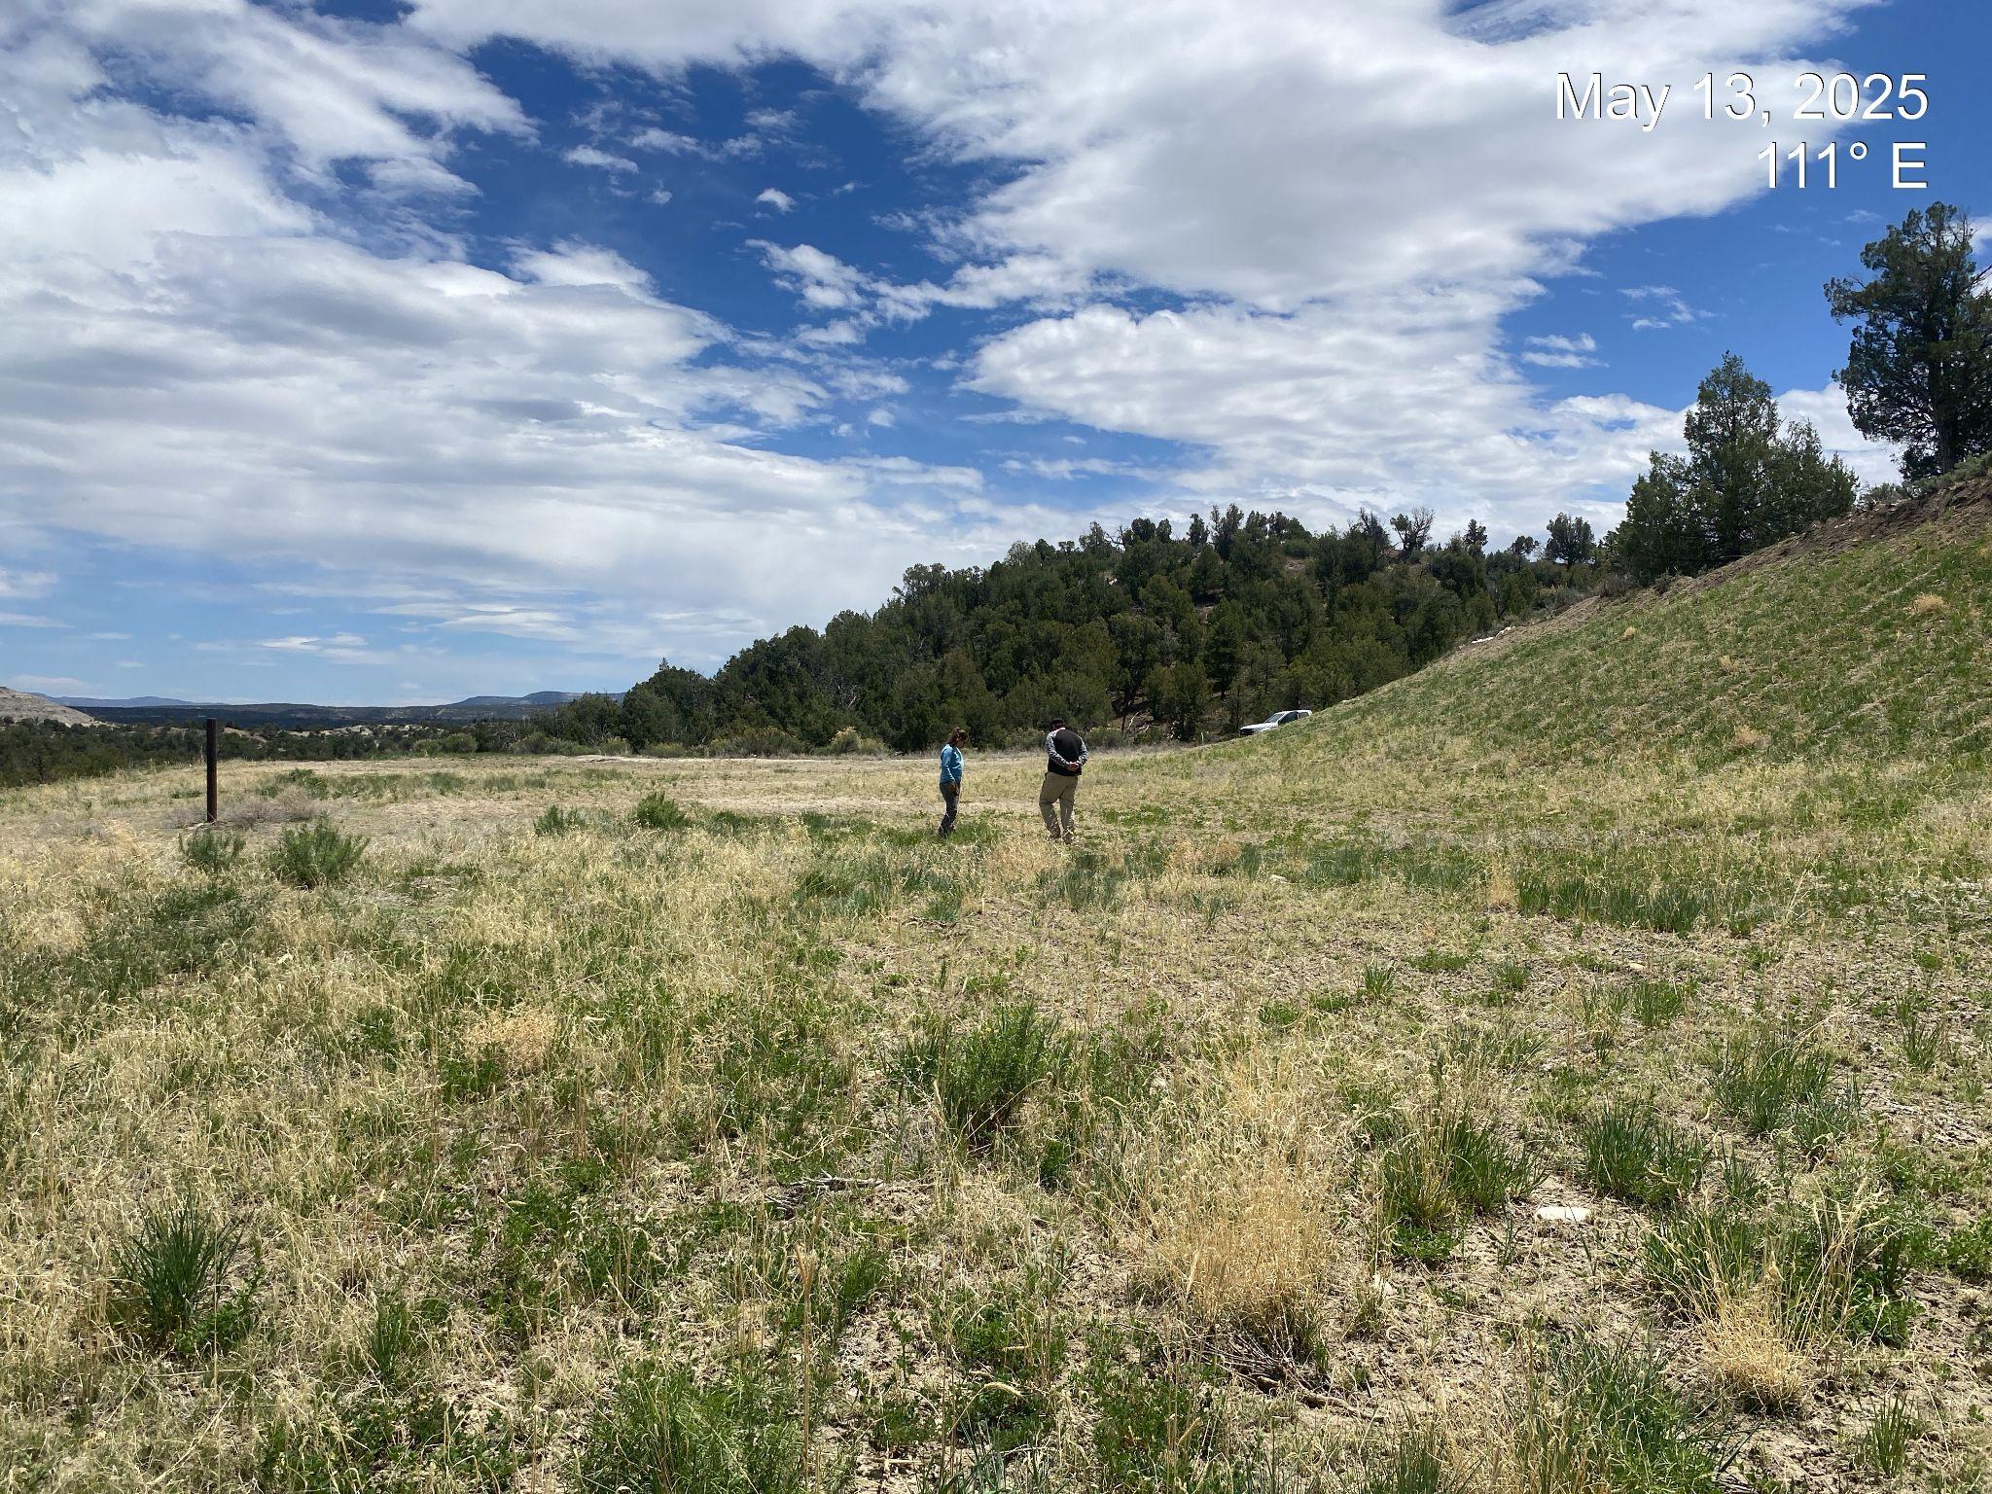
Inspection Photos
Location Name: Jacques 2
Location ID: 428734
Photo 6. View of western portion of project area and cut slope where vegetation appears to be progressing towards final reclamation standards.
API #: 067-06292

Slide 8
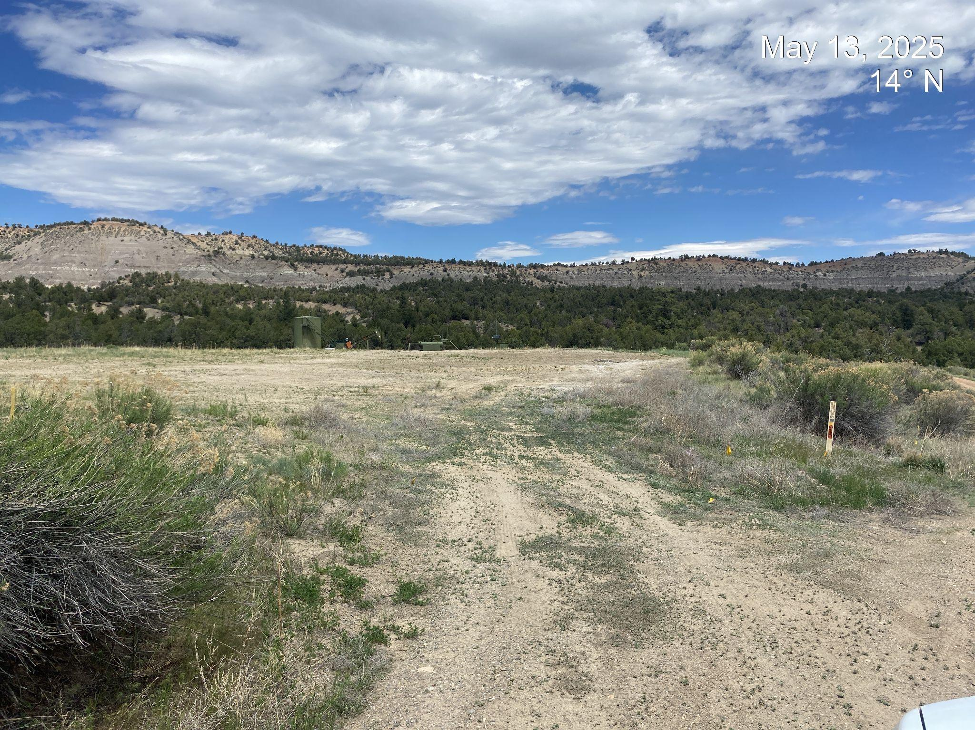
Inspection Photos
Location Name: Jacques 2
Location ID: 428734
Photo 7. View of access point which remains unreclaimed.
API #: 067-06292

