Slide 1
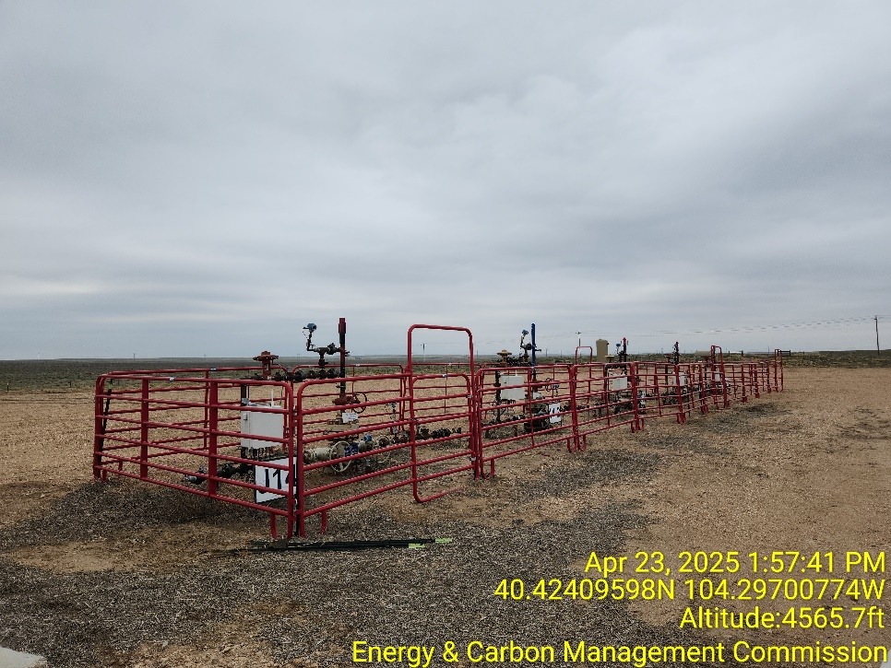
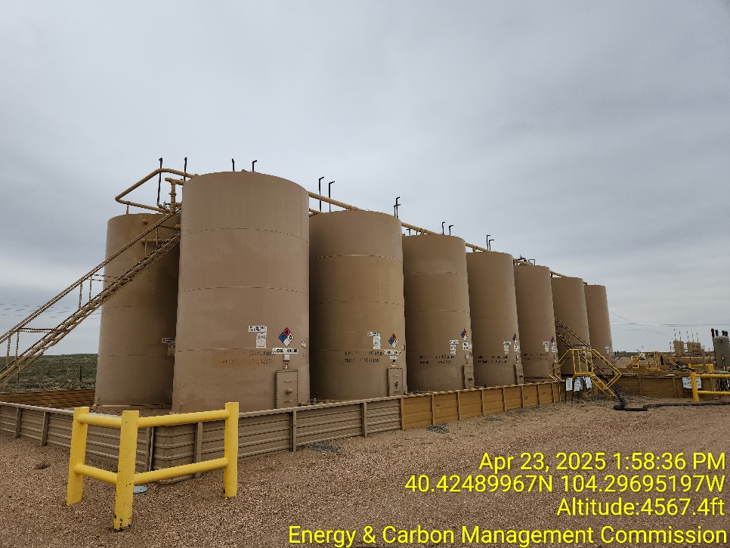
Inspection Photos
Location Name: State Antelope 14-2 PAD
Location ID: 435952
Photo 1 – West Wellheads
Photo 2 – Tank Battery

Slide 2
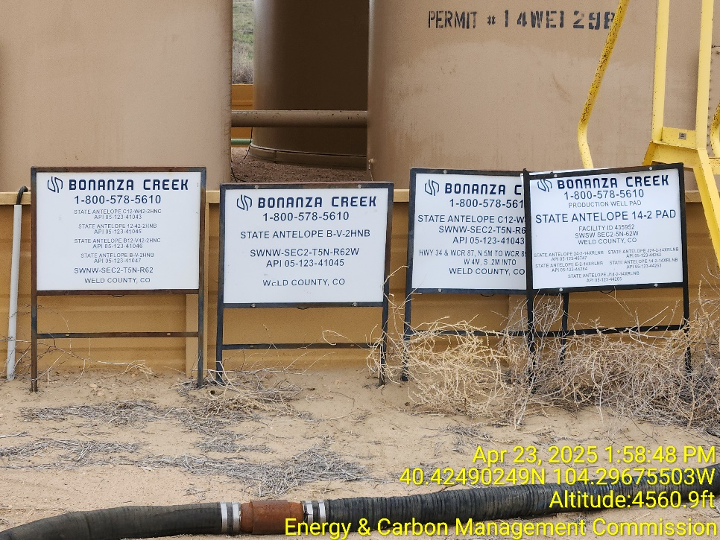
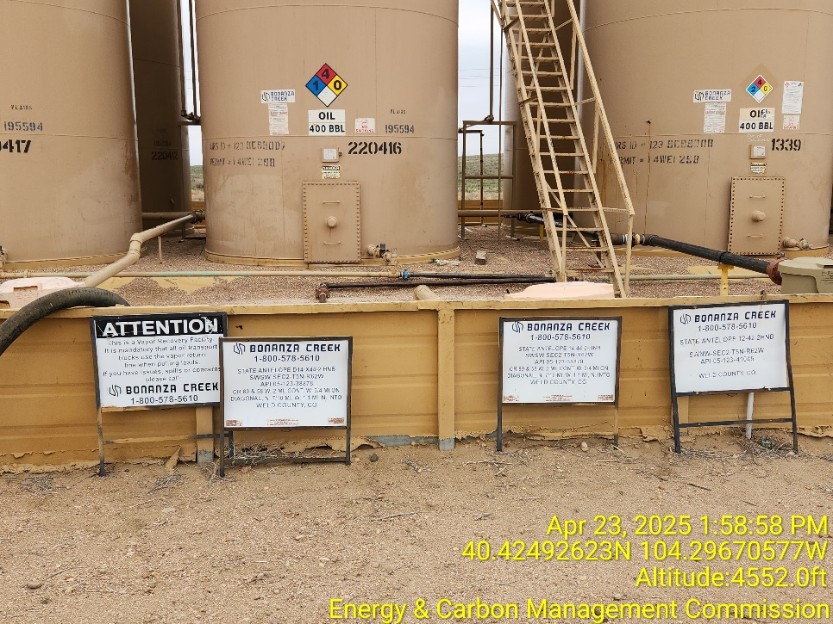
Inspection Photos
Location Name: State Antelope 14-2 PAD
Location ID: 435952
Photo 3 – Tank Battery Sign
Photo 4 – Tank Battery Sign

Slide 3
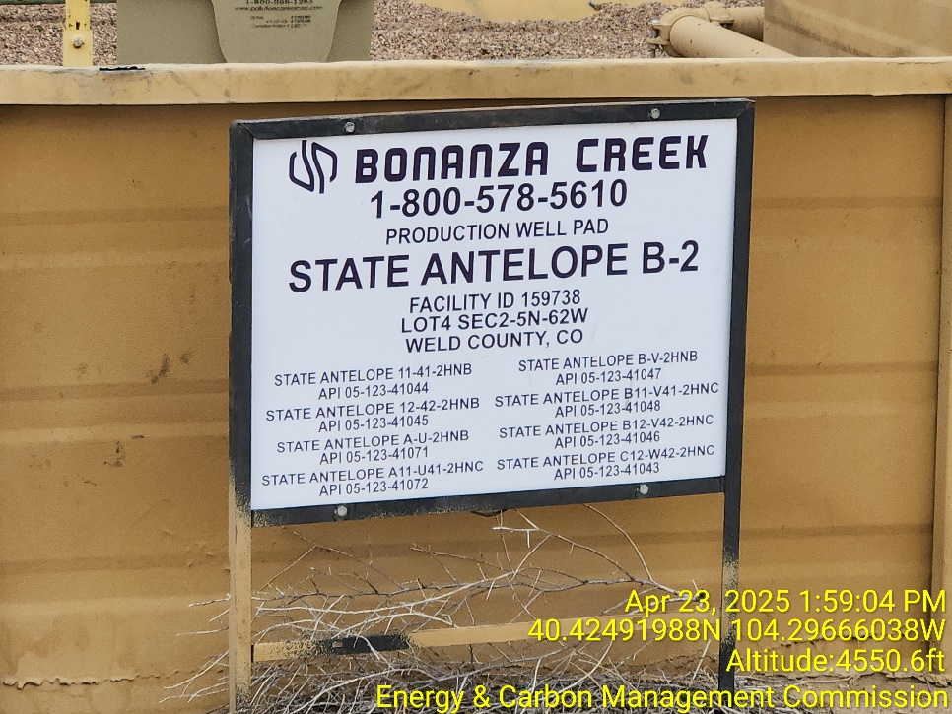
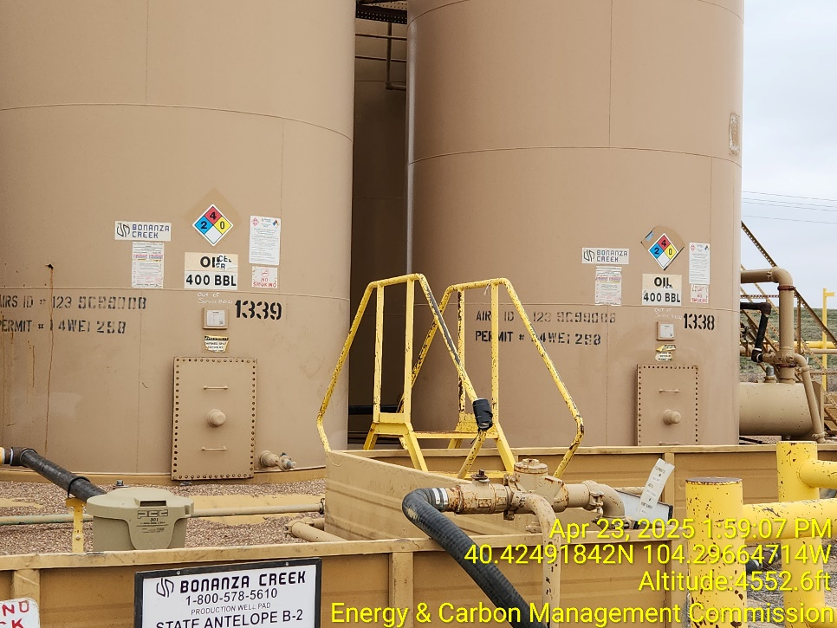
Inspection Photos
Location Name: State Antelope 14-2 PAD
Location ID: 435952
Photo 5 – Tank Battery Sign
Photo 4 – NFPA Labels have been replaced

Slide 4
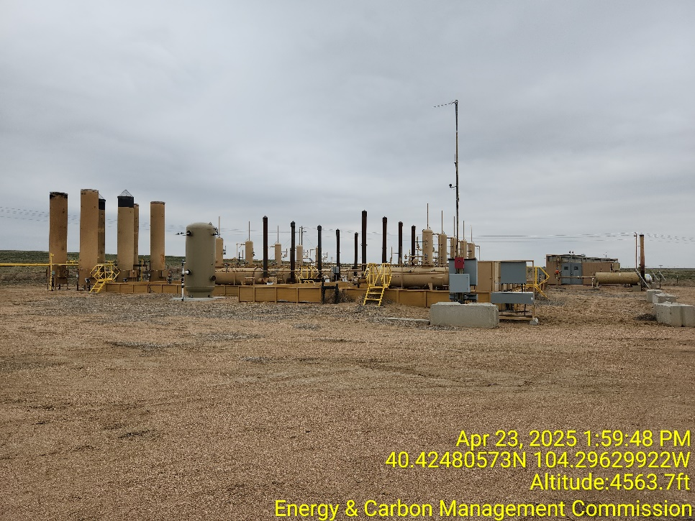
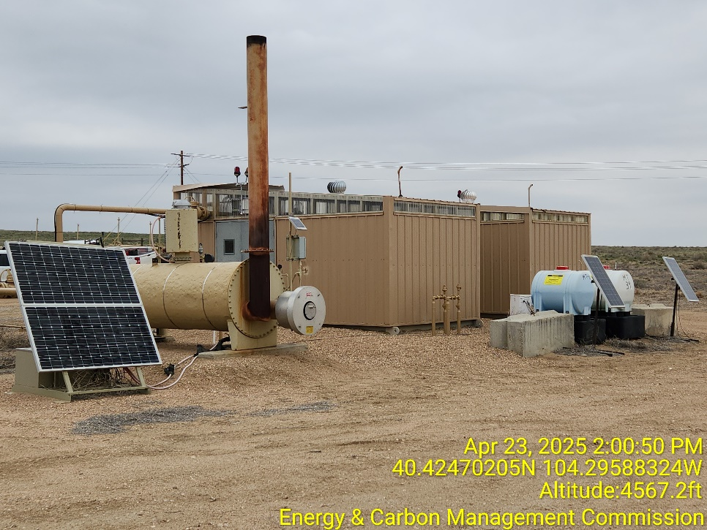
Inspection Photos
Location Name: State Antelope 14-2 PAD
Location ID: 435952
Photo 7 – Separator and ECDs
Photo 8 – Gas Lift Injection Meter Houses and Line Heater

Slide 5
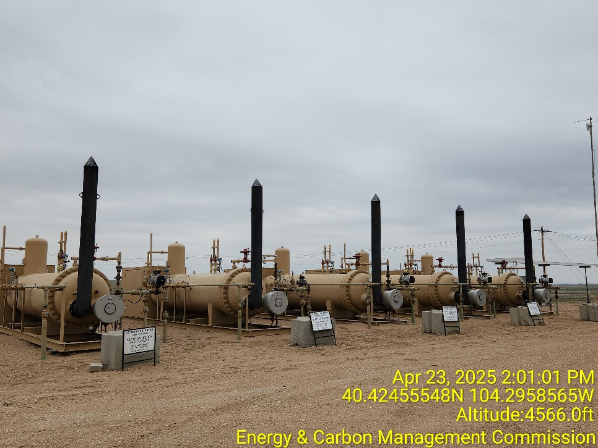
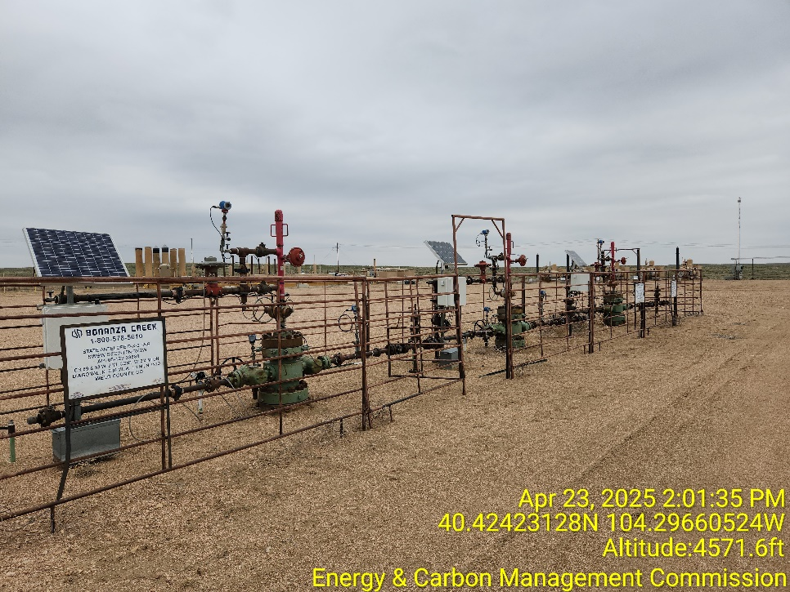
Inspection Photos
Location Name: State Antelope 14-2 PAD
Location ID: 435952
Photo 9 – Separators
Photo 10 – Wellheads

Slide 6
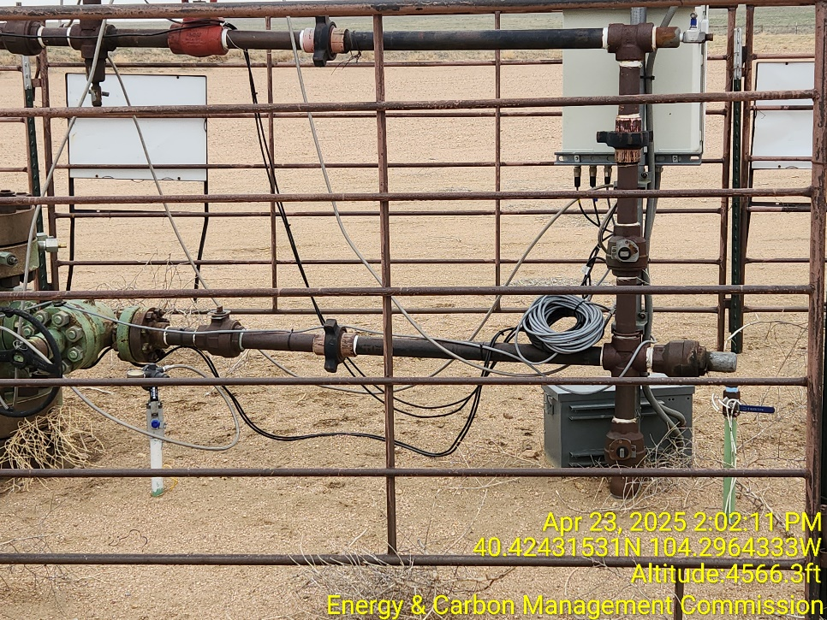
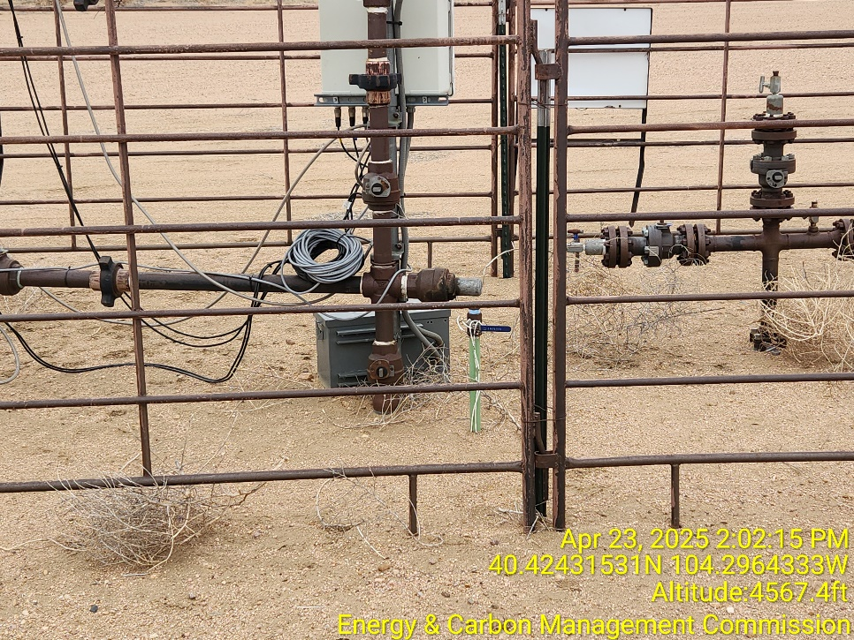
Inspection Photos
Location Name: State Antelope 14-2 PAD
Location ID: 435952
Photo 11 – Unmarked 1” Riser
Photo 12 – Unmarked 1” Riser

Slide 7
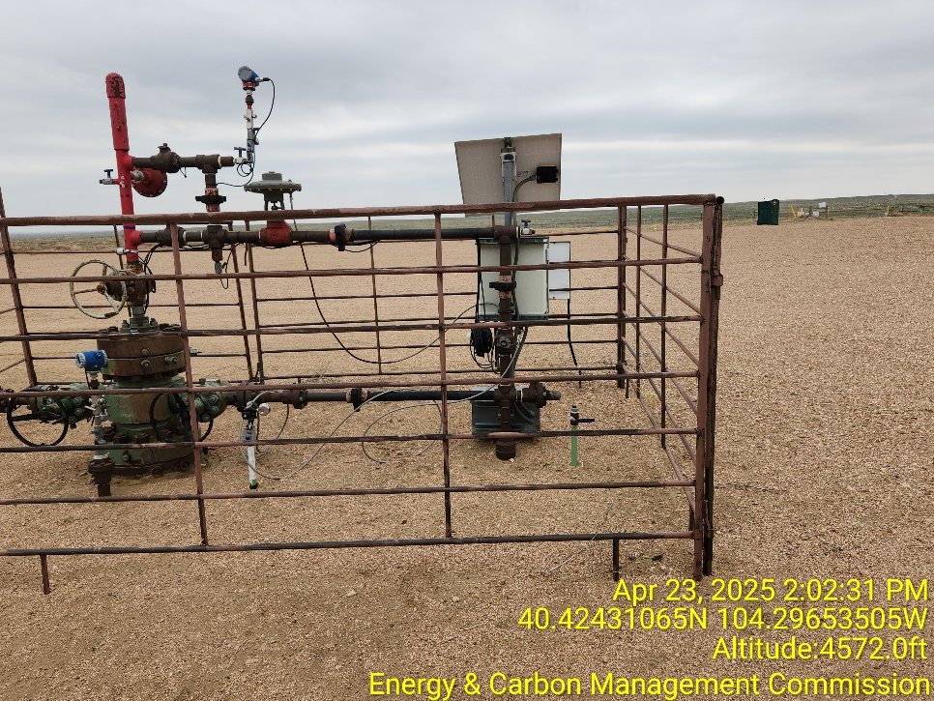
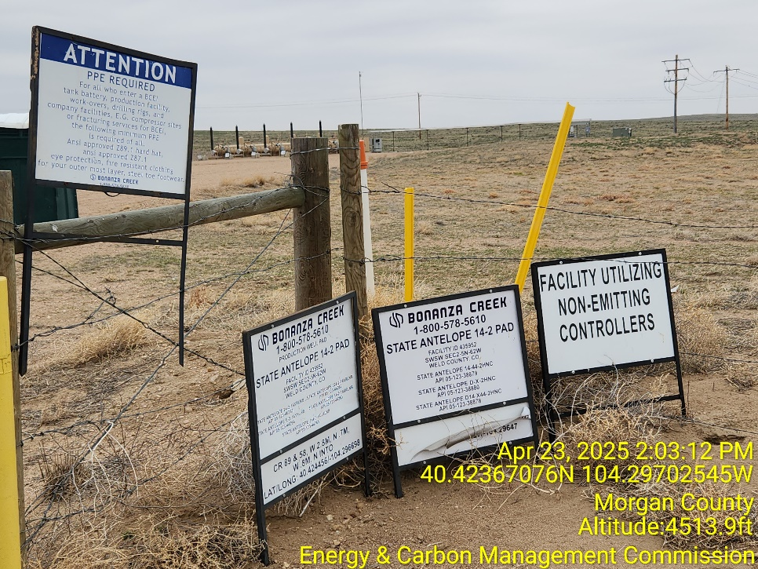
Inspection Photos
Location Name: State Antelope 14-2 PAD
Location ID: 435952
Photo 13 – Unmarked 1” Riser
Photo 14 – Signs at Entrance

