Slide 1
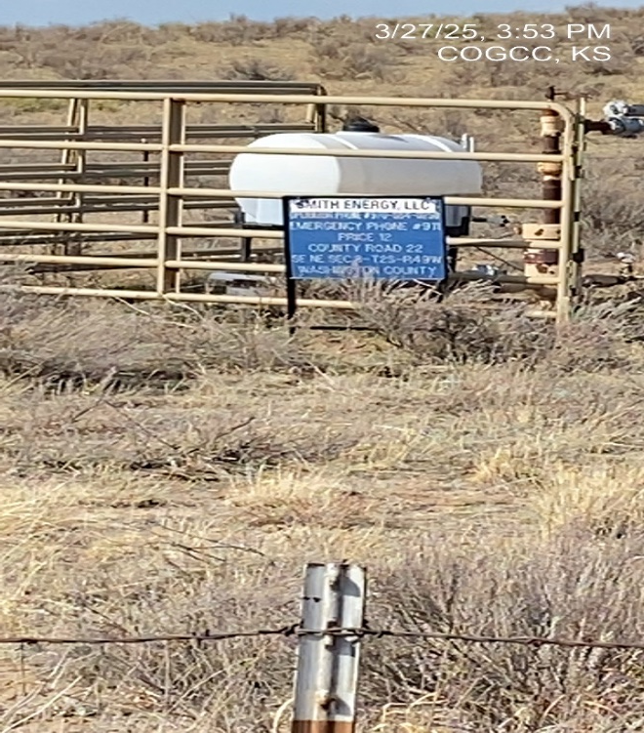
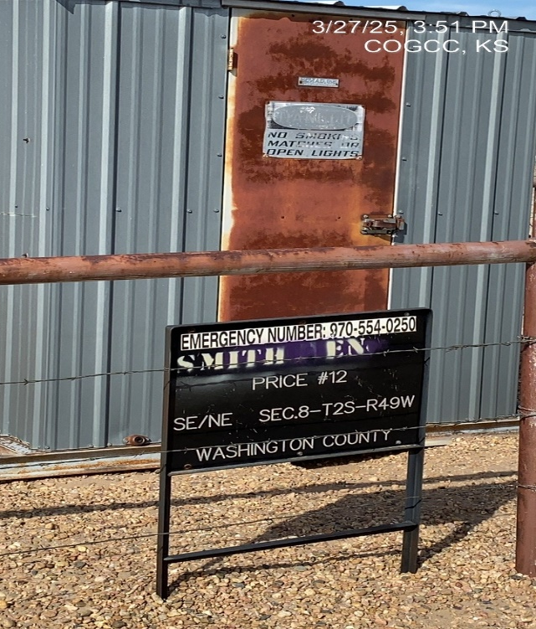
SMITH ENERGY LLC 10536
PRICE 12 121-10457
SIGN AT WH
SIGN AT MR

