Slide 1
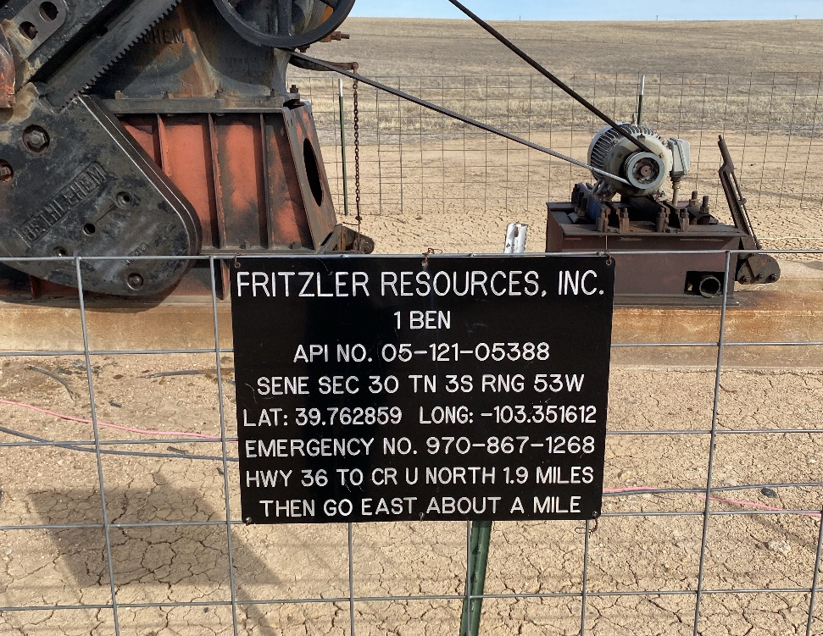
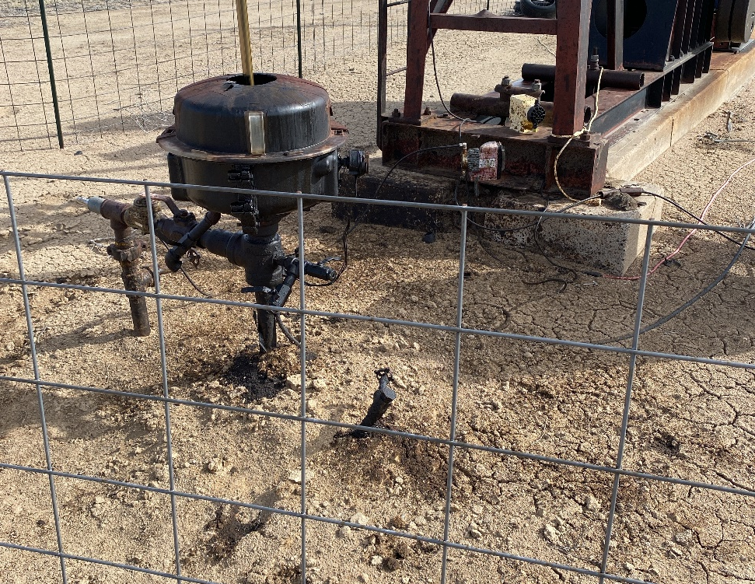
OPERATOR: FRITZLER RESOURCES INC #31257
BEN #1 05-121-05388
SIGN AT WELLHEAD
CO AFFECTED SOIL AT WELLHEAD COVERED WITH DIRT – See CO stain on cement pad indicating unreported release/spill.

Slide 2
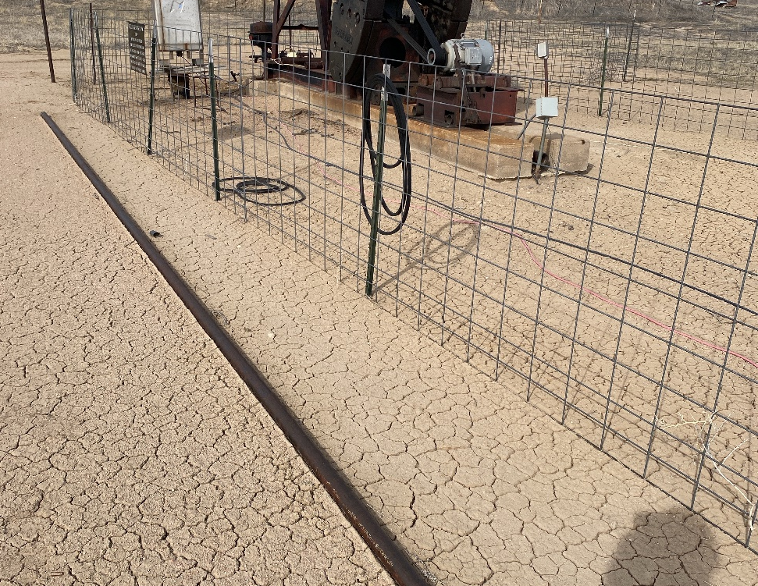
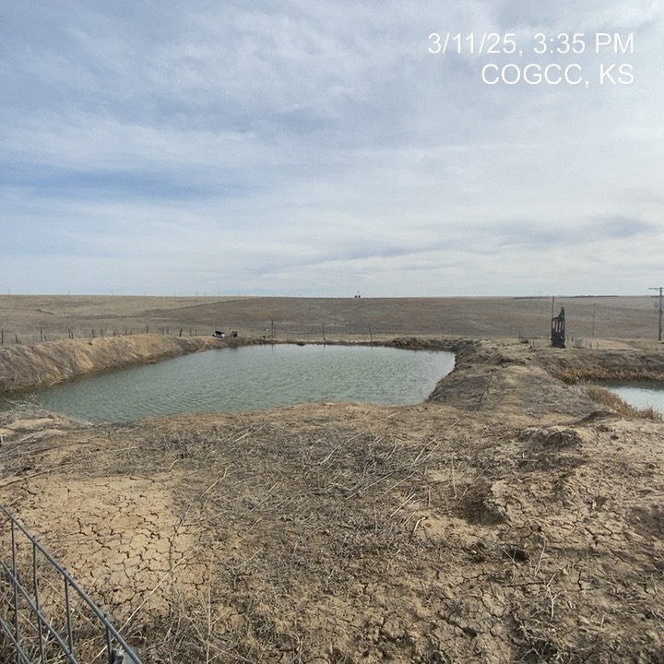
FRITZLER RESOURCES INC. #31257
BEN #1 05-121-05388
TUBING LAYING ON GROUND – REMOVE FROM LOCATION
INADEQUATE FREEBOARD ON SOUTH END OF #2 PW PIT

Slide 3
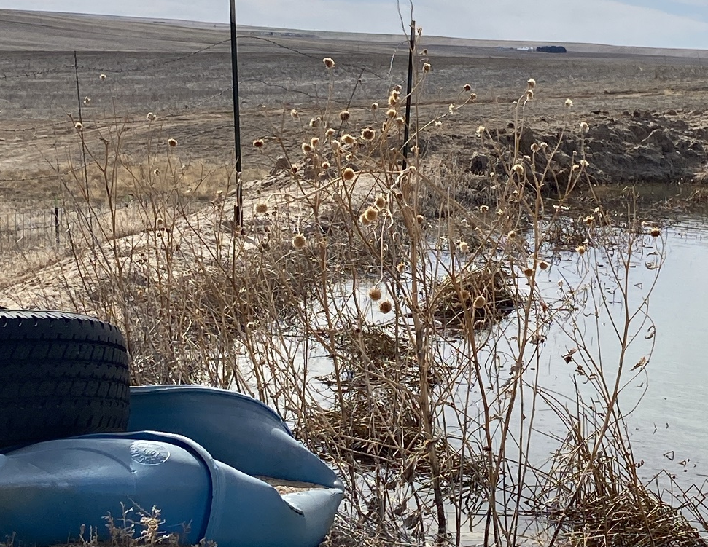
FRITZLER RESOURCES INC. #31257
BEN #1 05-121-05388
INADEQUATE FREEBOARD ON SOUTH END OF PW PIT #2 – CONSTRUCT ADEQUATE FREE BOARD
DEBRIS-TRASH AT PW PIT #2 SOUTH END OF PIT – REMOVE DEBRIS

Slide 4
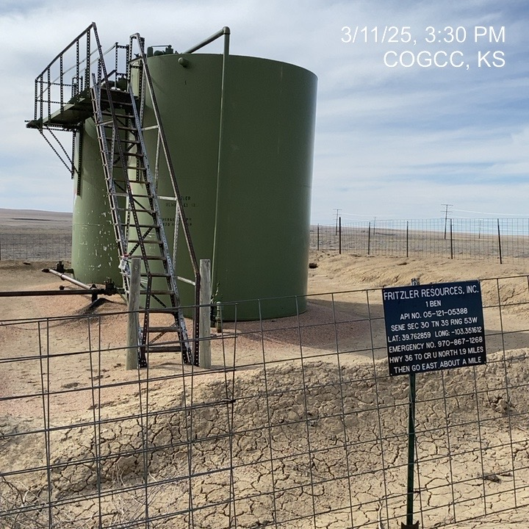
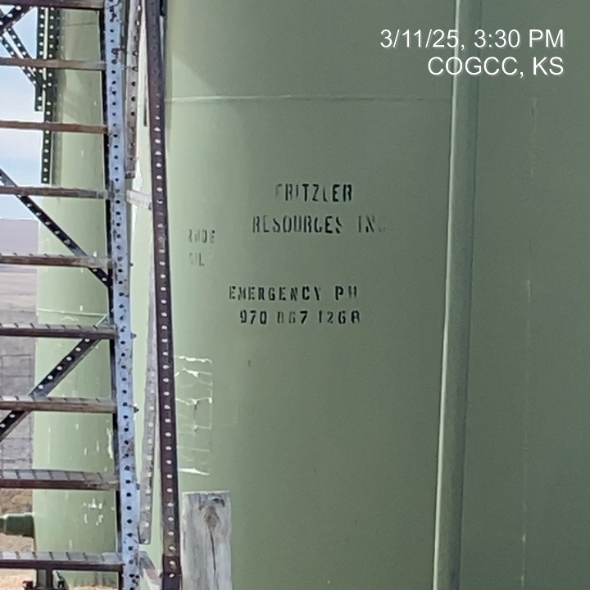
FRITZLER RESOURCES INC. #31257
BEN #1 05-121-05388
BERM REPAIR/RESTORATION REQUIRED
INADEQUATE PLACARDING ON TANKS AT BATTERY -

