Slide 1
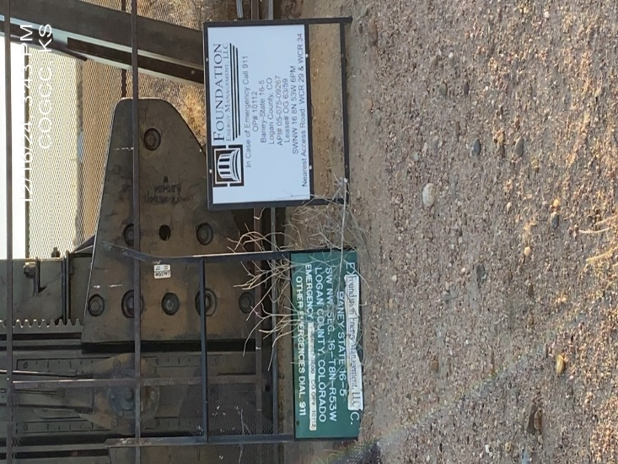
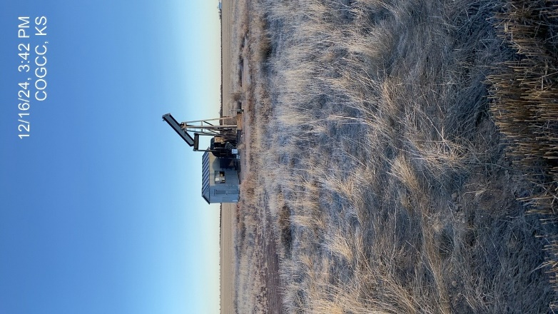
STRACHAN EXPLORATION INC. # 83130
BANEY STATE 16-5
05-075-09267
INVALID SIGNAGE @ WELLHEAD – EMERGENCY CONTACT INFO.
UNMARKED DEADMAN (4) WEEDS/MAINTENANCE - FENCE DOWN AT PJ

Slide 2
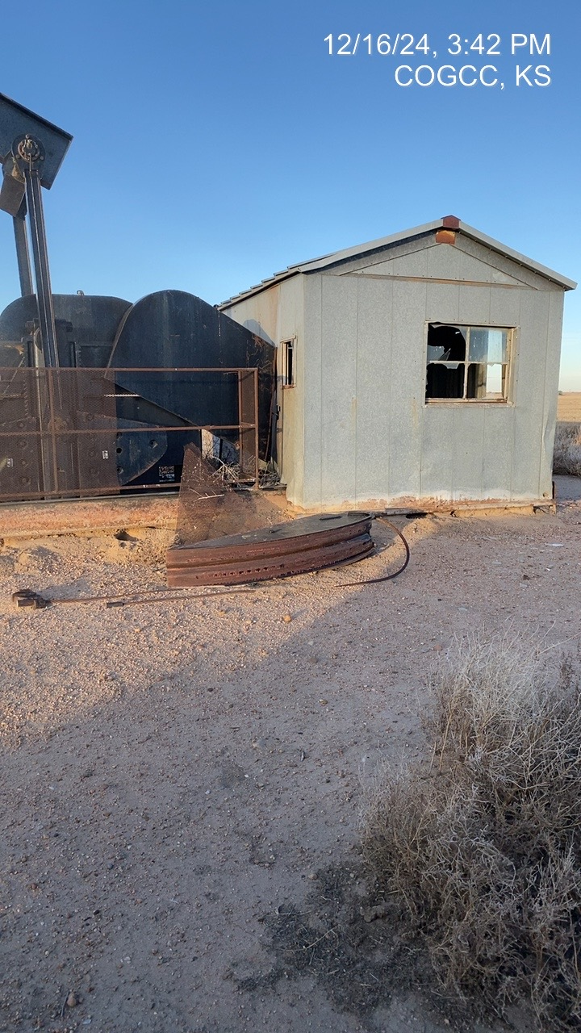
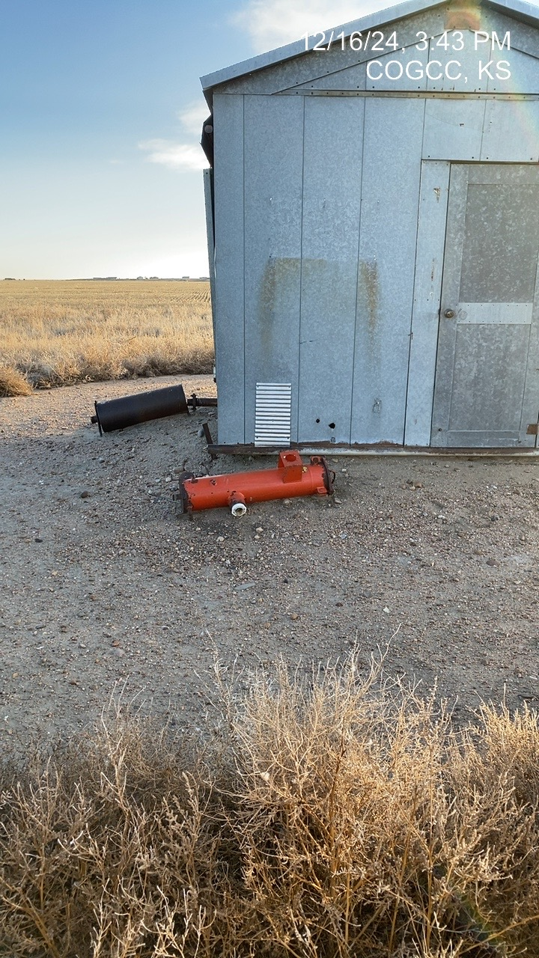
SMITH ENERGY
EQUIPMENT :UNUSED – STORAGE
EQUIPMENT : UNUSED-STORAGE

