Slide 1

Inspection Photos
Loc: 429093 Operator: AUSCO PETROLEUM INC Inspection Date: 11/14/2024

Slide 2
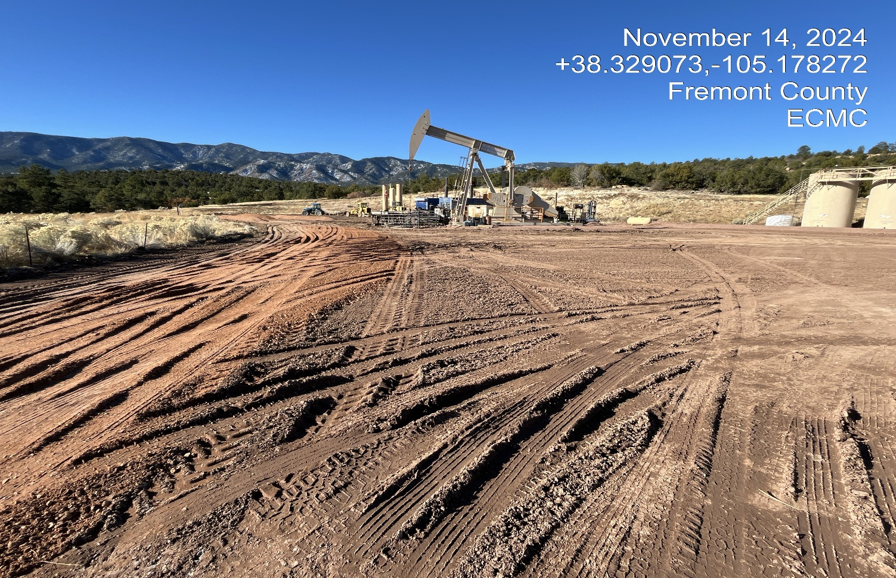
Inspection Photos
Photo 1. Facing southwest toward the location.

Slide 3
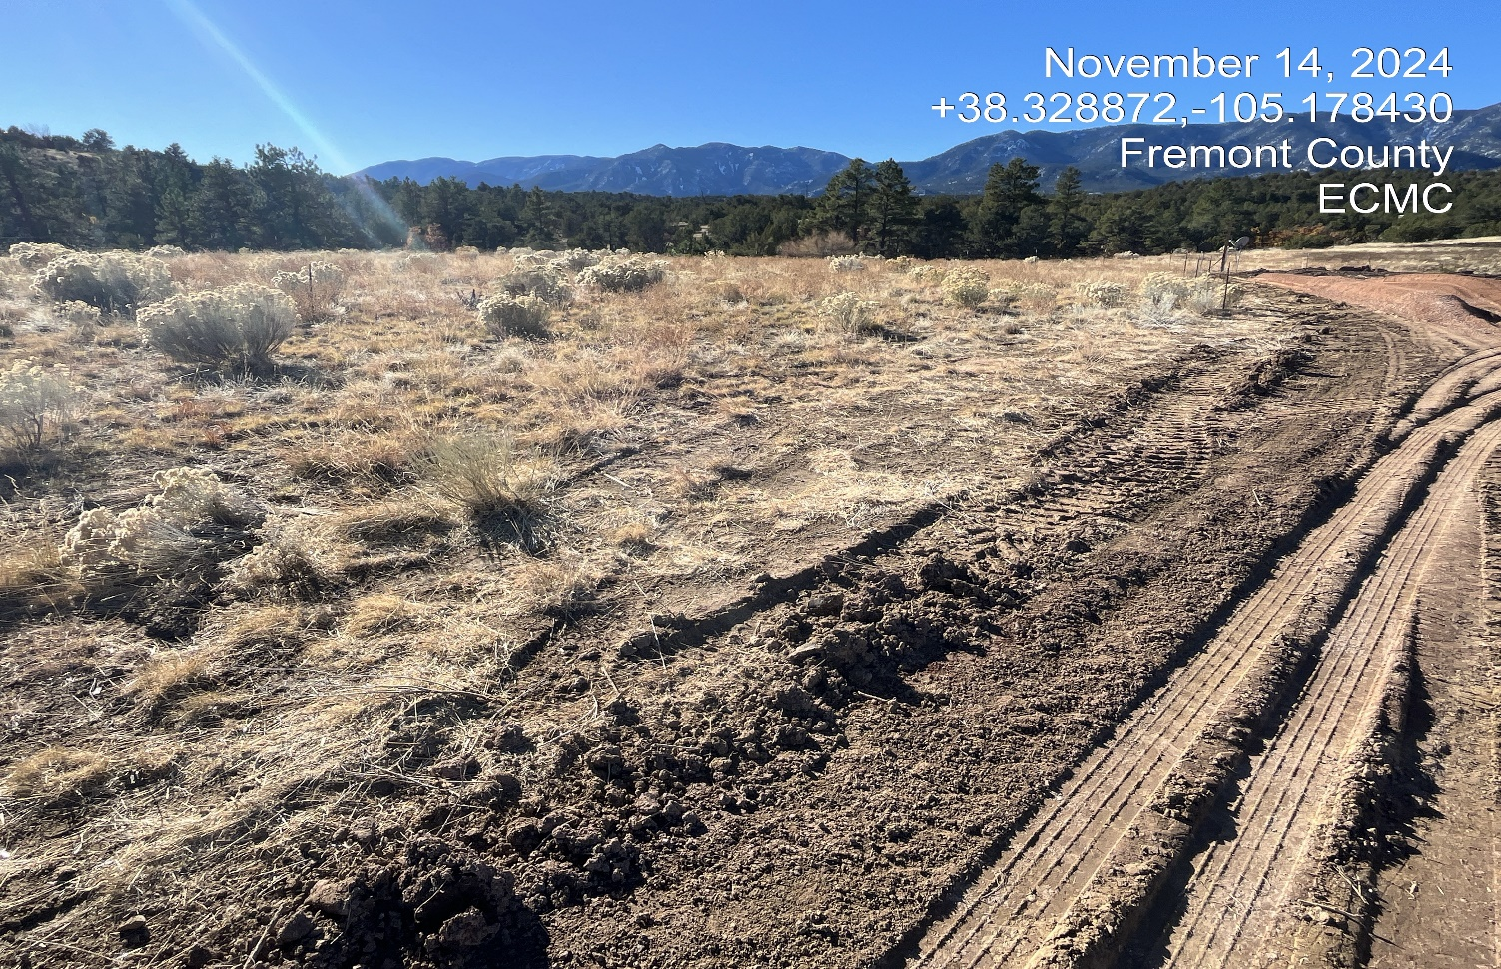
Inspection Photos
Photo 2. The one wire fence was taken down and needs to be replaced.

Slide 4
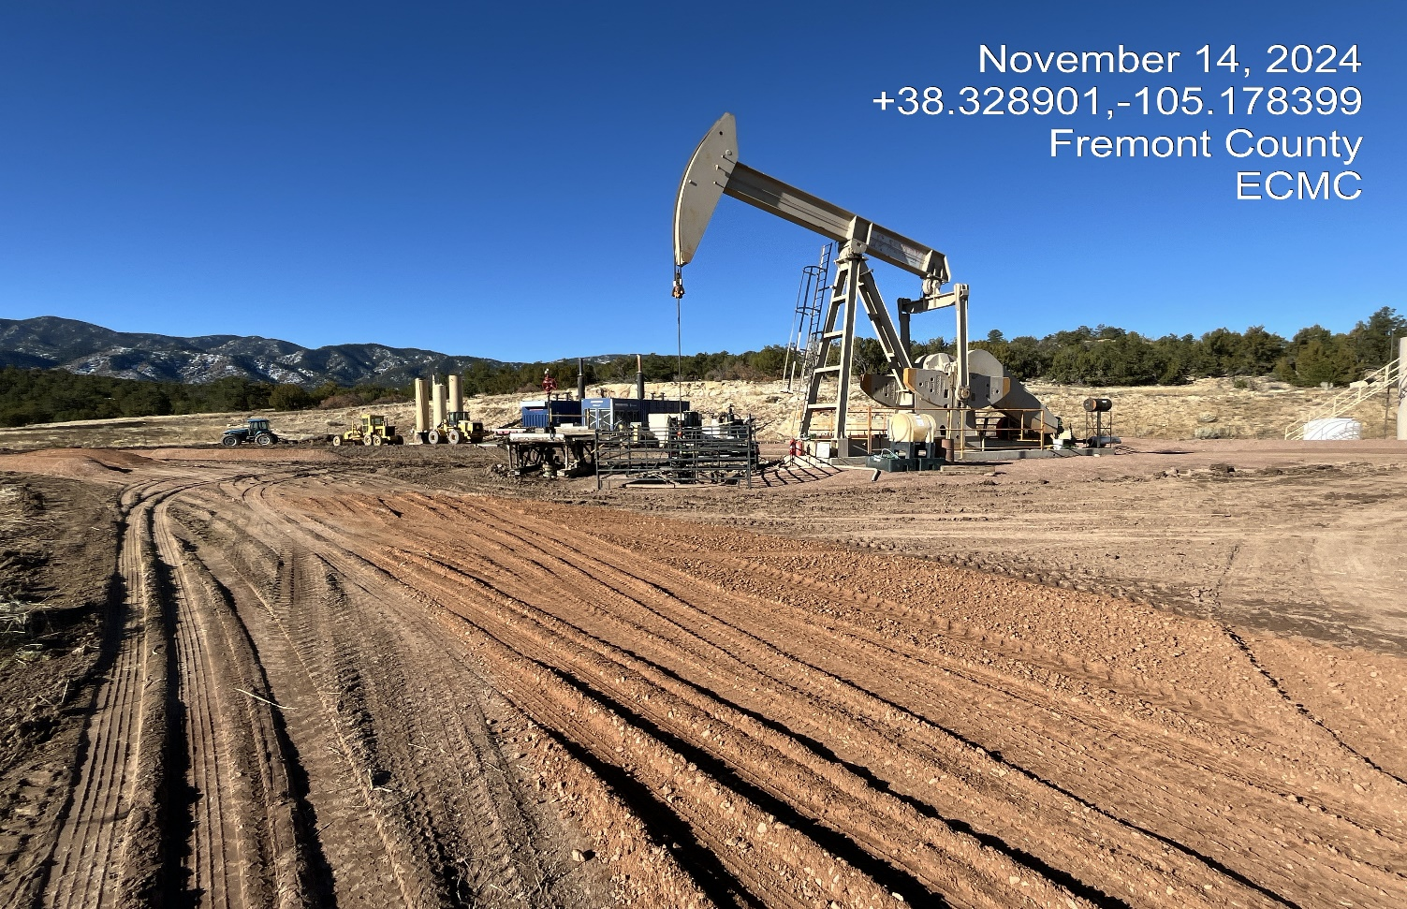
Inspection Photos
Photo 3. Facing toward the wellsite. It appears the wells have been reworked. Additional roadbase was haled into the site.

Slide 5
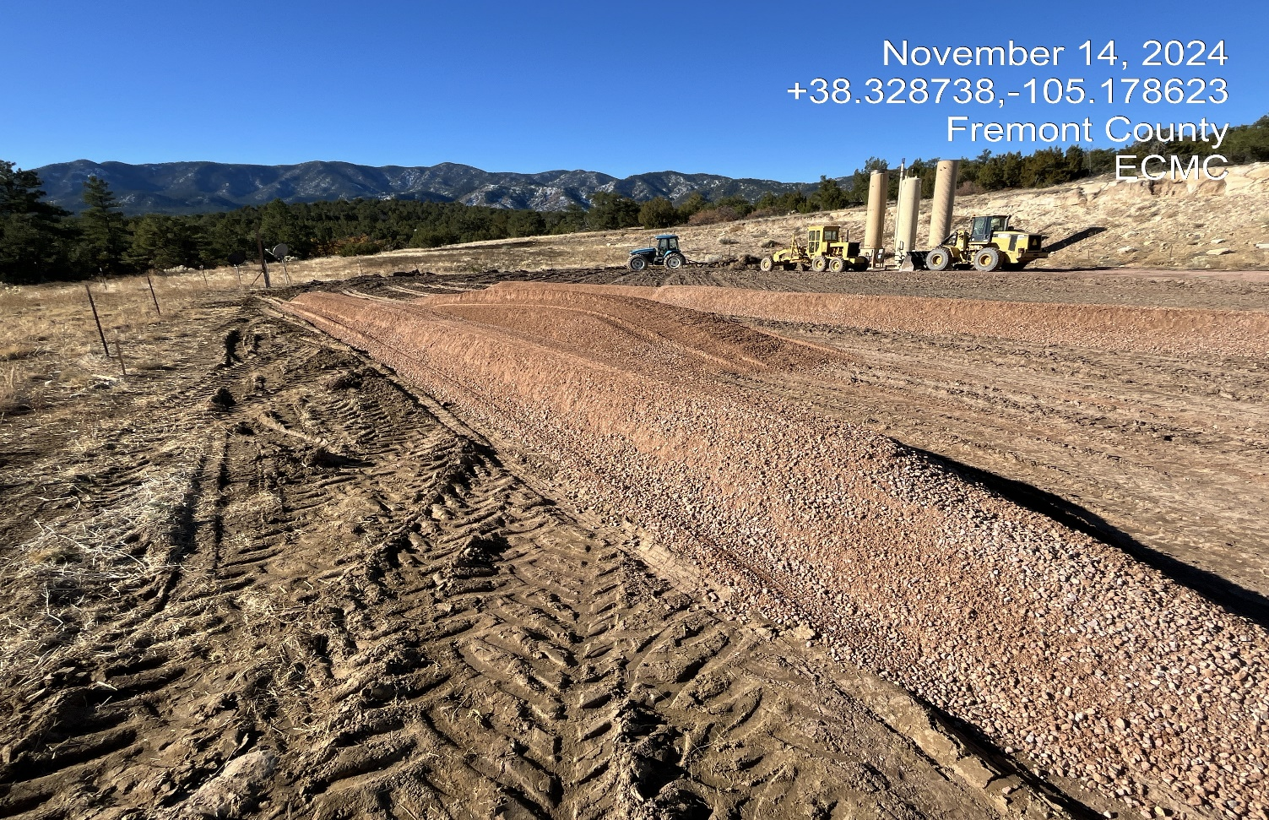
Inspection Photos
Photo 4. Facing southwest at the location. The bit coin was removed and new gravel has been hauled in..

Slide 6
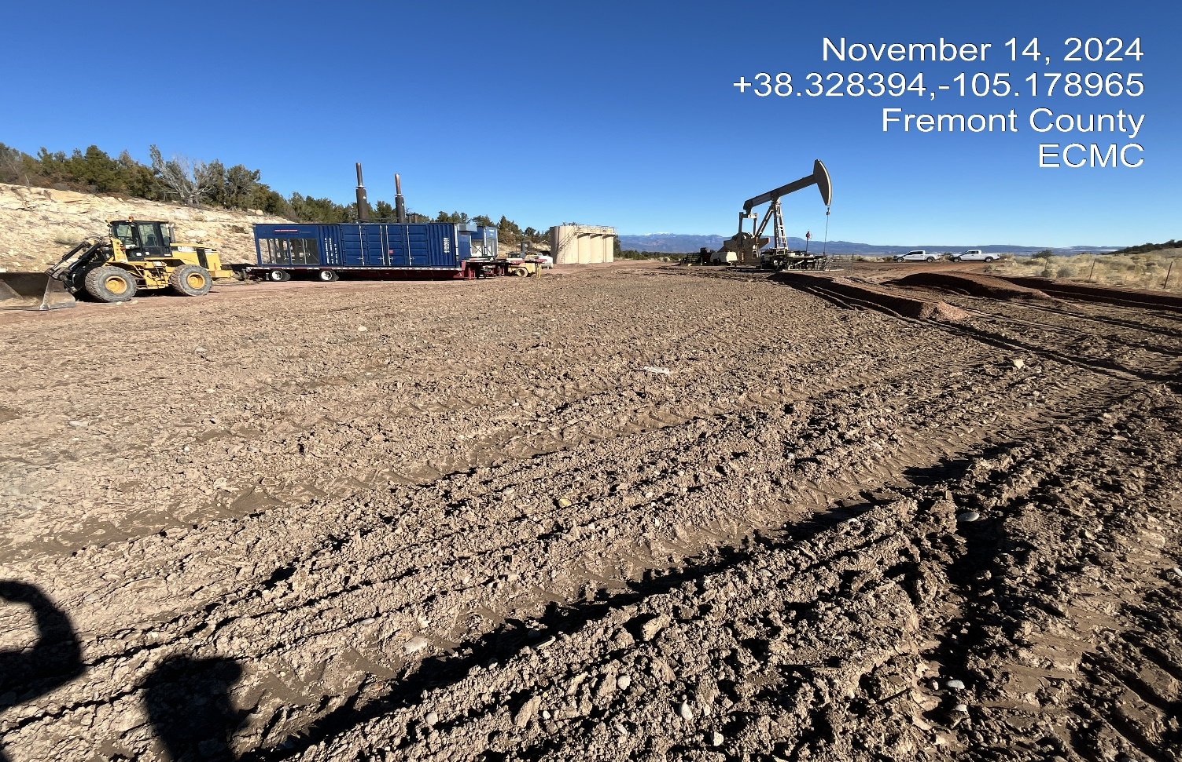
Inspection Photos
Photo 5. Facing north at the south side of the location. The soils have been lightly ripped in this area. Unused areas of the location will need to be reclaimed.

Slide 7
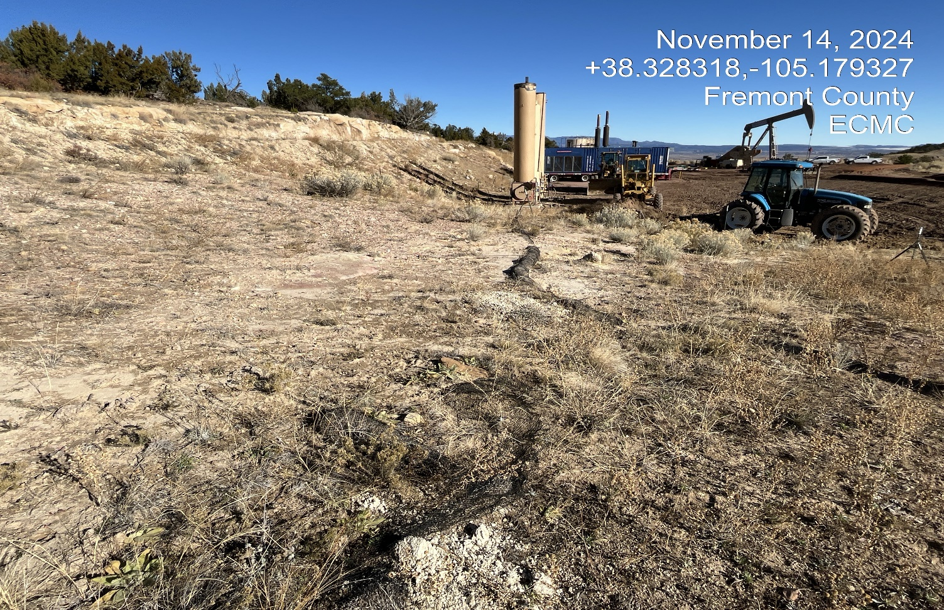
Inspection Photos
Photo 6. South side of the location facing north. The old wattles in this area
need to be replaced or removed. Previous corrective action was not completed.

Slide 8
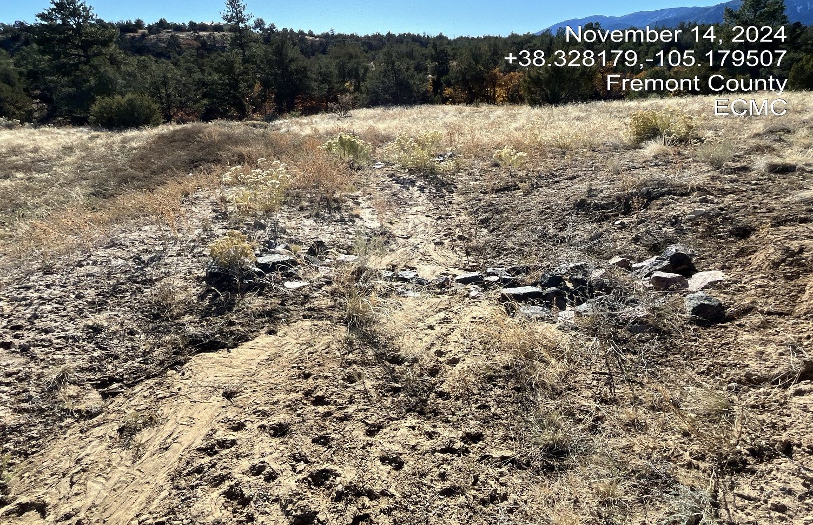
Inspection Photos
Photo 7. Facing south at the perimeter ditch. The check dams have filled in with
sediment and need to be cleaned out. Previous corrective action was not completed.

Slide 9
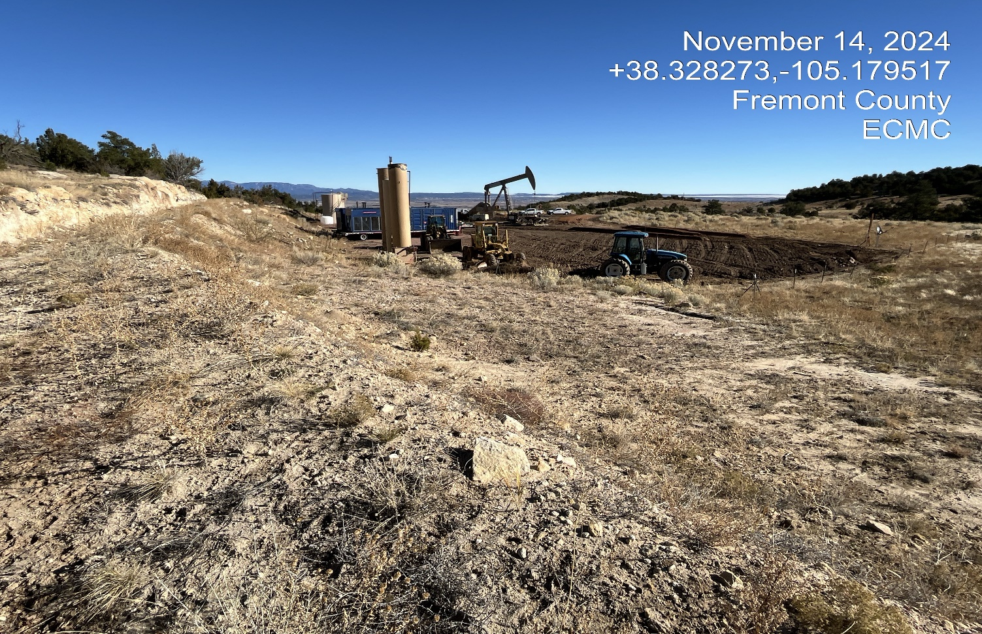
Inspection Photos
Photo 8. Facing north along the run-on ditch at the west side of the location.

Slide 10
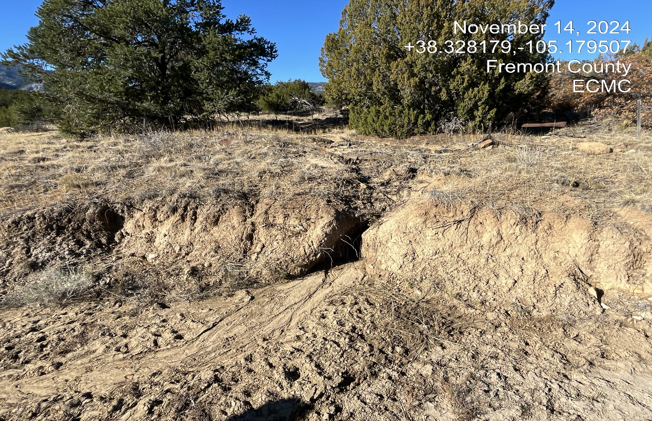
Inspection Photos
Photo 9. The wattles along the west perimeter of the location are degraded and need to be replaced or removed. There is erosion along this area of the southwest corner of the location. Previous corrective action was not completed.

Slide 11
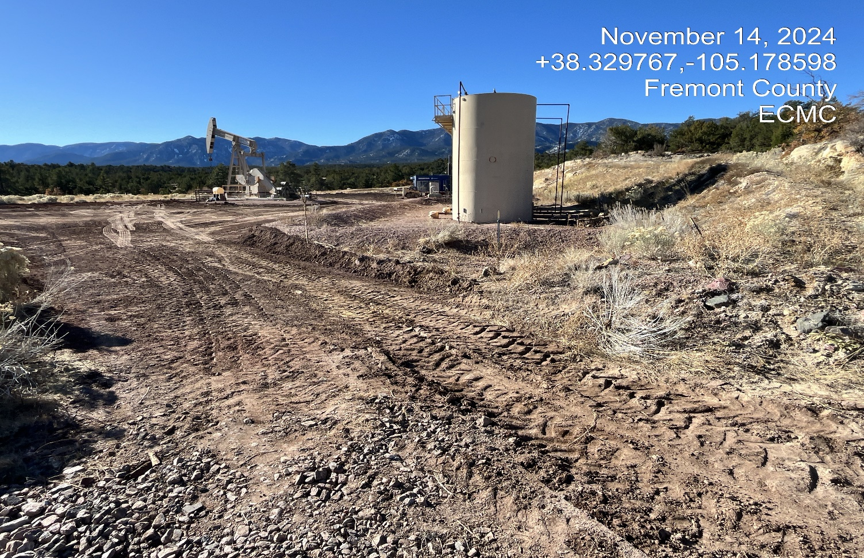
Inspection Photos
Photo 10. North side of the location facing south.

