Slide 1

Inspection Photos
July 31st, 2024
Operator: Seeley Oil Company - 10506
Location ID: 313558
Inspection Document #: 714001037
Montezuma County, CO
Township: SWSE 26 37N 19W N

Slide 2
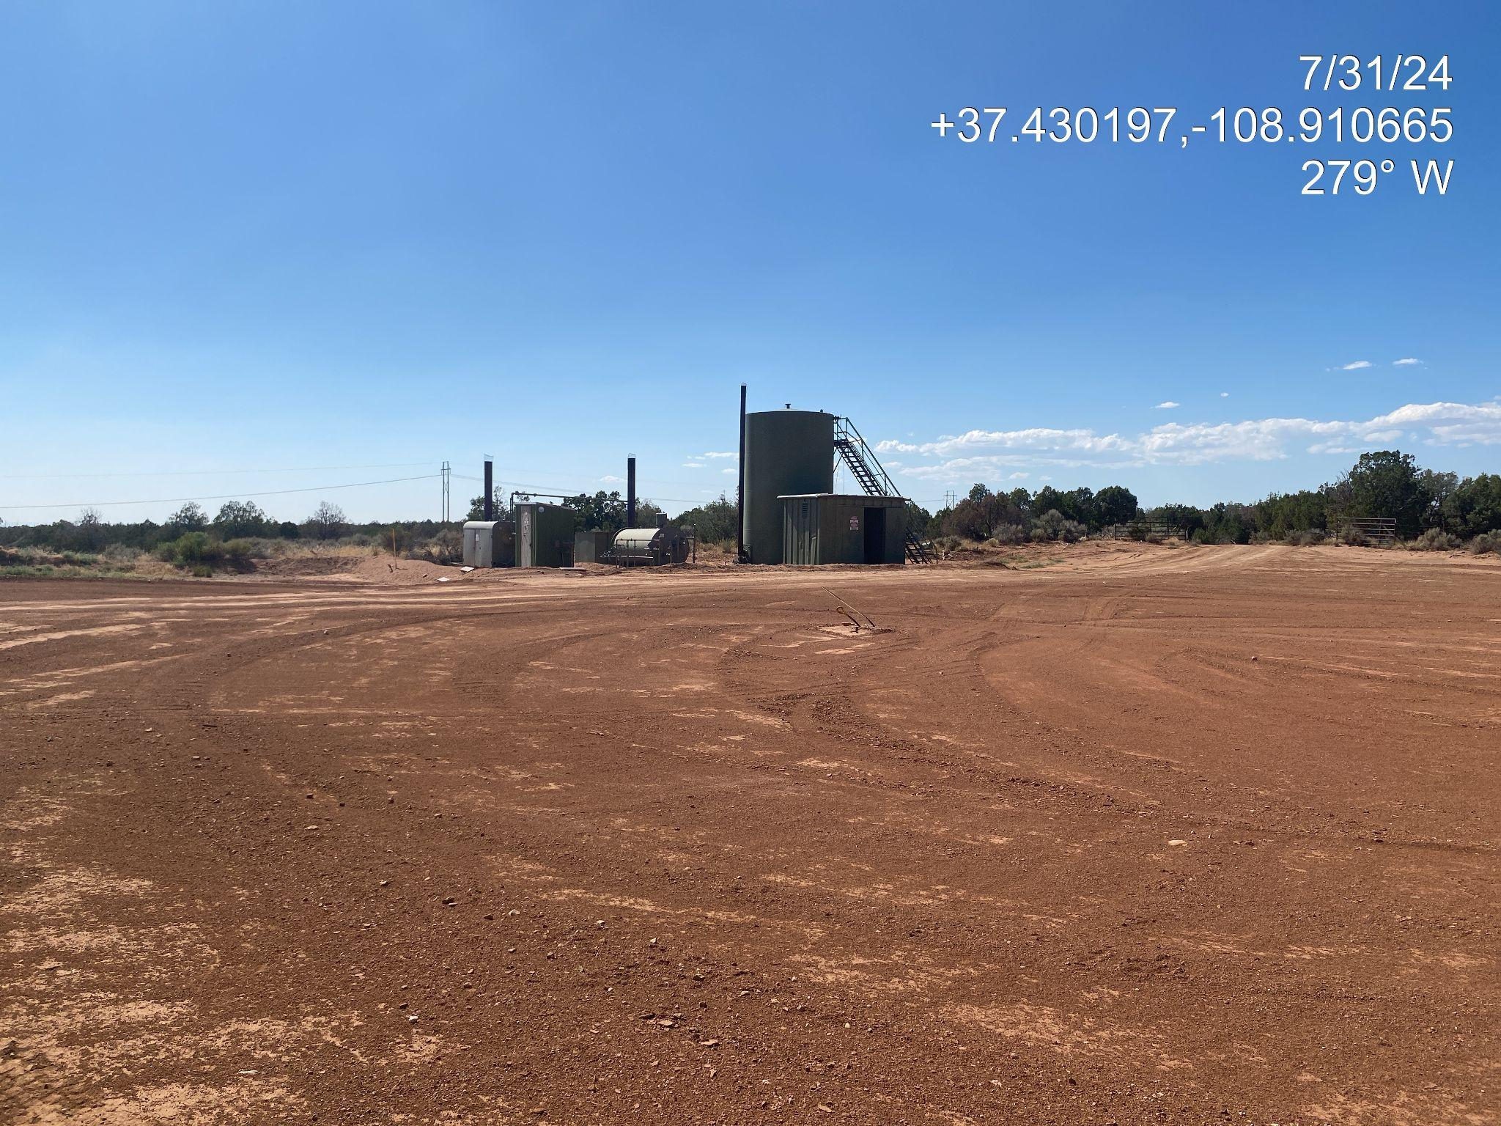
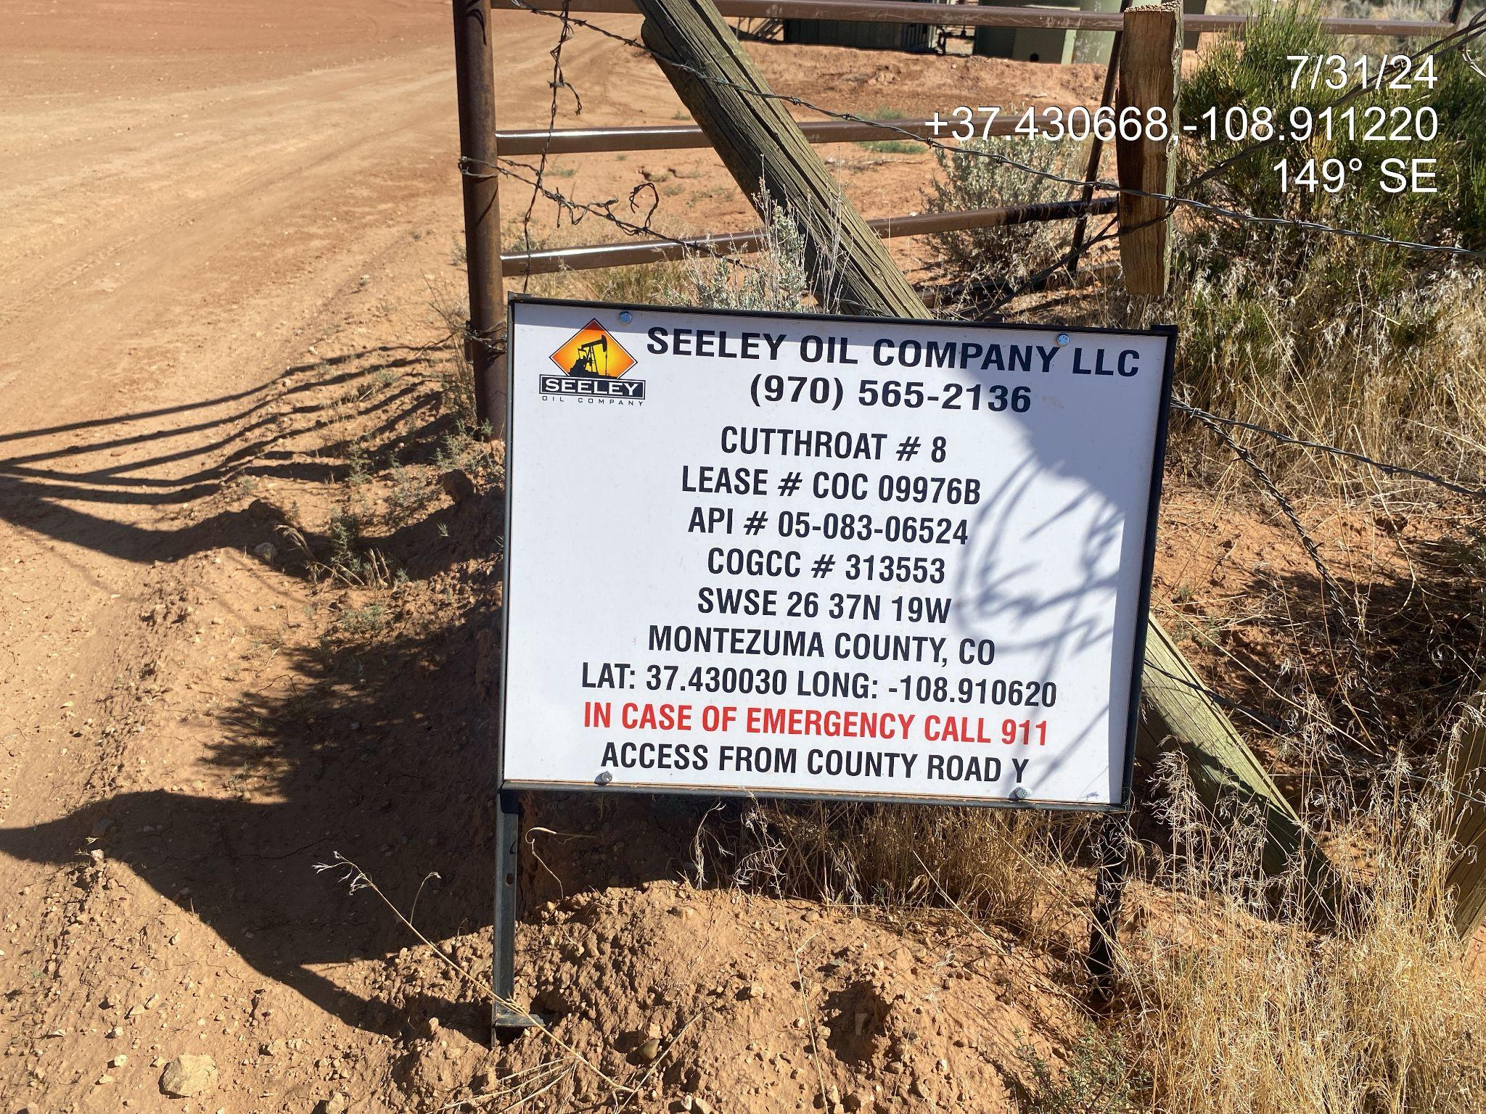
Inspection Photos
Location Name: Cutthroat 8
Location ID: 313558
Photo 1. View of the well pad taken from the access point facing center.
API #: 083-06524

Slide 3
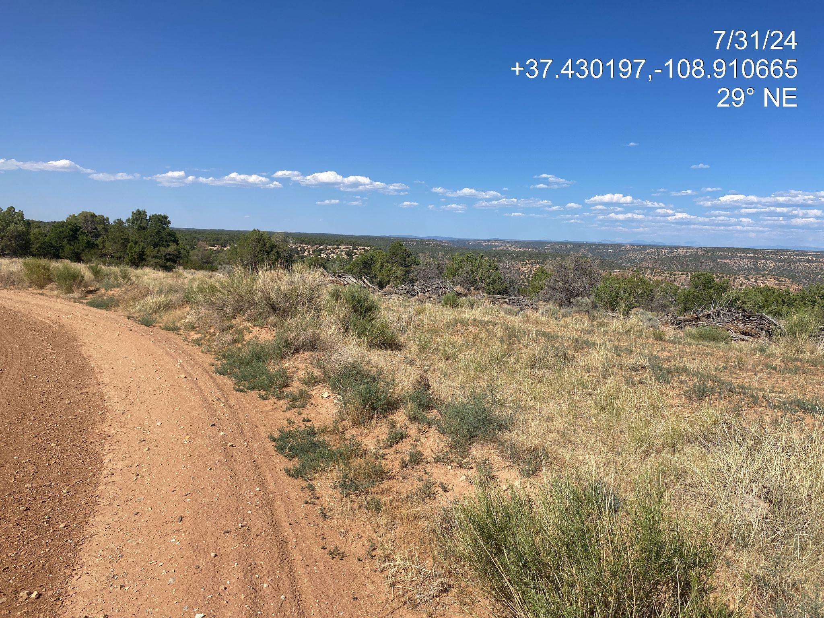
Inspection Photos
Location Name: Cutthroat 8
Location ID: 313558
Photo 2. View of the northern interim reclamation area facing northing east.
API #: 083-06524

Slide 4
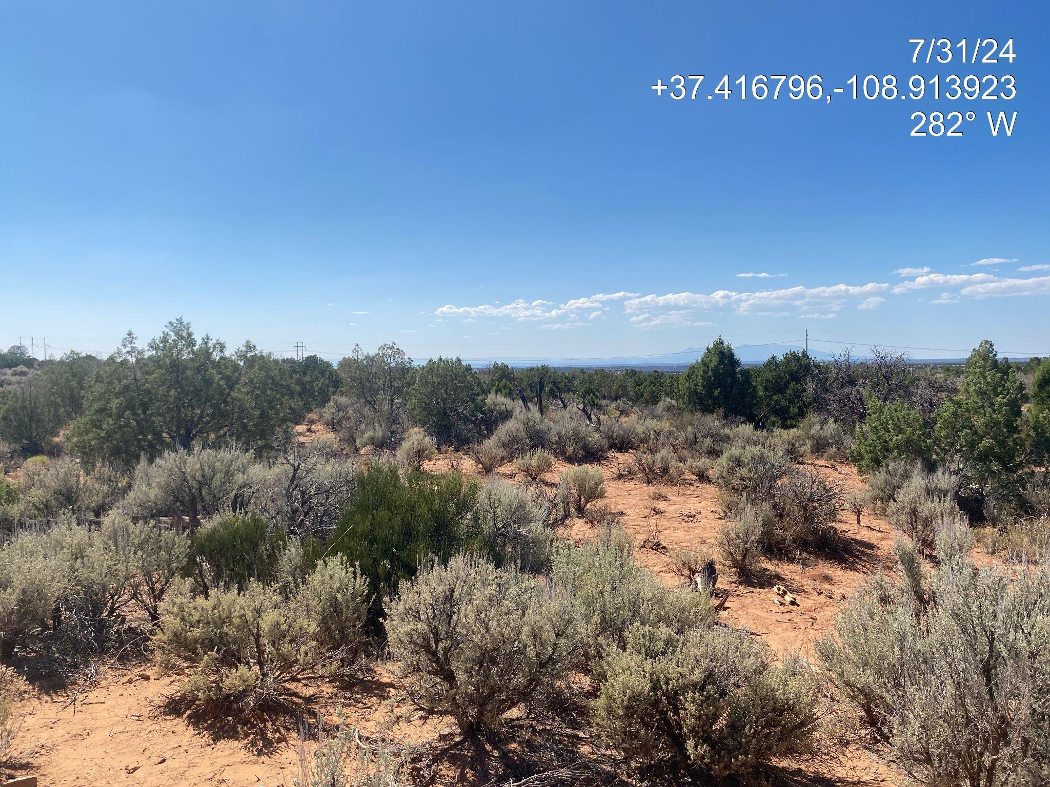
Inspection Photos
Location Name: Cutthroat 8
Location ID: 313558
Photo 3. Reference area comprised of Big sagebrush, Juniper and Ephedra.
API #: 083-06524

