Slide 1
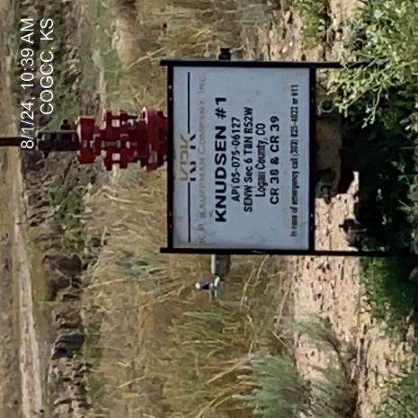
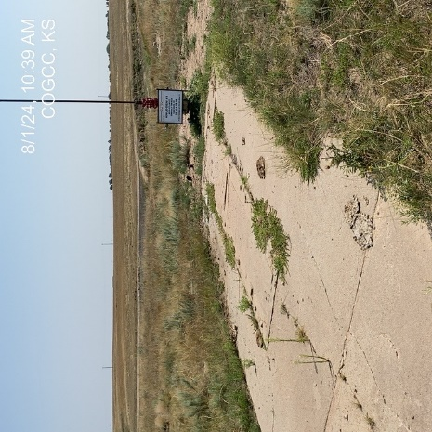
KP KAUFFMAN CO. INC.
KNUDSEN 1 075-06127
OPERATOR # 46290
SIGNAGE AT WELLHEAD
WELLHEAD

Slide 2
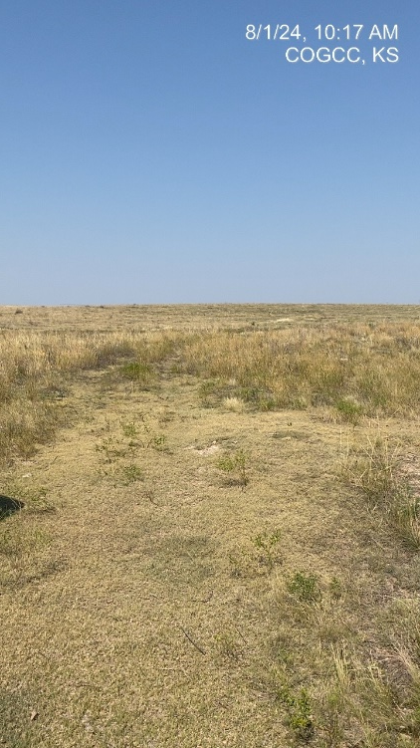
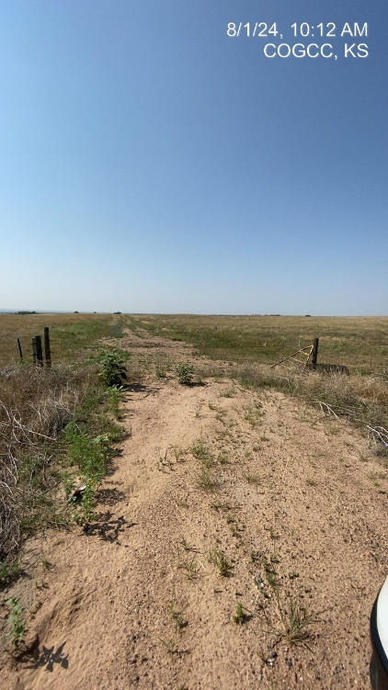
KP KAUFFMAN CO. INC.
KNUDSEN 1 075-06127
LEASE ROAD TO WELLHEAD
LEASE ROAD ENTRY AT GATE

