Slide 1
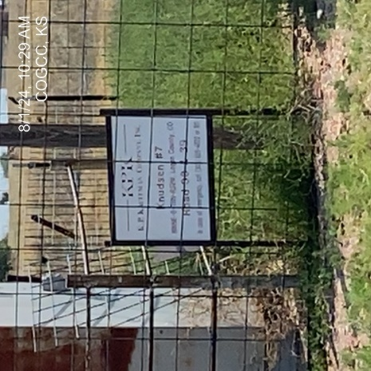
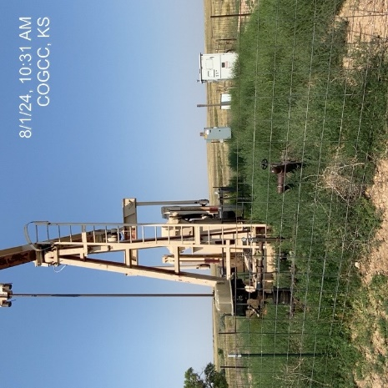
KP KAUFFMAN CO. INC.
KNUDSEN 7 075-07533
OPERATOR # 46290
SIGNAGE AT WELLHEAD
WELLHEAD – PJ – PM - WEEDS

Slide 2
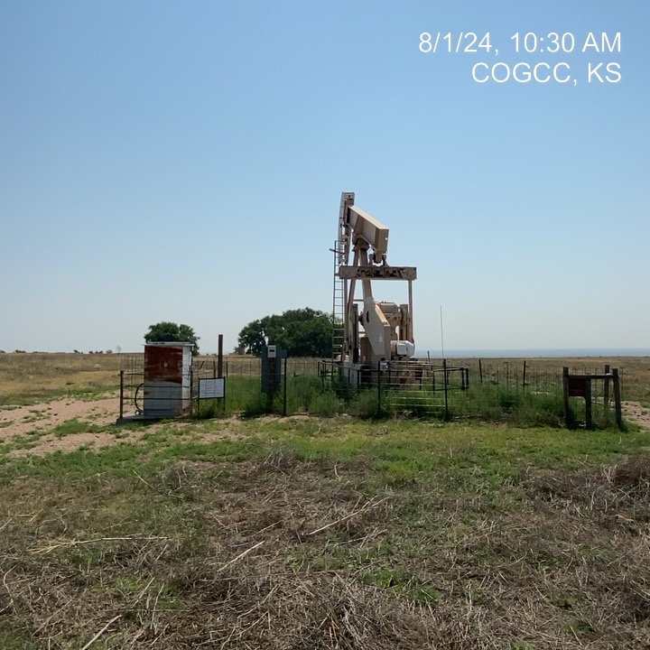
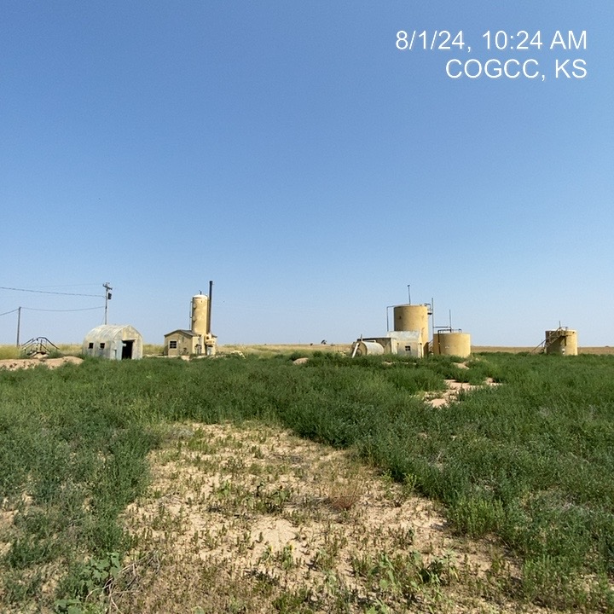
KP KAUFFMAN CO. INC.
KNUDSEN 7 075-07533
LEASE ROAD TO WELLHEAD
LEASE ROAD PARTIALLY GROWN OVER

