Slide 1
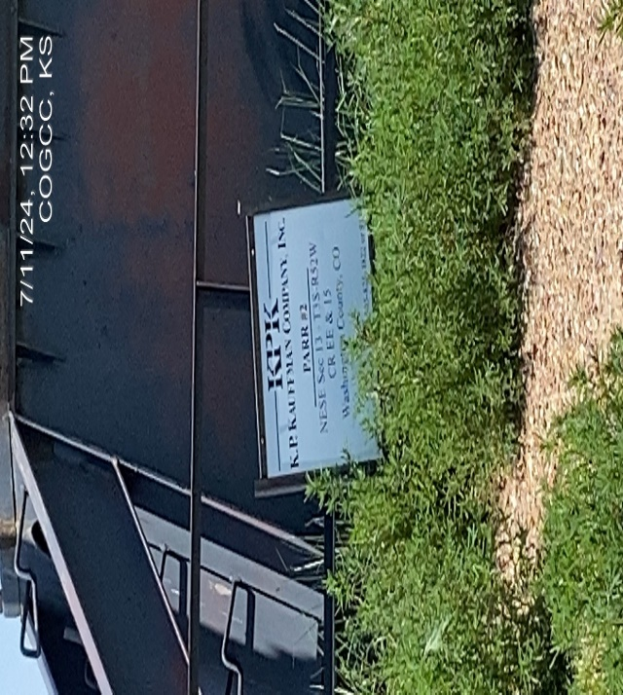
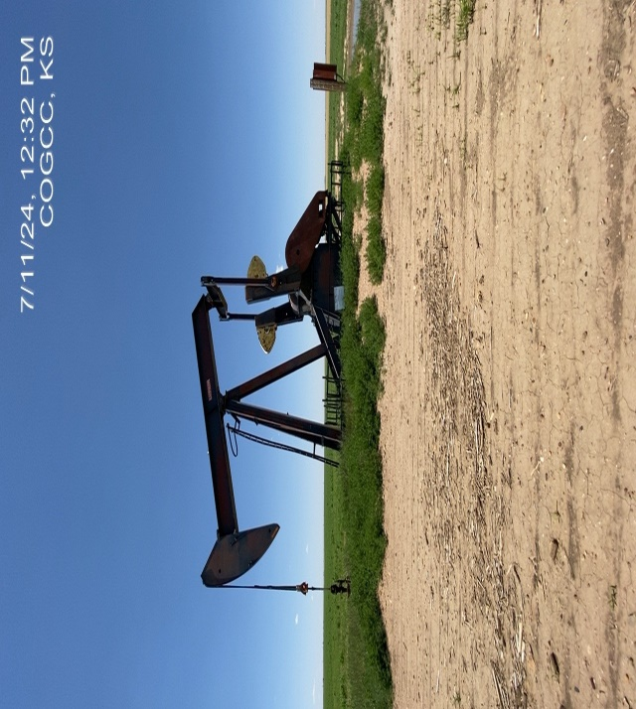
IMPETRO RESOURCES LLC
PARR 1 121-08996
OP. # 10690
KP KAUFFMAN CO. INC.
PARR 2 121-09275
OPERATOR# 46290
WELLHEAD SIGNAGE
PJ – PM - CONTAINMENT

Slide 2
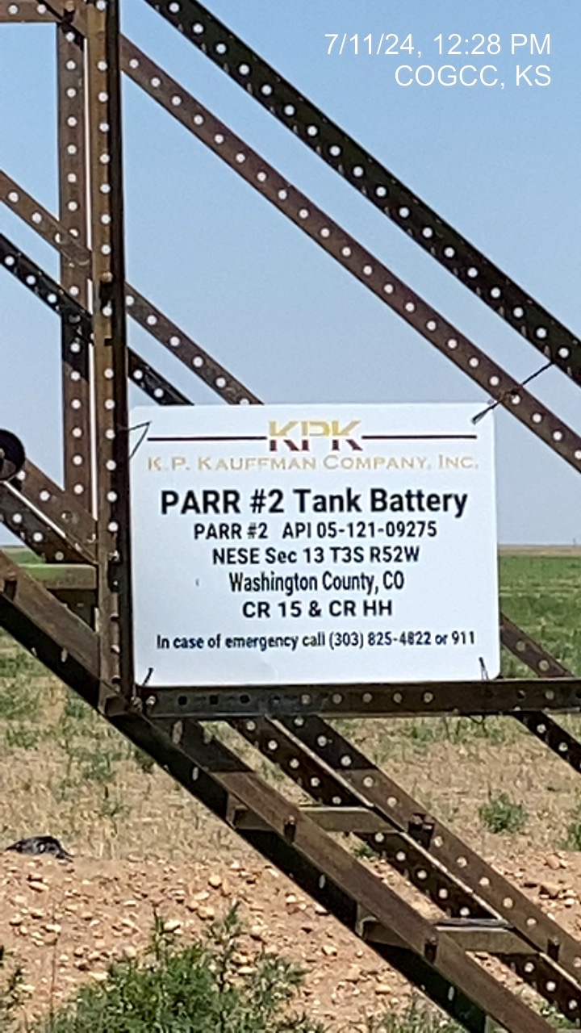
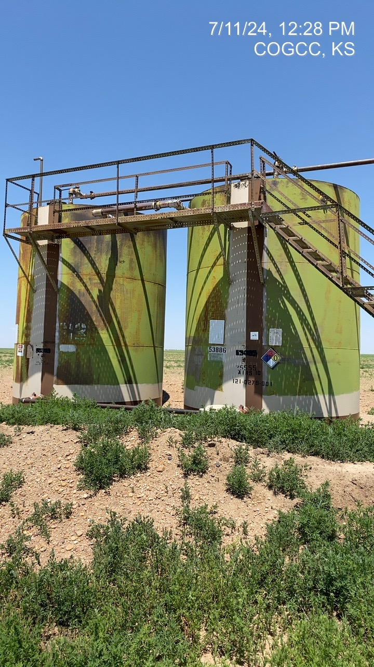
KPK CO. INC.
PARR 2 121-09275
TANK BATTERY SIGNAGE
TANK BATTERY

