Slide 1
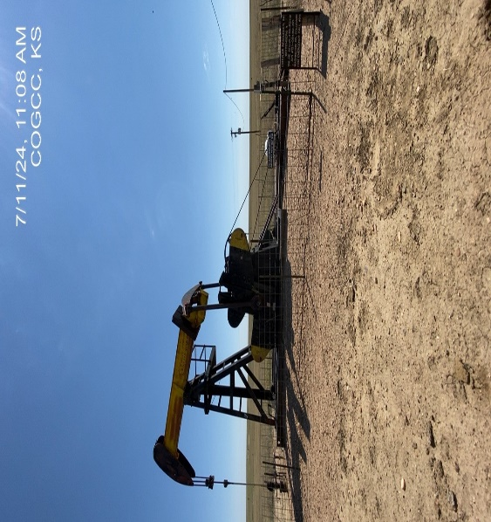
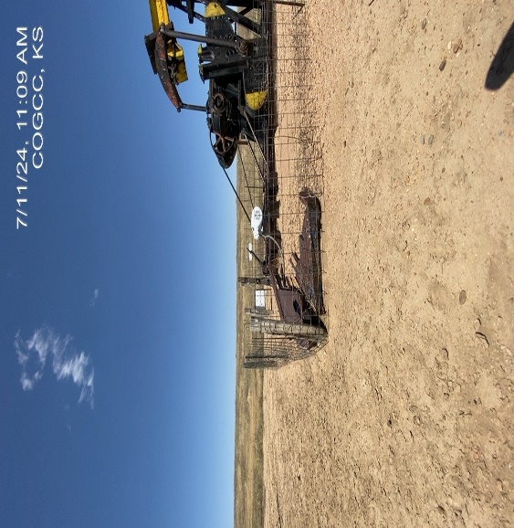
FRITZLER RESOURCES INC.
WITTENBERG 4 121-05489
OP. # 31257
WELLHEAD – SIGNAGE –
PUMP JACK – SHROUD ON GROUND

