Slide 1
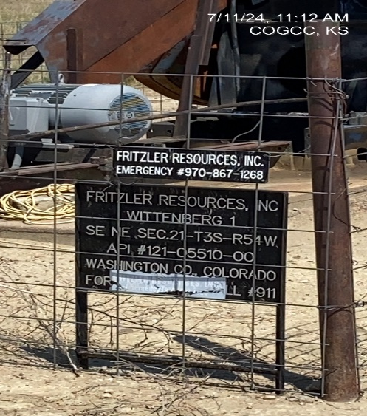
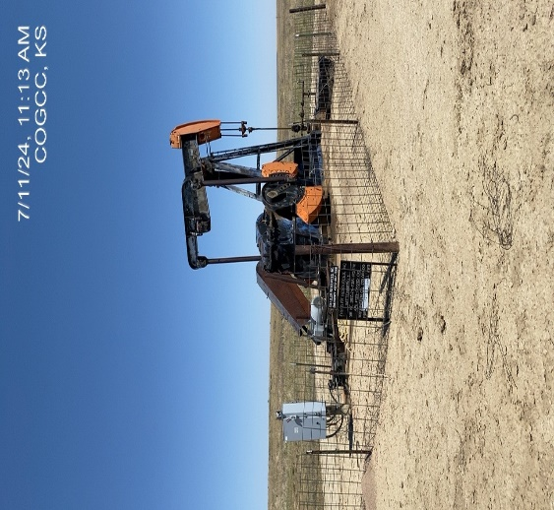
FRITZLER RESOURCES INC.
WITTENBERG 1 121-05510
OP. # 31257
WELLHEAD – SIGNAGE –
PUMP JACK

Slide 2
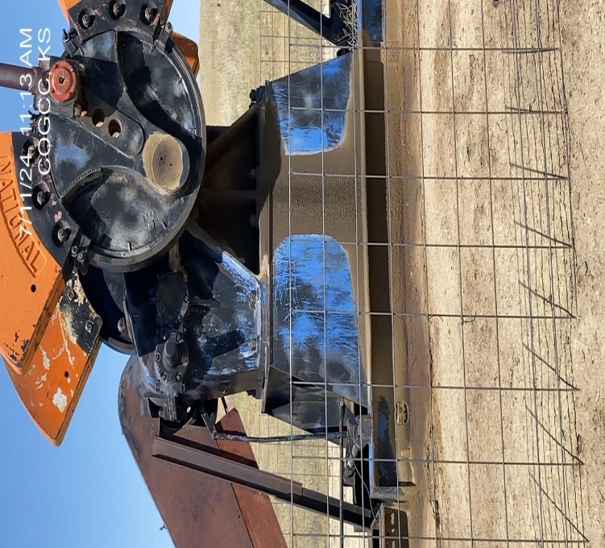
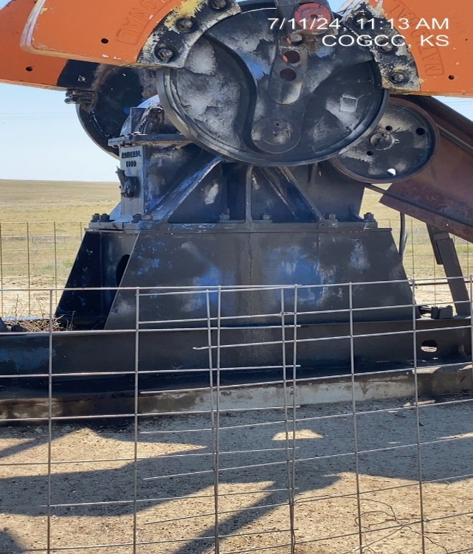
FRITZLER RESOURCES
WITTENBERG 1
LEAK AT GEARBOX
LEAK AT GEARBOX

