Slide 1
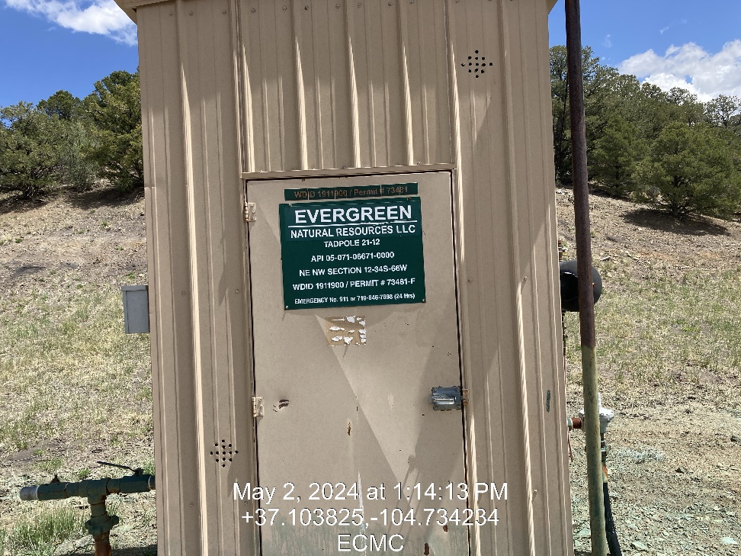
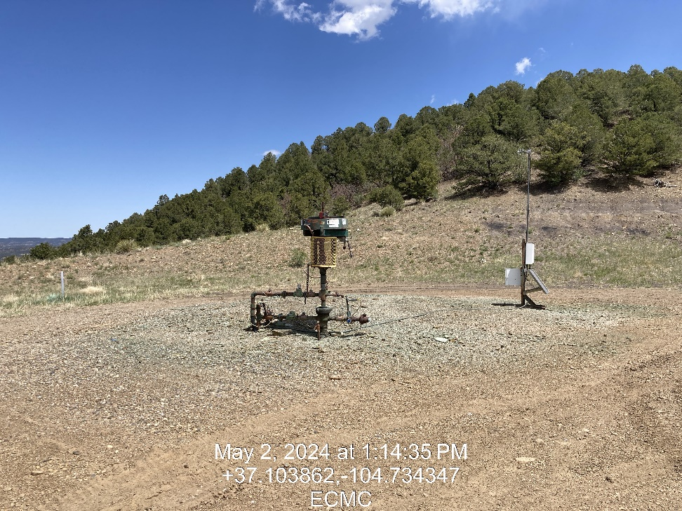

Inspection Photos
Location: Tad Pole 21-12
Facility ID: 307609
Photo 1 –Wellhead Placard
Photo 2 – Wellhead

Slide 2
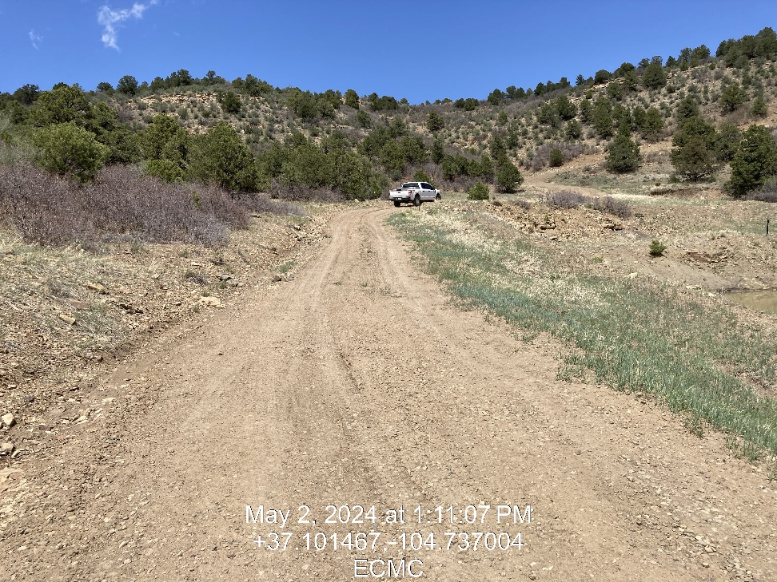
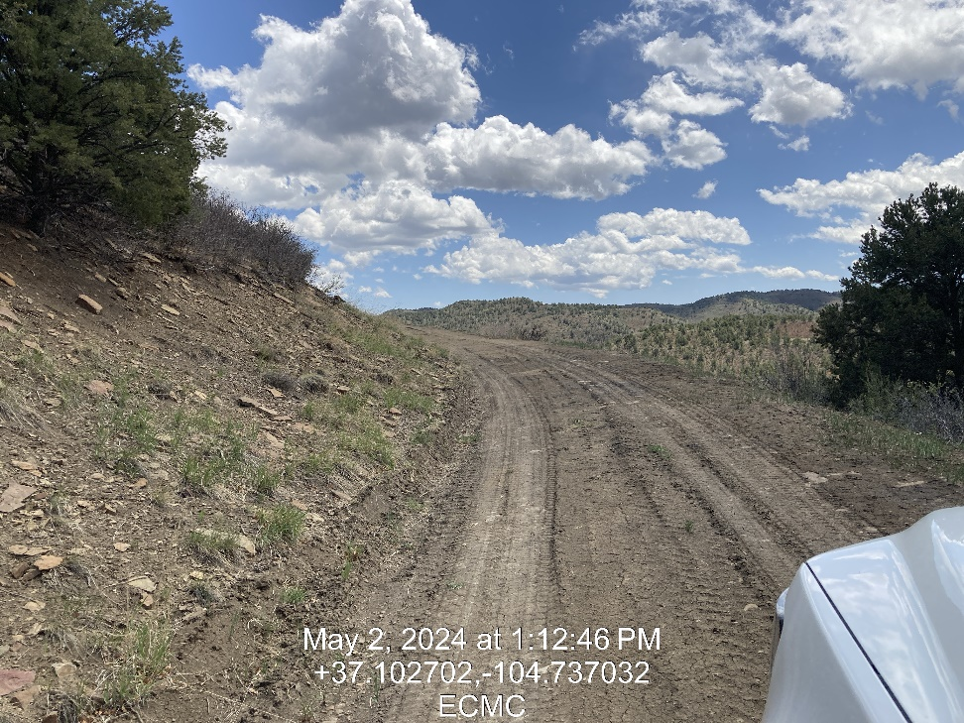
Inspection Photos
Location: Tad Pole 21-12
Facility ID: 307609
Photo 3 – Repairs to Secondary Roadway
Photo 4 – Repairs to Secondary Roadway

Slide 3
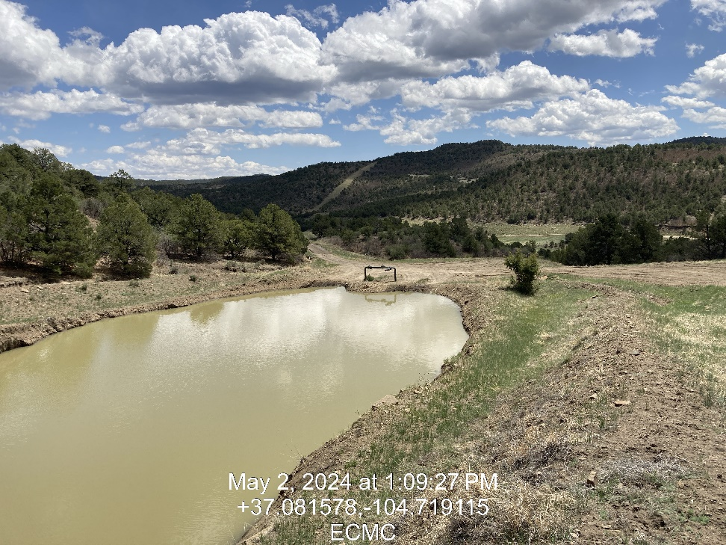
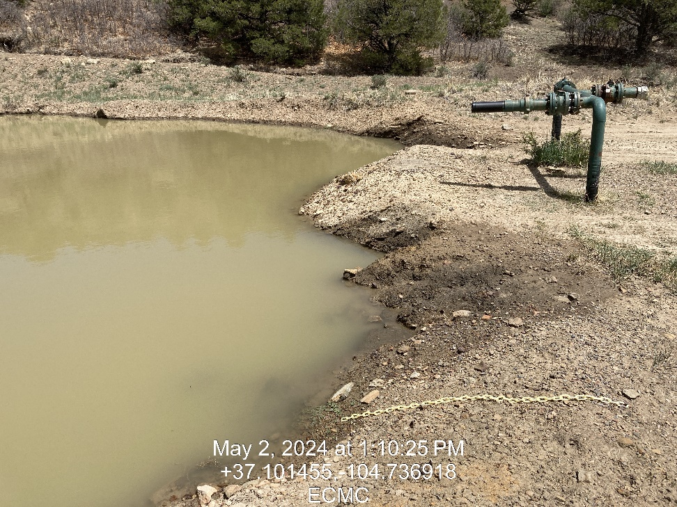
Inspection Photos
Location: Tad Pole 21-12
Facility ID: 307609
Photo 5 – Tad Pole 21-12 Offsite Pit AKA Rita 51 Pit ID 258340
Photo 6 – High Fluid Level, Does not meet freeboard per Rule 909.c.

Slide 4
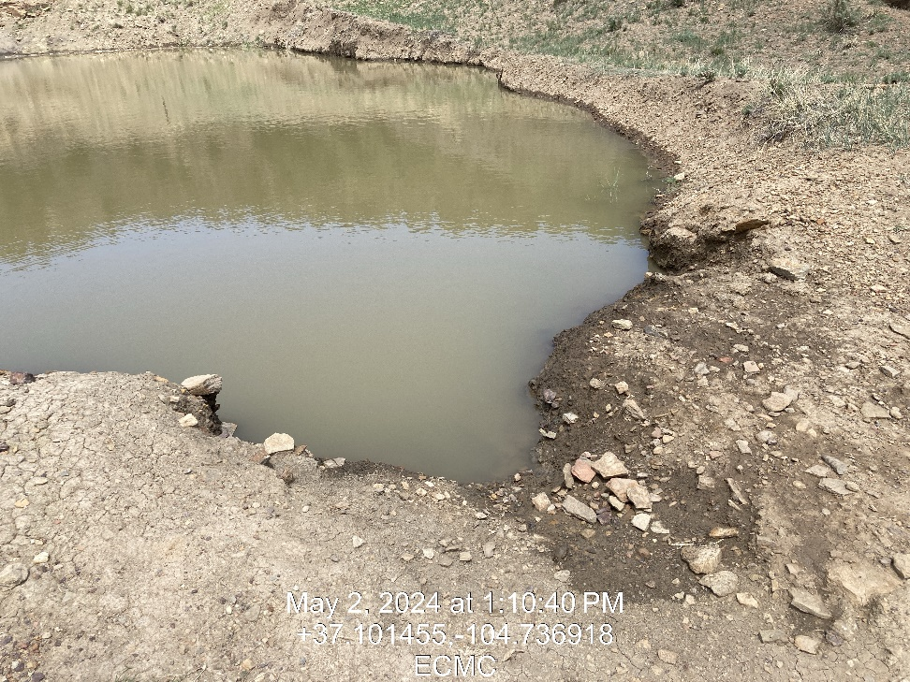
Inspection Photos
Location: Tad Pole 21-12
Facility ID: 307609
Photo 7 – High Fluid Level, Does not meet freeboard per Rule 909.c.

