Slide 1
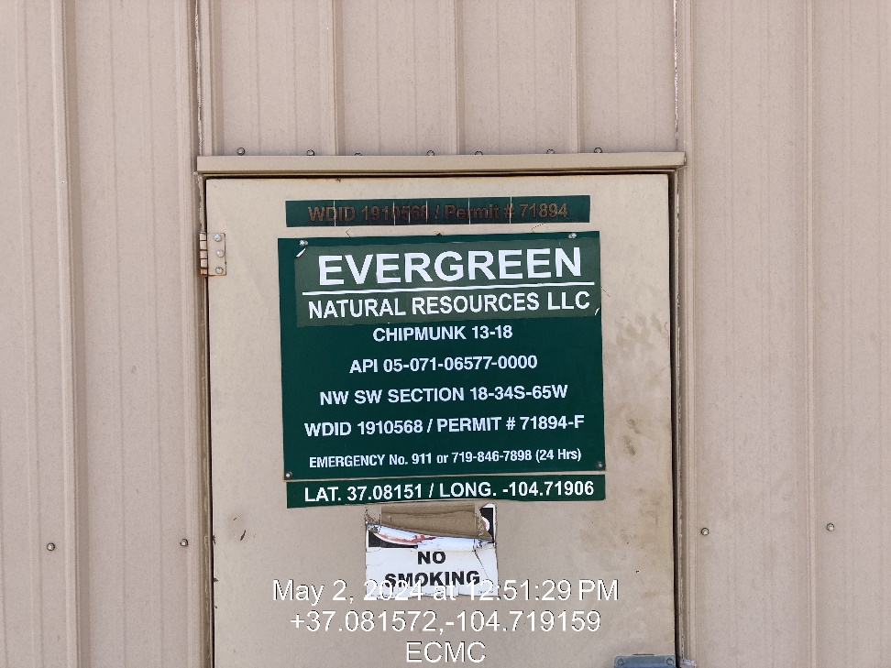
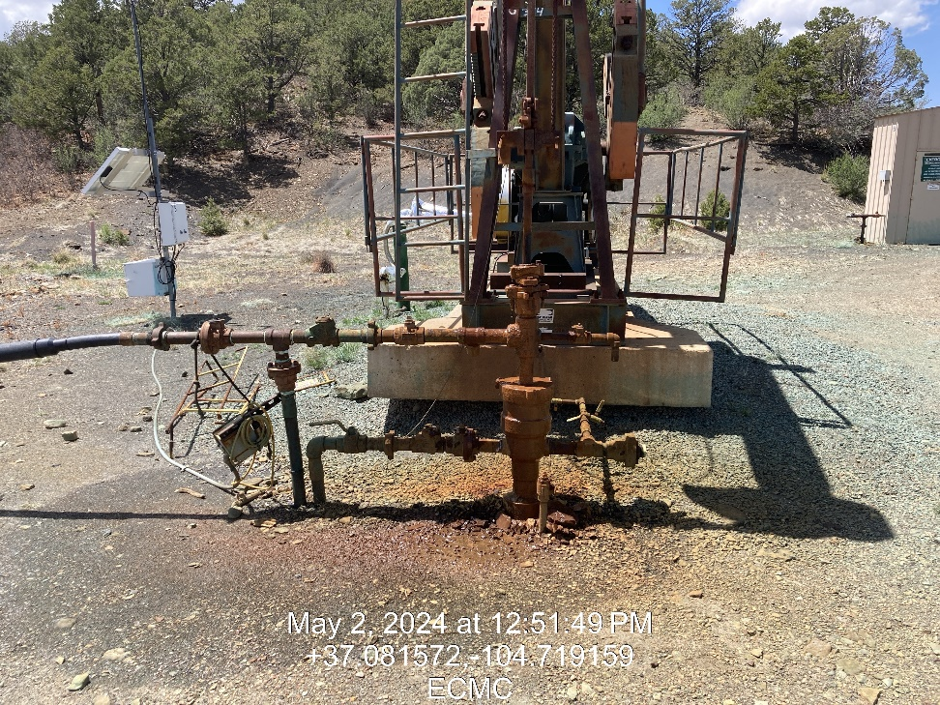

Inspection Photos
Location: Chipmunk 13-18
Facility ID: 307538
Photo 1 –Wellhead Placard
Photo 2 – Leaking packing

Slide 2
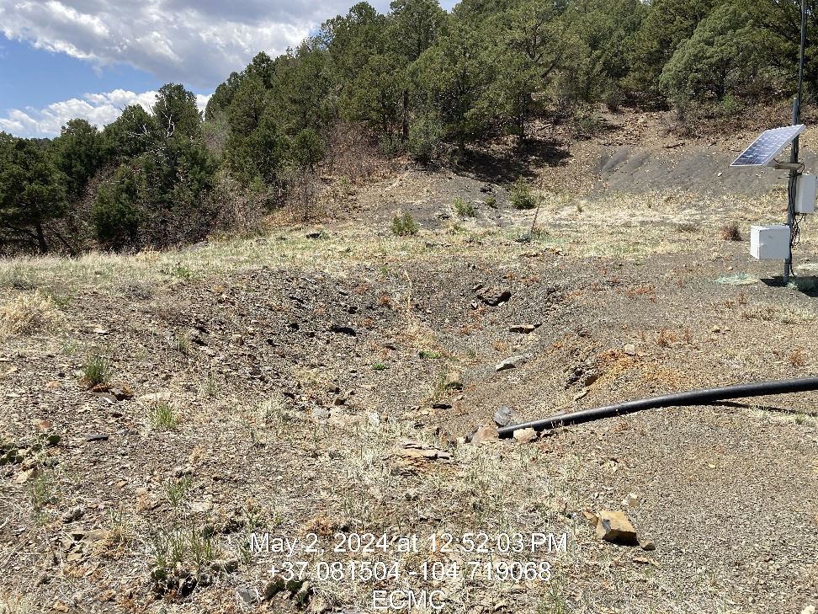
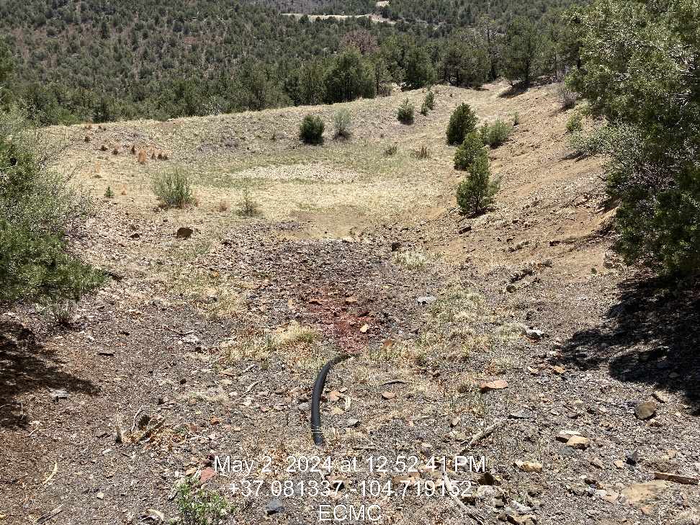
Inspection Photos
Location: Chipmunk 13-18
Facility ID: 307538
Photo 3 – Onsite pit ID 119883, freeboard marker
Photo 4 – Offsite pit, Pit ID 119882

Slide 3
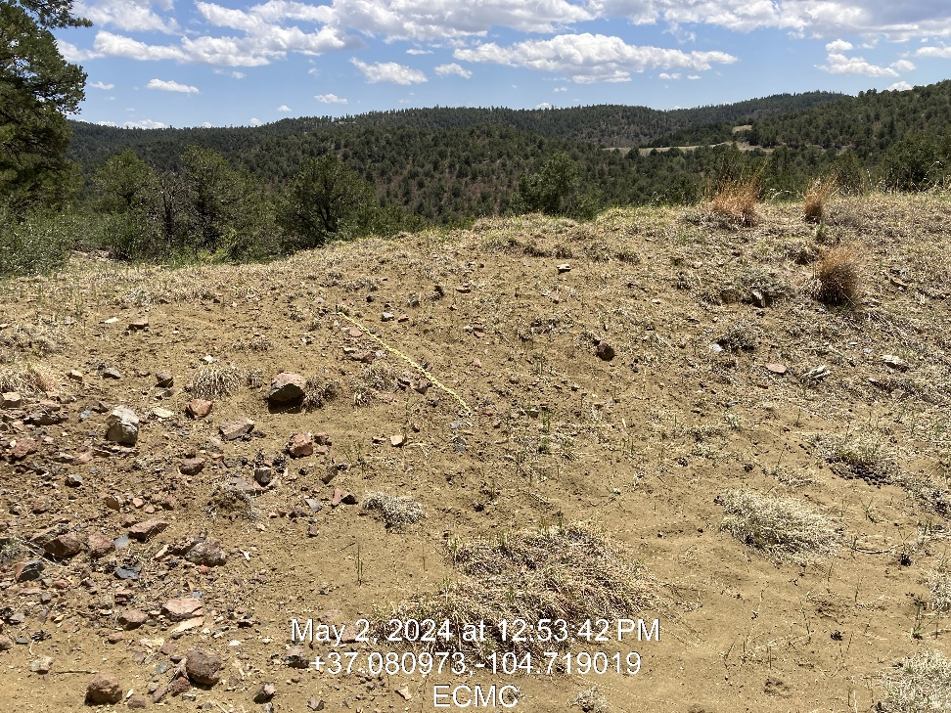
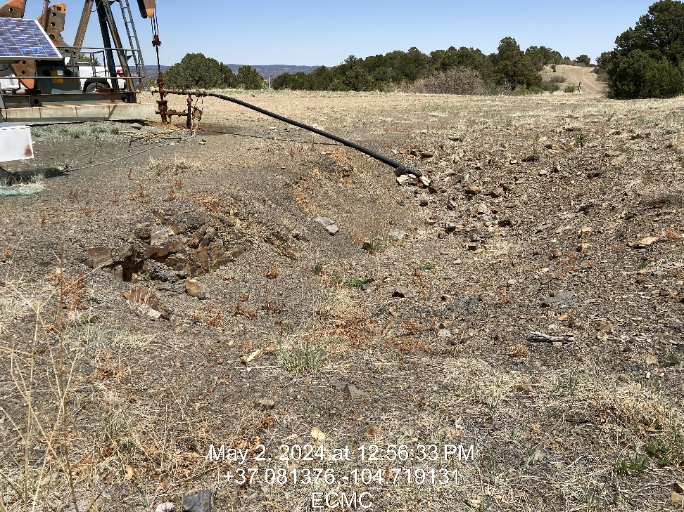
Inspection Photos
Location: Chipmunk 13-18
Facility ID: 307538
Photo 5 – Offsite pit freeboard marker
Photo 6 – Onsite pit

