Slide 1

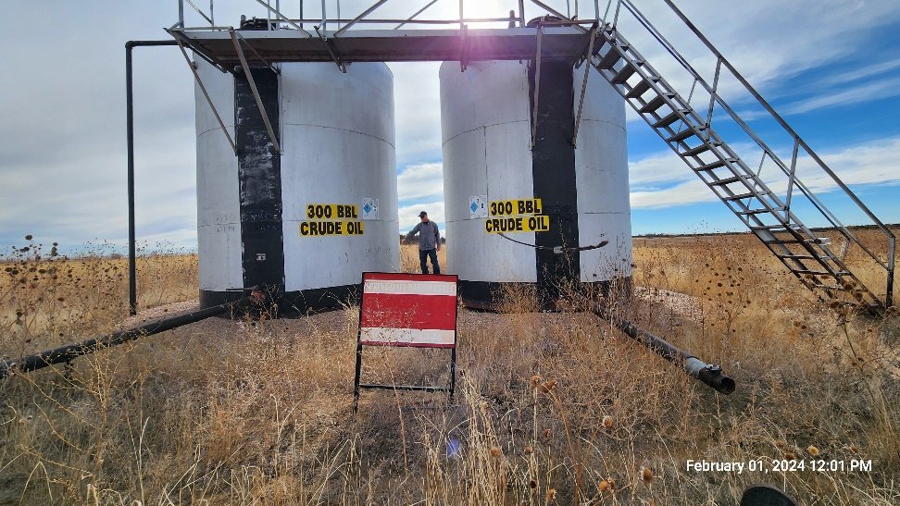
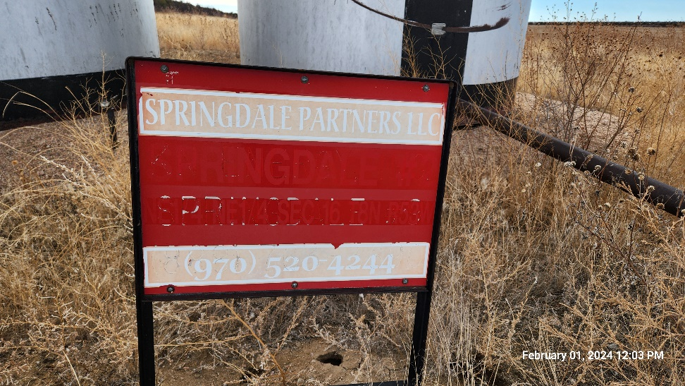
Inspection Photos
SPRINGDALE STORAGE 2
Location ID: 312147
Tank Battery : South
Tank Battery : Sign
This is an orphaned well inspection. Inspection completed to document current condition of location, equipment, and wellhead. Inspection may also identify possible task required for final closure/release of location from the Orphaned Well Program.
Inspection Number: 709200111

Slide 2
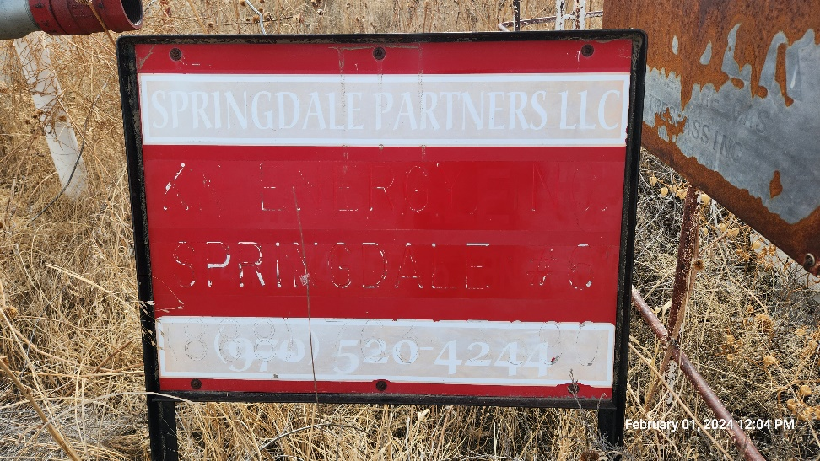
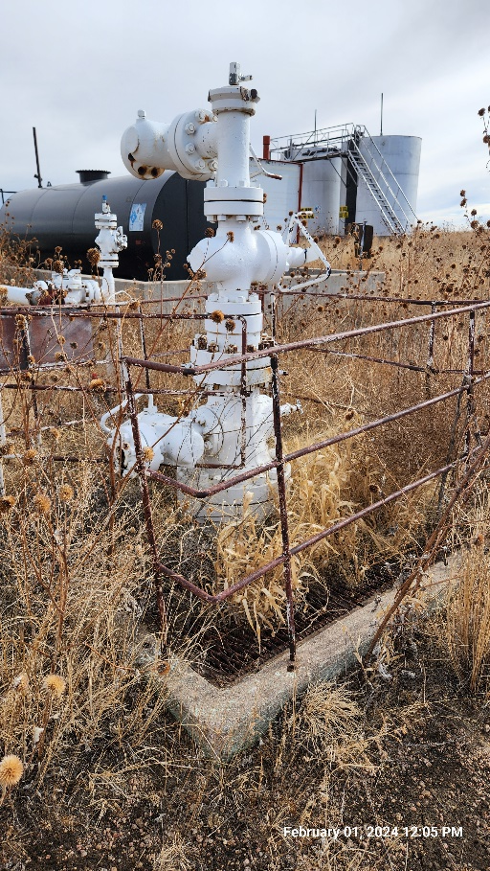
Inspection Photos
SPRINGDALE STORAGE 2
Location ID: 312147
Well Head : South East
Well Head Sign - Incorrect
Inspection Number: 709200111

Slide 3
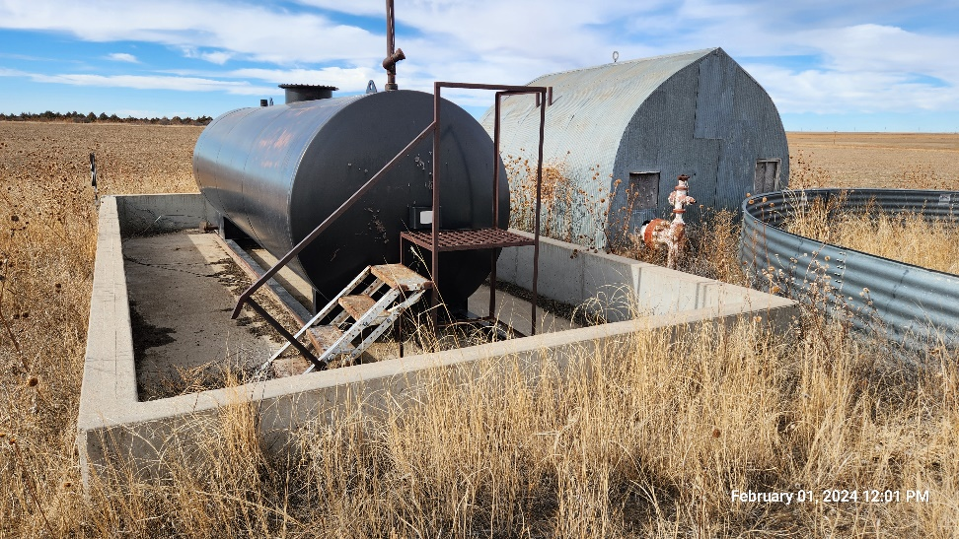
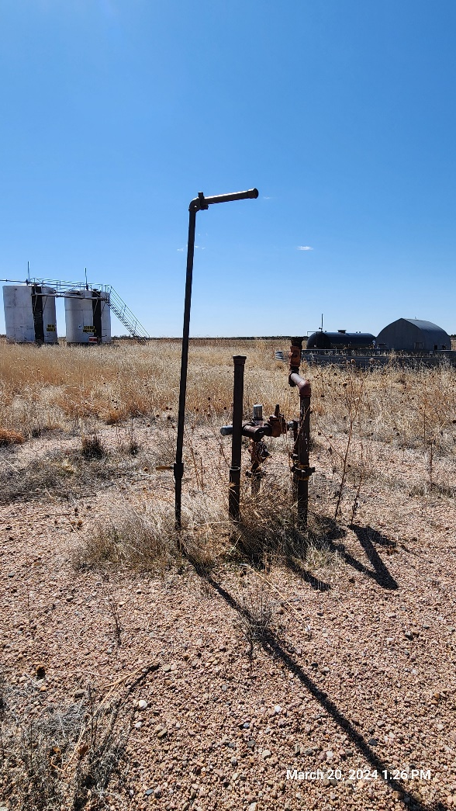
Inspection Photos
SPRINGDALE STORAGE 2
Location ID: 312147
Nearby Risers : South West
Well Head Storage Equipment: South
Inspection Number: 709200111

