Slide 1

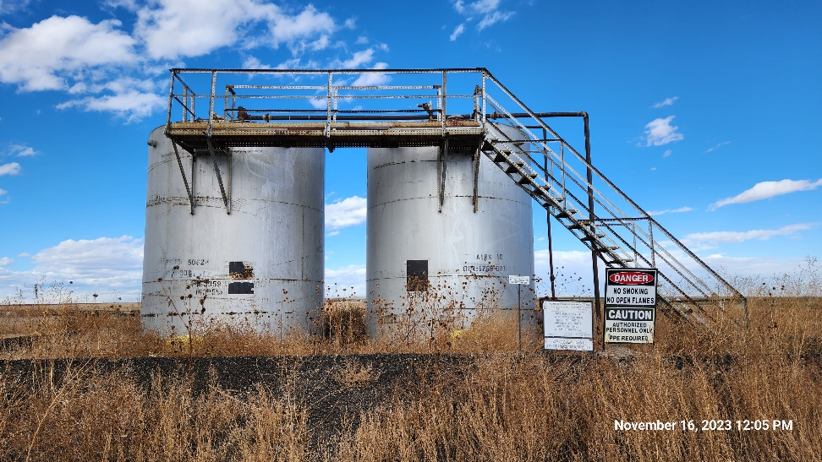
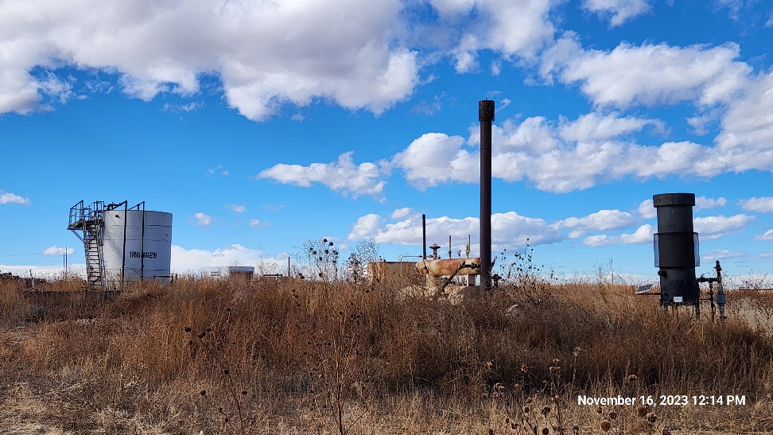
Inspection Photos
AMBUSH 31-22
Location ID: 320374
Tank Battery : North
Tank Battery : West
This is an orphaned well inspection. Inspection completed to document current condition of location, equipment, and wellhead. Inspection may also identify possible task required for final closure/release of location from the Orphaned Well Program.
Inspection Number: 709200066

Slide 2
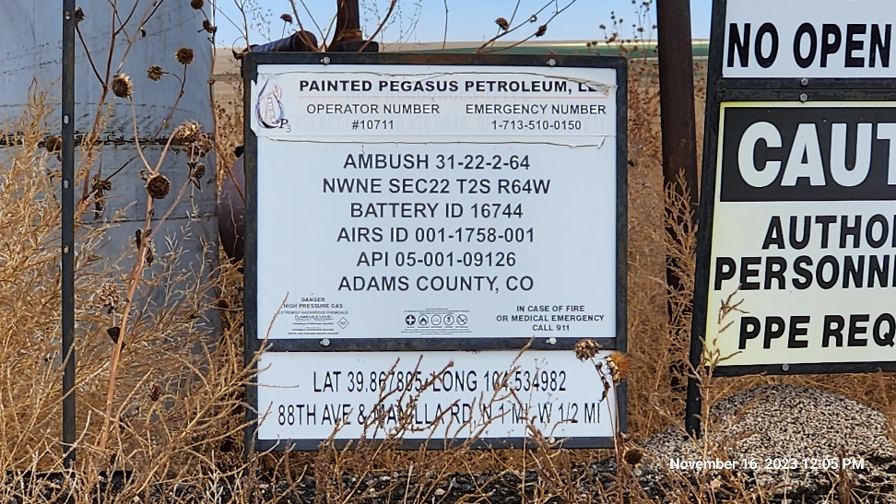
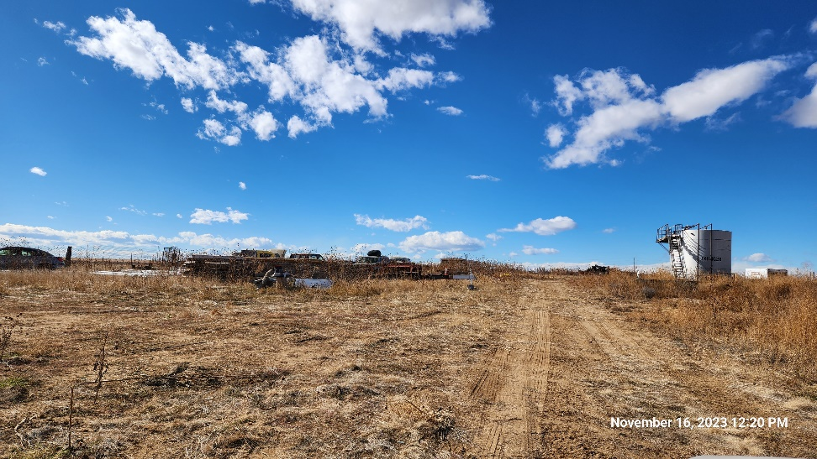
Inspection Photos
AMBUSH 31-22
Location ID: 320374
Tank Battery : Sign
Tank Battery : Site Debris
Inspection Number: 709200066

Slide 3
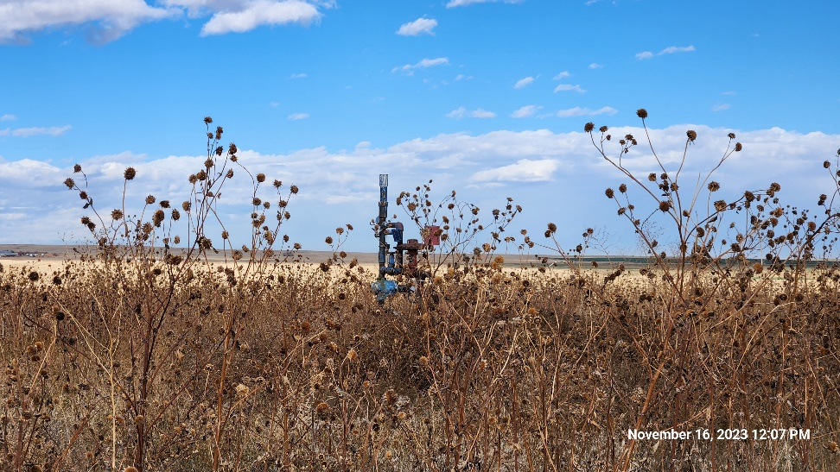
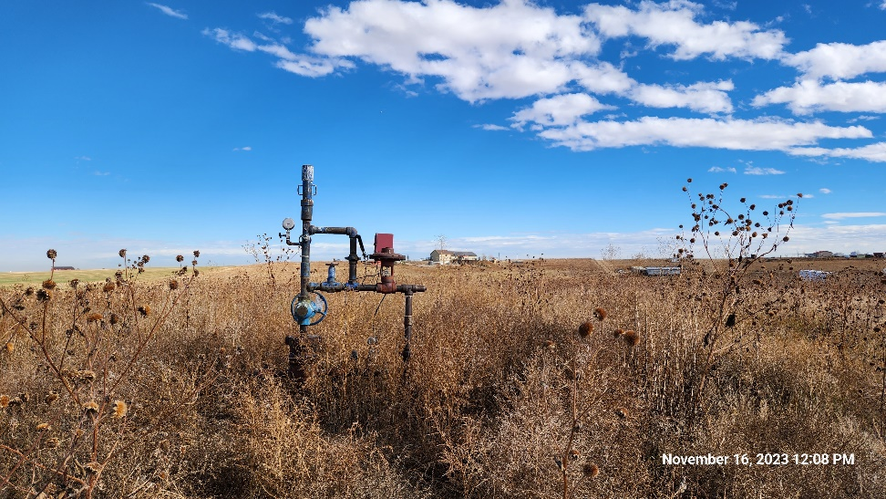
Inspection Photos
AMBUSH 31-22
Location ID: 320374
Well Head : North
Well Head : East
Inspection Number: 709200066

Slide 4
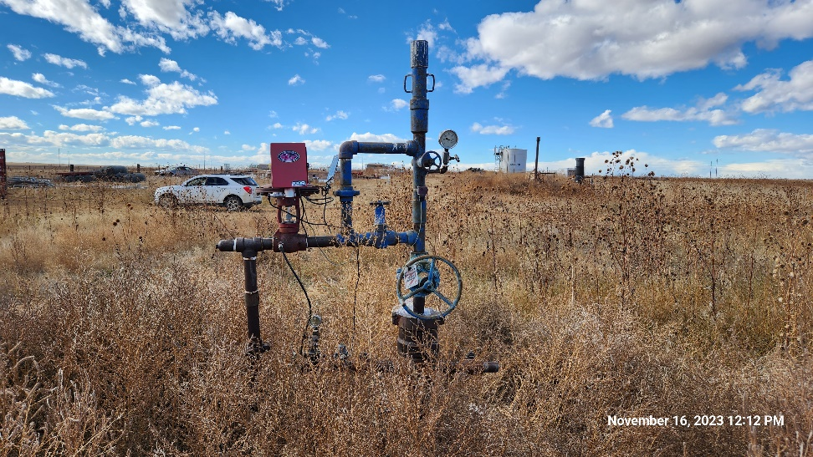
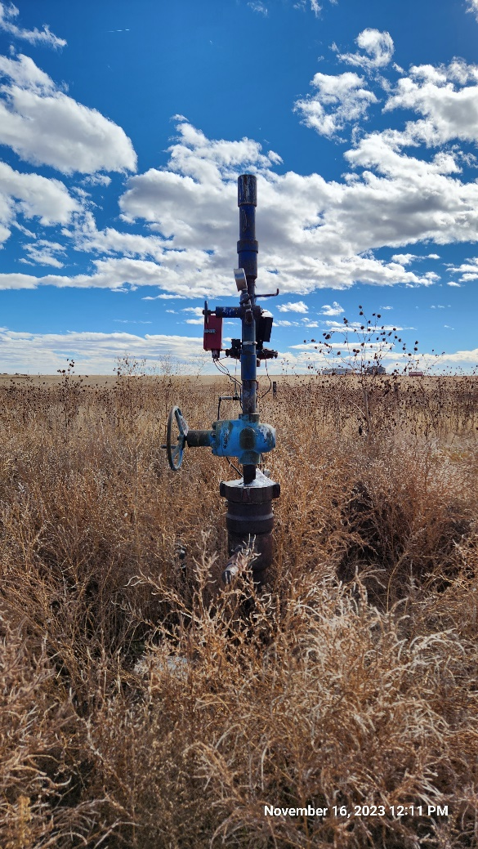
Inspection Photos
AMBUSH 31-22
Location ID: 320374
Well Head: South
Well Head: West
Inspection Number: 709200066

