Slide 1
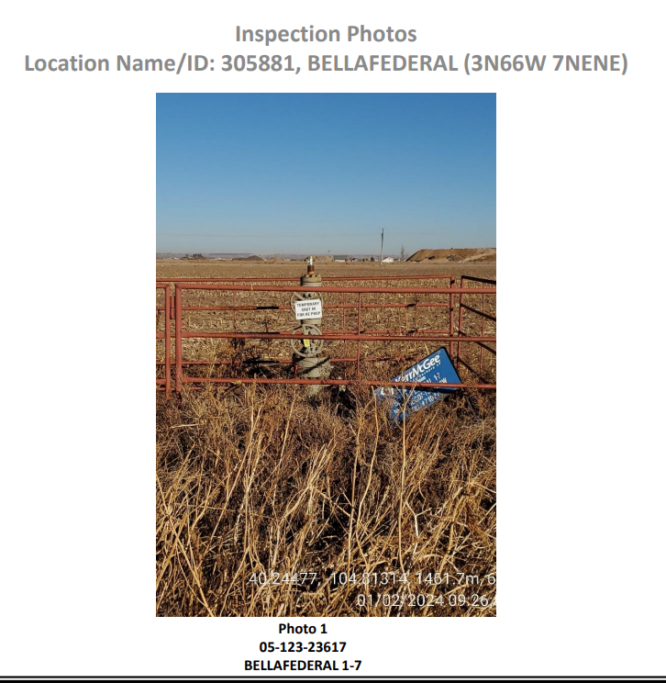
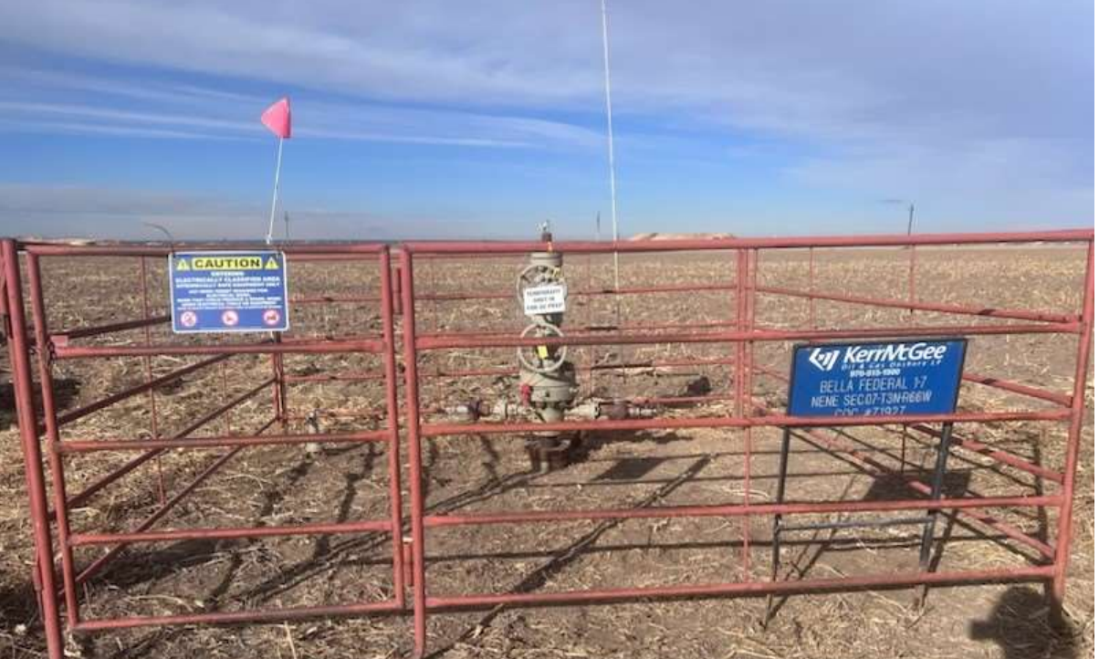
Alternative Method of Inspection Photos
Photo from Inspection
Photo from FIRR

