Slide 1
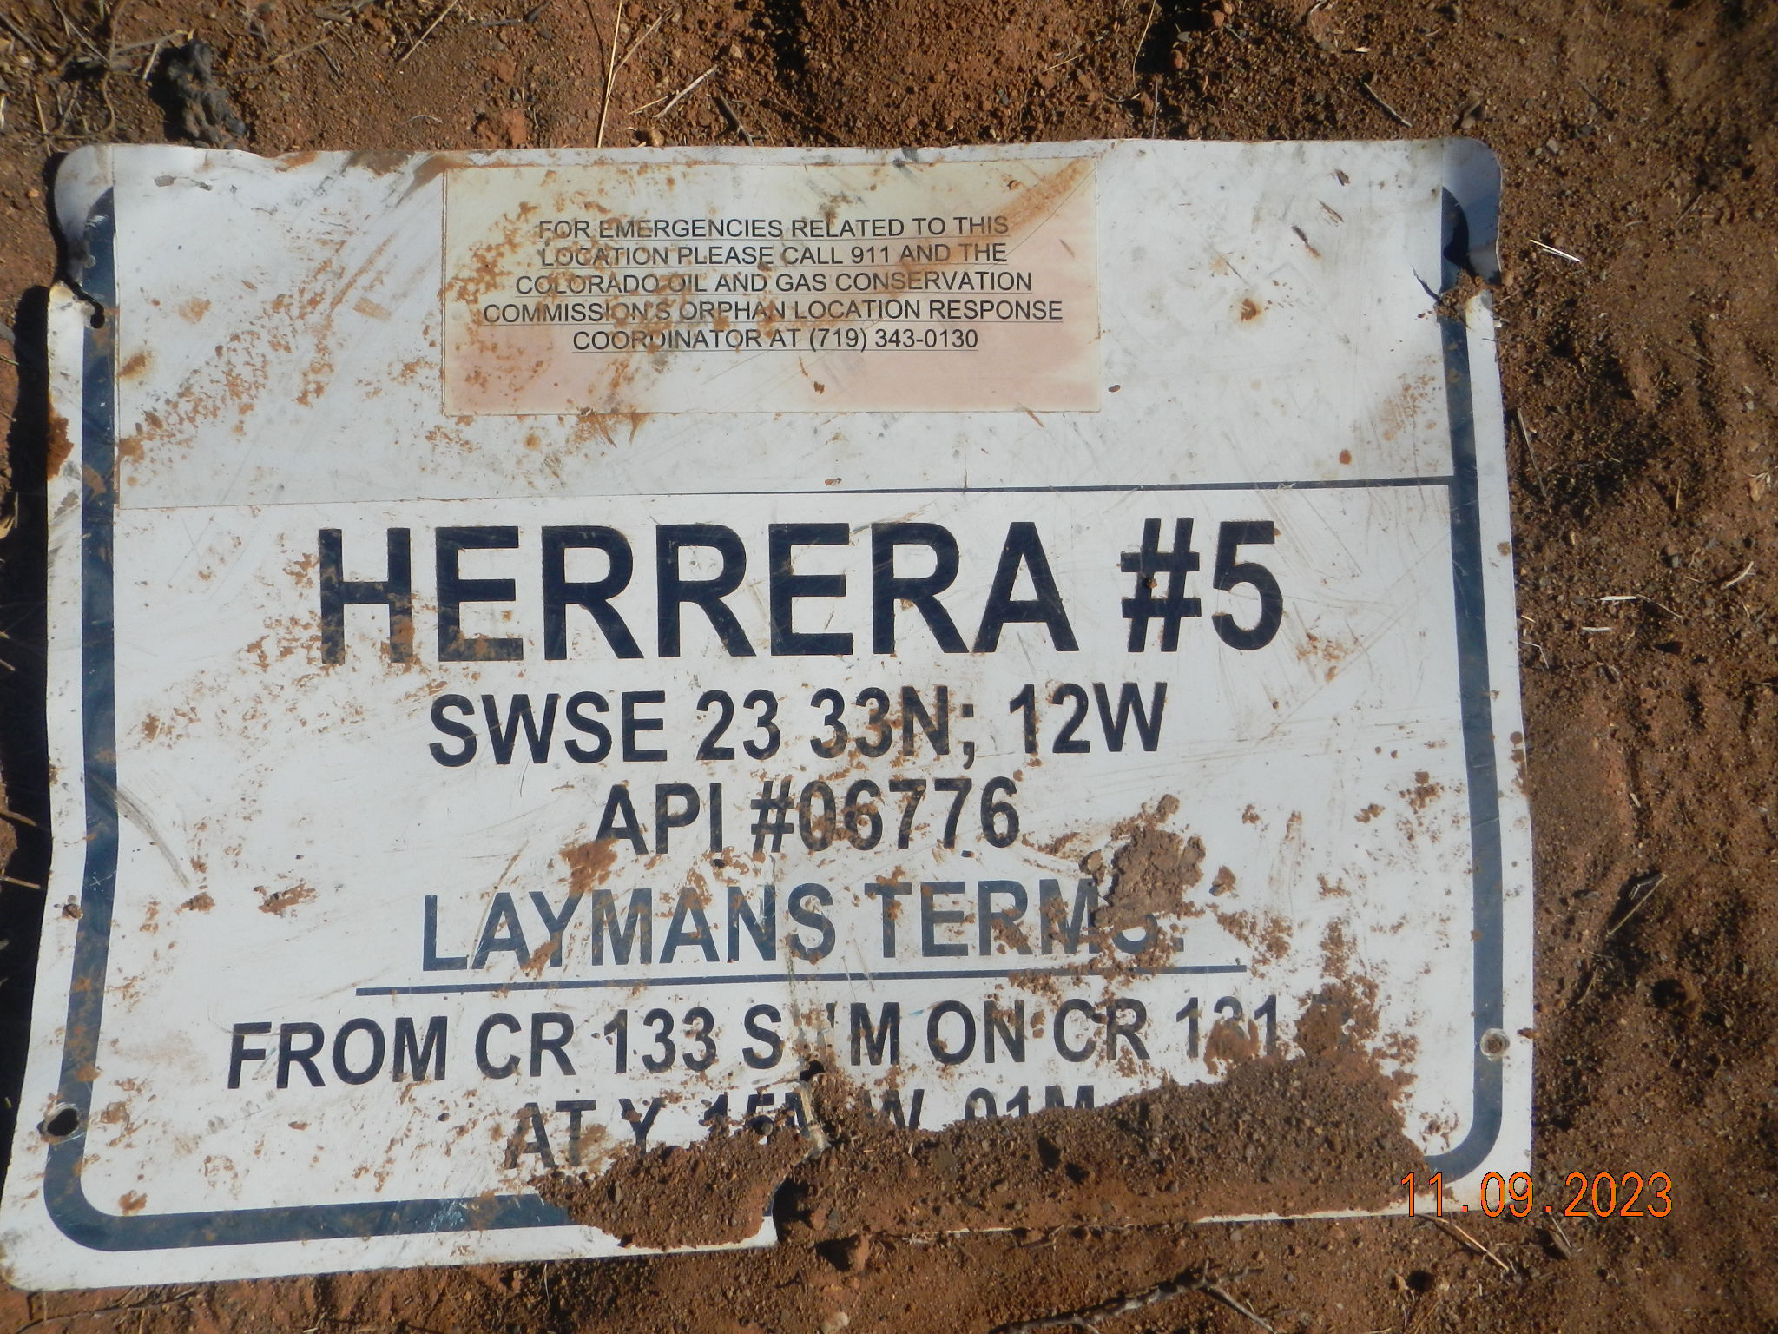
Hererra 5 (OWP) ~ Rem #27393 – Fac ID 215171 (11-09-2023)
Photo 1 –

Slide 2
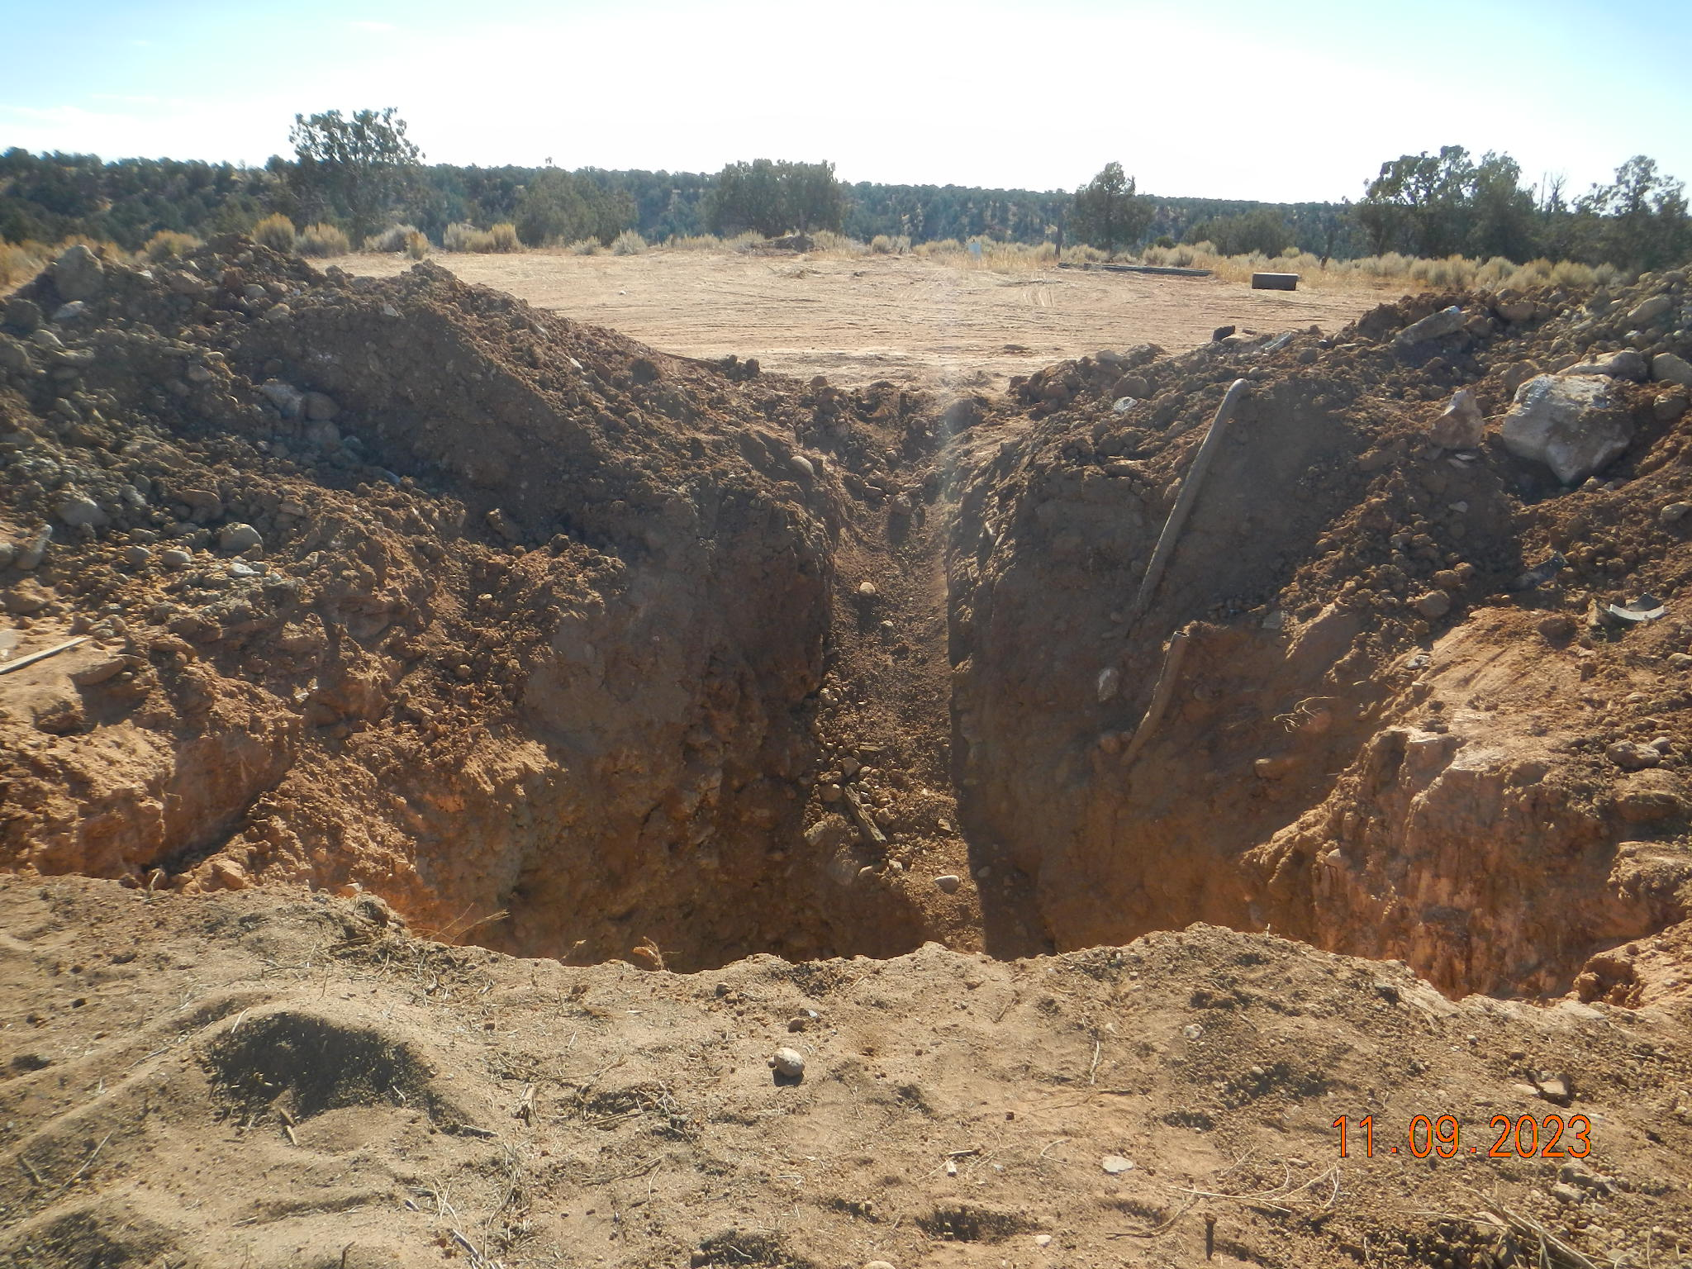
Hererra 5 (OWP) - 067-06776 ~ Rem #27393 – Fac ID 215171 (11-09-2023)
Photo 2 – Wellhead cut and cap excavation open for soil sampling view south

Slide 3
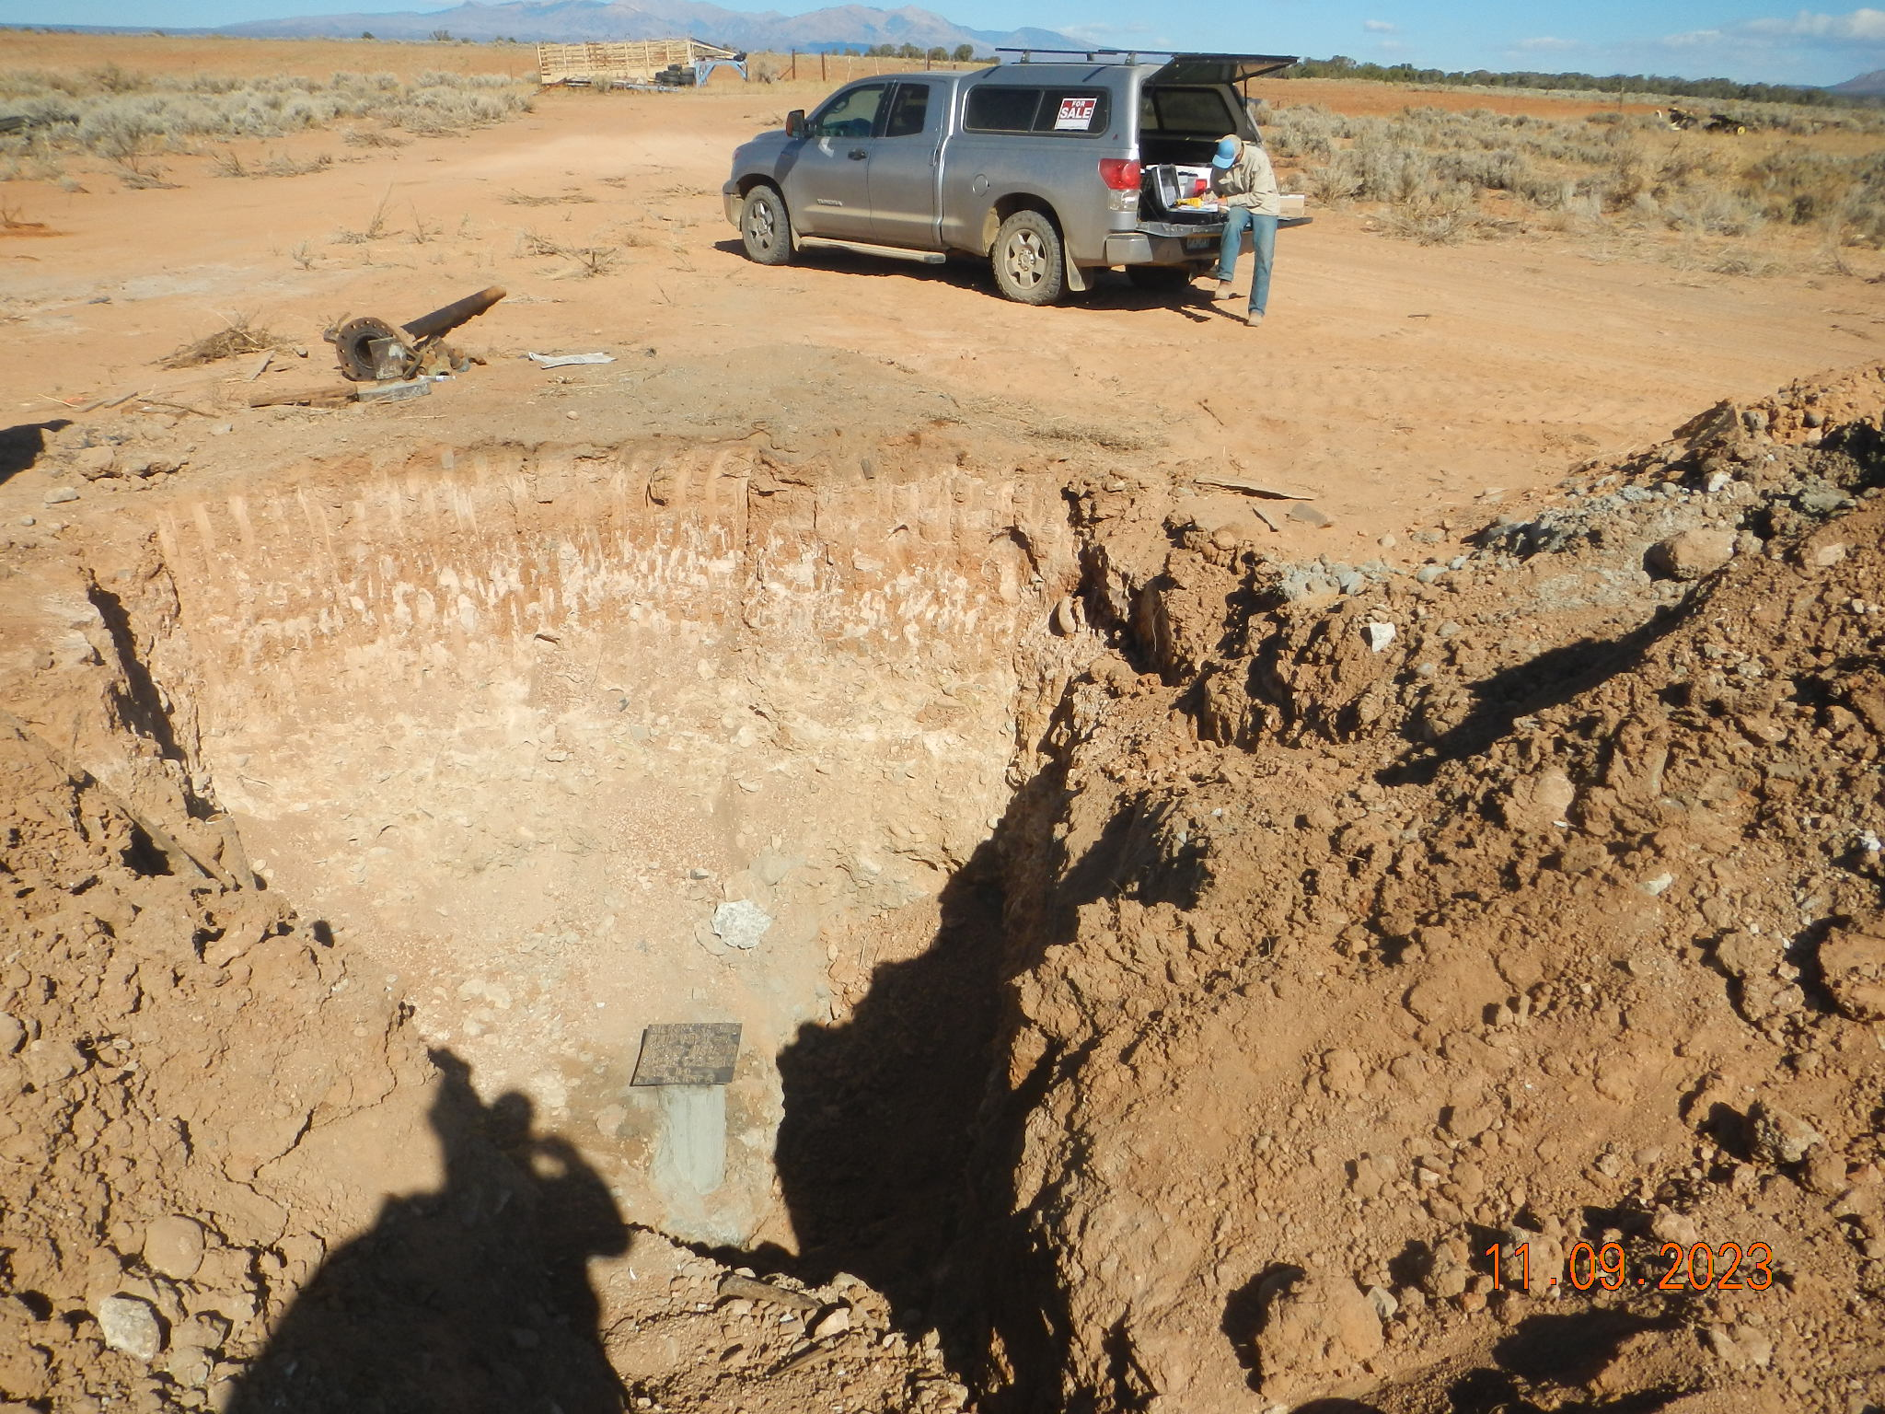
Hererra 5 (OWP) - 067-06776 ~ Rem #27393 – Fac ID 215171 (11-09-2023)
Photo 3 – Wellhead cut and cap excavation open for soil sampling view north

