Slide 1

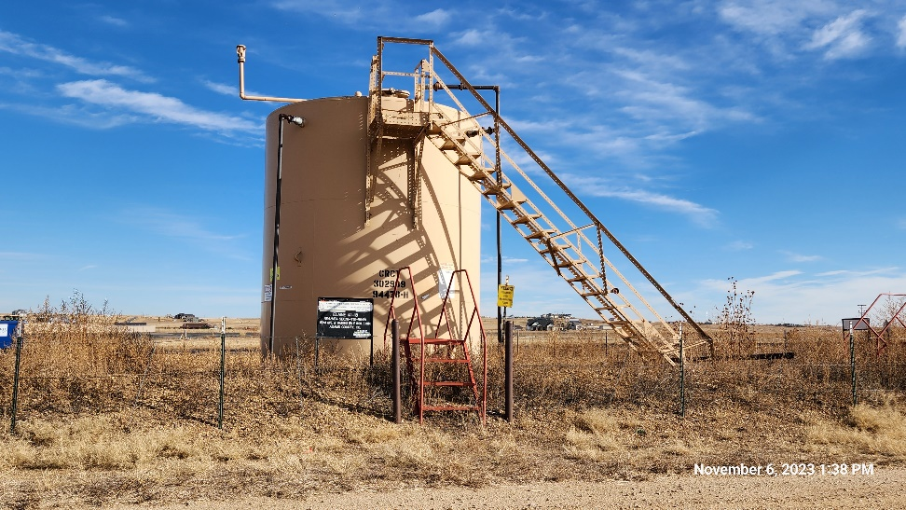
Inspection Photos
ELAINE 41-18
Location ID: 320103
Tank Battery : East
This is an orphaned well inspection. Inspection completed to document current condition of location, equipment, and wellhead. Inspection may also identify possible task required for final closure/release of location from the Orphaned Well Program.
Inspection Number: 709200029

Slide 2
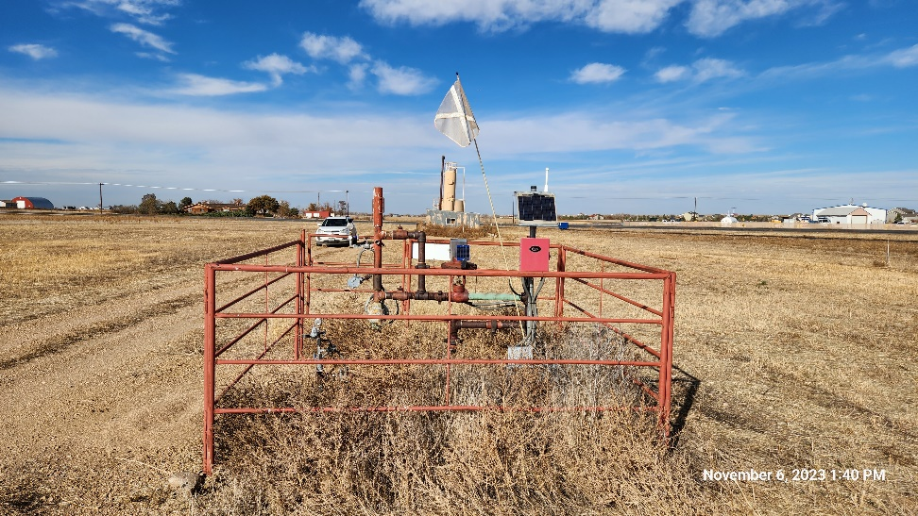
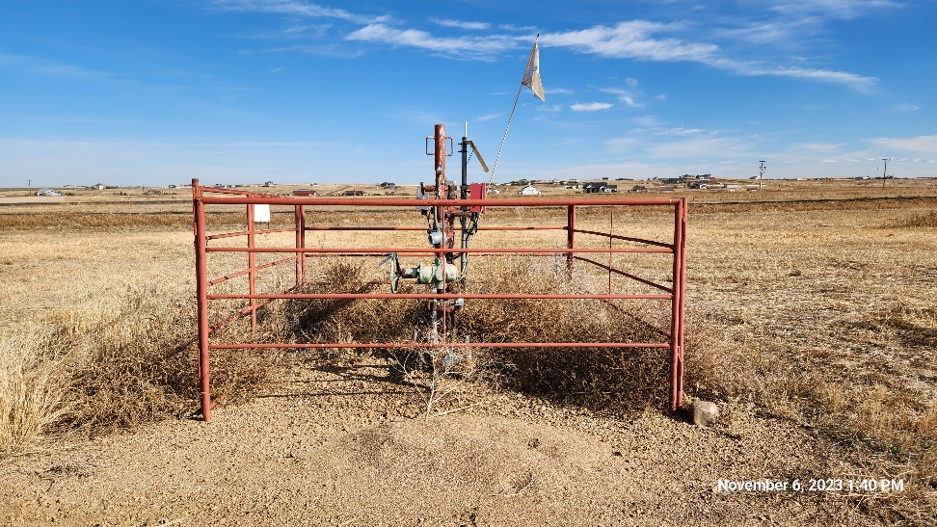
Inspection Photos
ELAINE 41-18
Location ID: 320103
Well Head : North
Well Head : East
This is an orphaned well inspection. Inspection completed to document current condition of location, equipment, and wellhead. Inspection may also identify possible task required for final closure/release of location from the Orphaned Well Program.
Inspection Number: 709200029

Slide 3
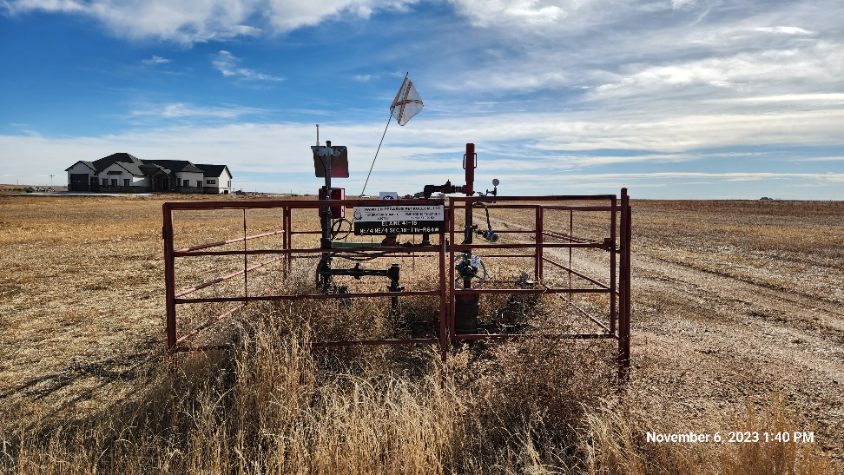
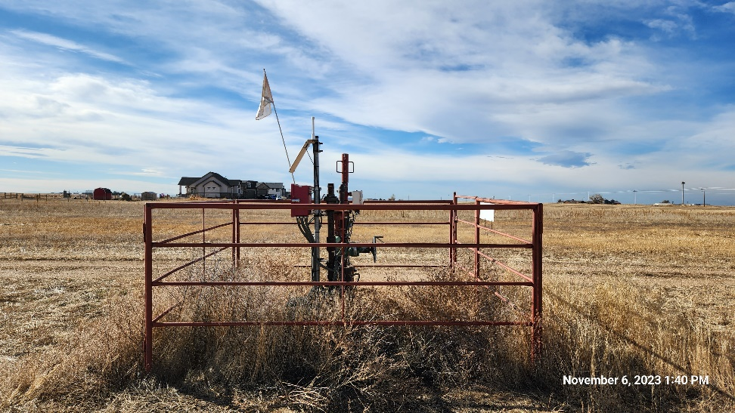
Inspection Photos
ELAINE 41-18
Location ID: 320103
Well Head: South
Well Head: West
This is an orphaned well inspection. Inspection completed to document current condition of location, equipment, and wellhead. Inspection may also identify possible task required for final closure/release of location from the Orphaned Well Program.
Inspection Number: 709200029

Slide 4
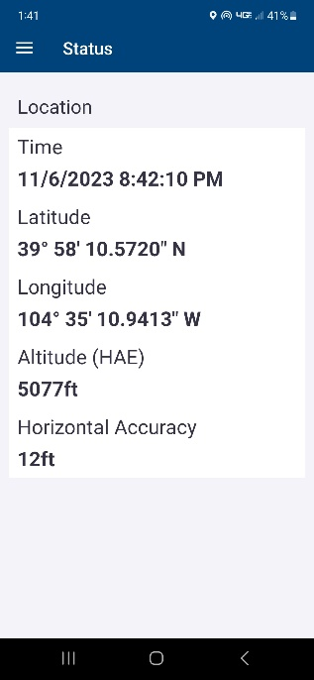
Inspection Photos
ELAINE 41-18
Location ID: 320103
Well Head : GPS Screenshot
This is an orphaned well inspection. Inspection completed to document current condition of location, equipment, and wellhead. Inspection may also identify possible task required for final closure/release of location from the Orphaned Well Program.
Inspection Number: 709200029

