Slide 1

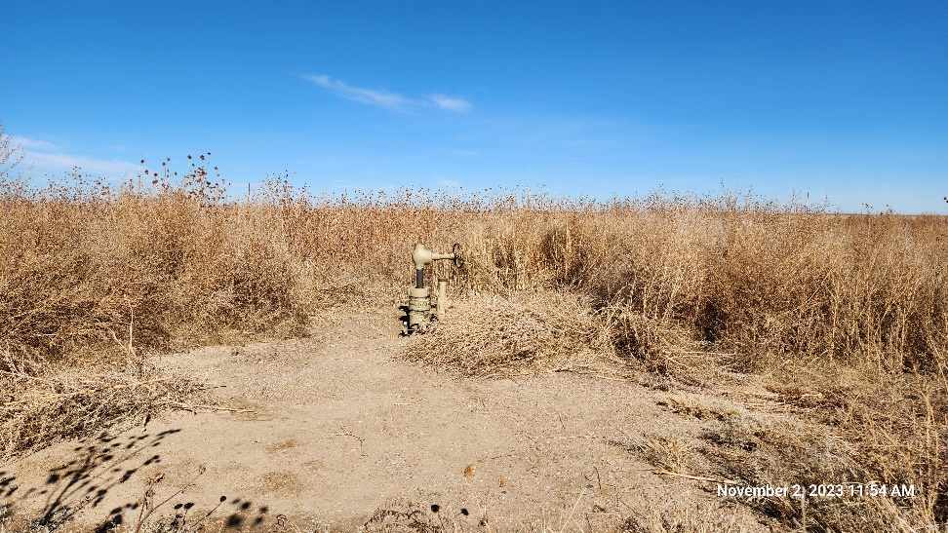
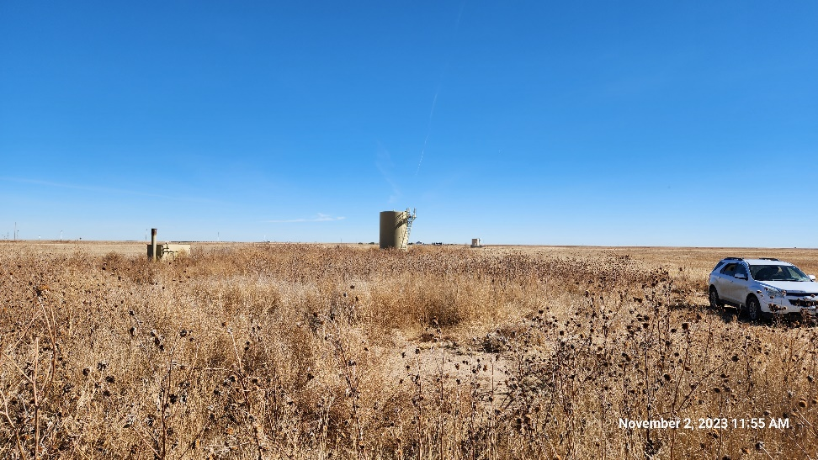
Inspection Photos
ANTELOPE FARMS 41-23 #2
Location ID: 320003
Well Head : North
Well Head : East
This is an orphaned well inspection. Inspection completed to document current condition of location, equipment, and wellhead. Inspection may also identify possible task required for final closure/release of location from the Orphaned Well Program.
Inspection Number: 709200021

Slide 2
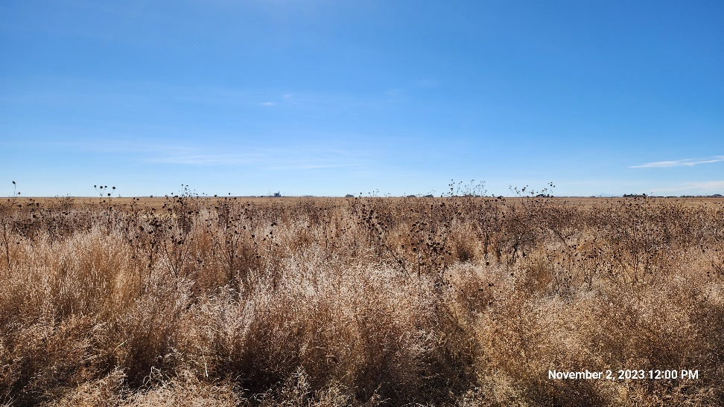
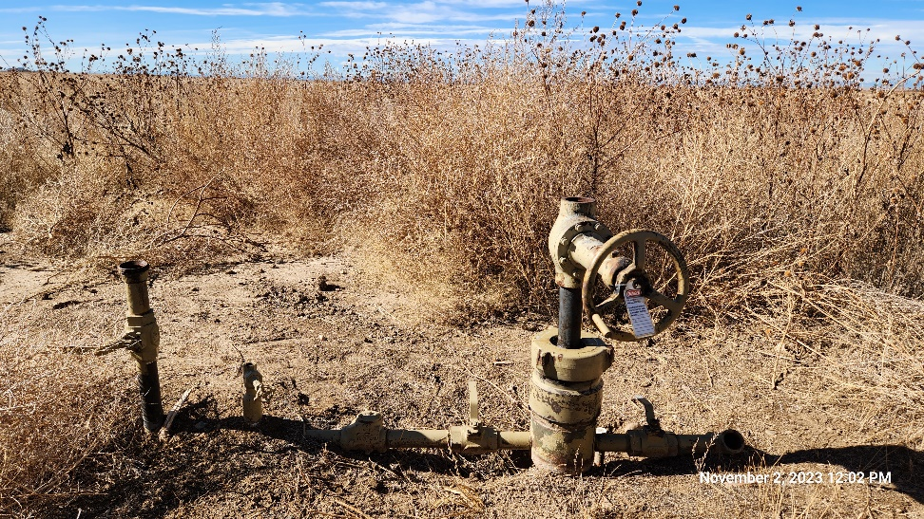
Inspection Photos
ANTELOPE FARMS 41-23 #2
Location ID: 320003
Well Head: South (not visible)
Well Head: West
This is an orphaned well inspection. Inspection completed to document current condition of location, equipment, and wellhead. Inspection may also identify possible task required for final closure/release of location from the Orphaned Well Program.
Inspection Number: 709200021

Slide 3
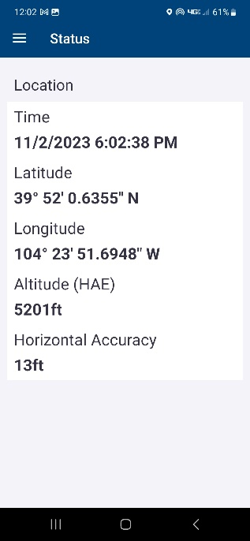
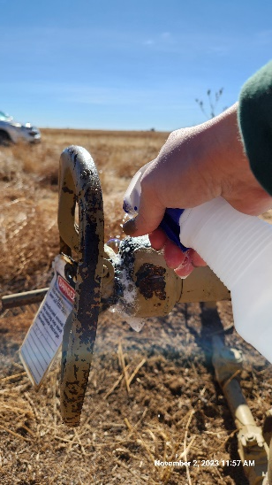
Inspection Photos
ANTELOPE FARMS 41-23 #2
Location ID: 320003
Well Head : GPS Screenshot
Bubbled with soapy solution
This is an orphaned well inspection. Inspection completed to document current condition of location, equipment, and wellhead. Inspection may also identify possible task required for final closure/release of location from the Orphaned Well Program.
Inspection Number: 709200021

Slide 4
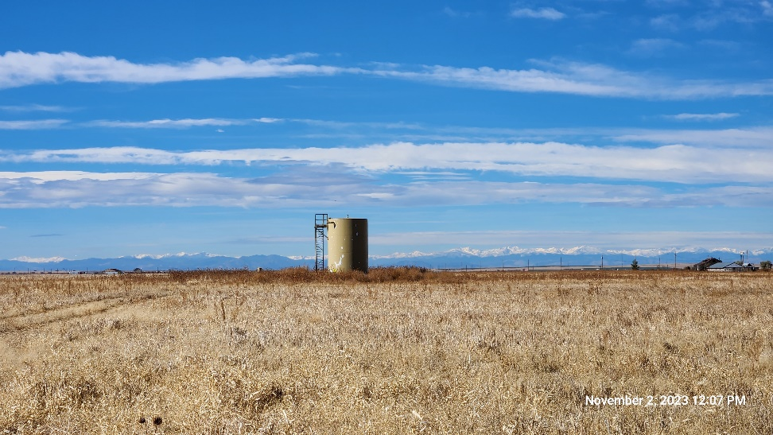
Inspection Photos
ANTELOPE FARMS 41-23 #2
Location ID: 320003
Tank Battery : West
This is an orphaned well inspection. Inspection completed to document current condition of location, equipment, and wellhead. Inspection may also identify possible task required for final closure/release of location from the Orphaned Well Program.
Inspection Number: 709200021

